Slide 1
Analyzing SARS-CoV-2 Full Genome Sequences with Galaxy
Dr Cathrine Scheepers

Slide 2
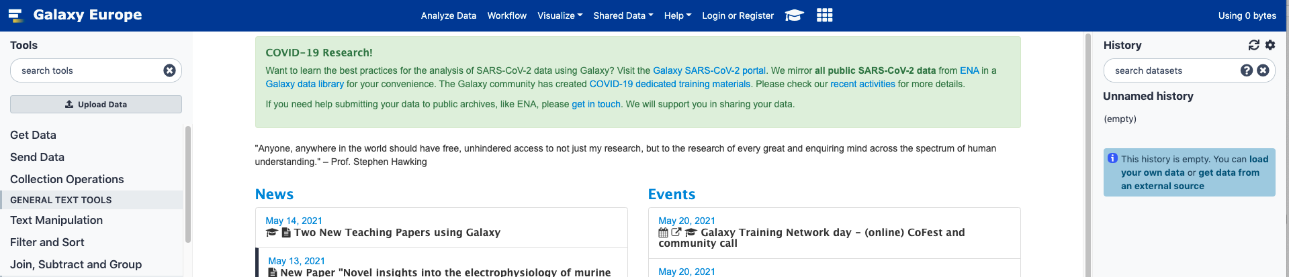
What is Galaxy?
Galaxy is an open-source, web-based platform for bioinformatic analyses. Anyone is able to freely open an account on on galaxy or you could have your own galaxy server installed locally. Two useful galaxy servers that are free for people to use are: usegalaxy.org and usegalaxy.eu
usegalaxy.org
usegalaxy.eu

Slide 3
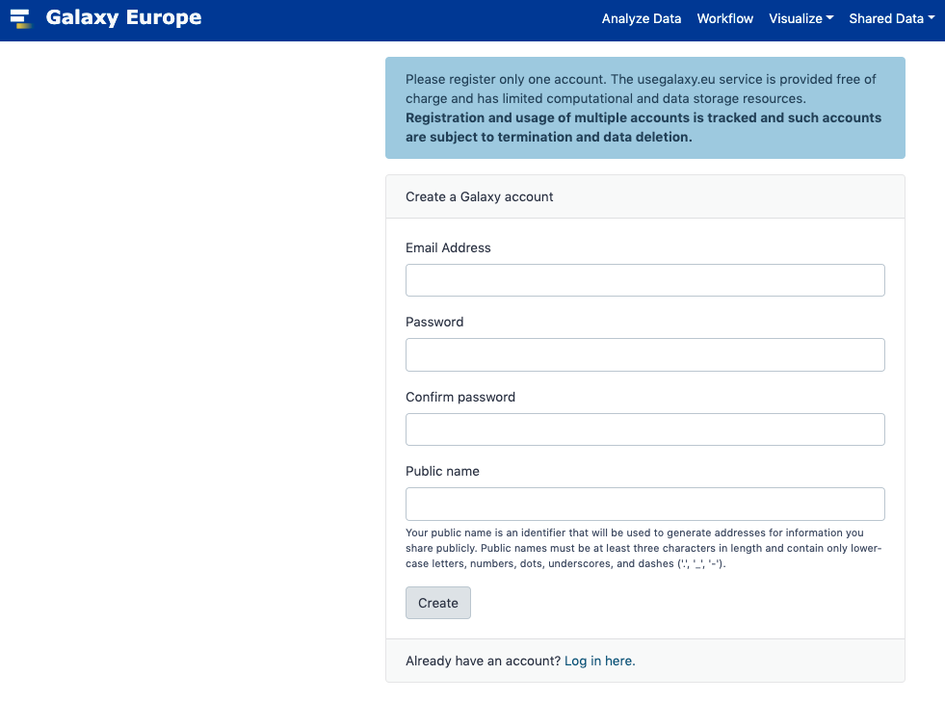
Register and Login to Galaxy
In order to run your own analyses you have to register an account and login to galaxy. I’m going to demonstrate using usegalaxy.eu but you can also use usegalaxy.org
usegalaxy.eu
Fill in the necessary information to register an account

Slide 4
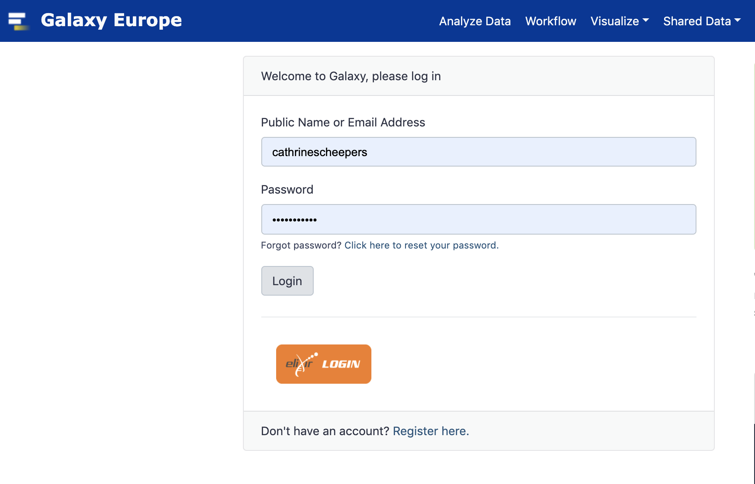
Register and Login to Galaxy
Once registered, login to galaxy to begin your analyses.
Your details
Your details

Slide 5
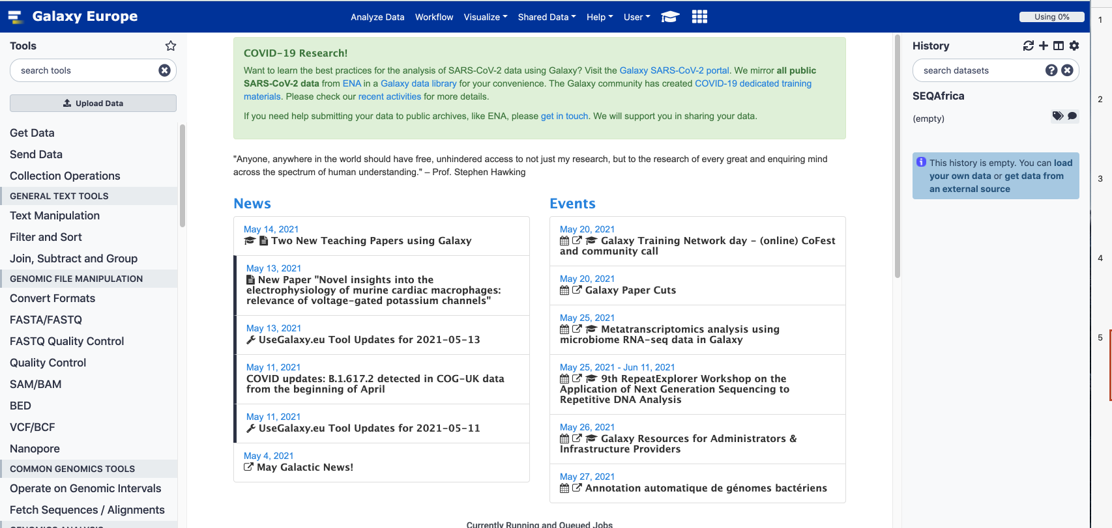
Galaxy Orientation
Galaxy home page
Working History Information
Tool bar
COVID-19 galaxy project (https://covid19.galaxyproject.org/)
Navigation bar
View All histories and create new ones

Slide 6
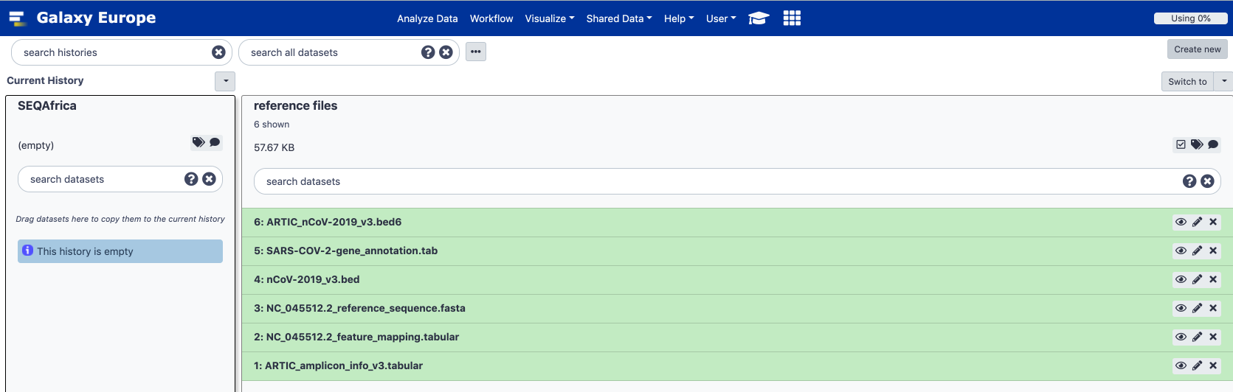
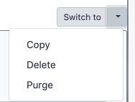
Creating a History
Viewing and using histories
Clicking on “create new” will allow you to create a new history and you can call it whatever you like. I have made one called SEQ Africa where we’ll load the data for our new analysis.
You can also move data from other histories into the current history by dragging and dropping the files from one to the other.

Slide 7
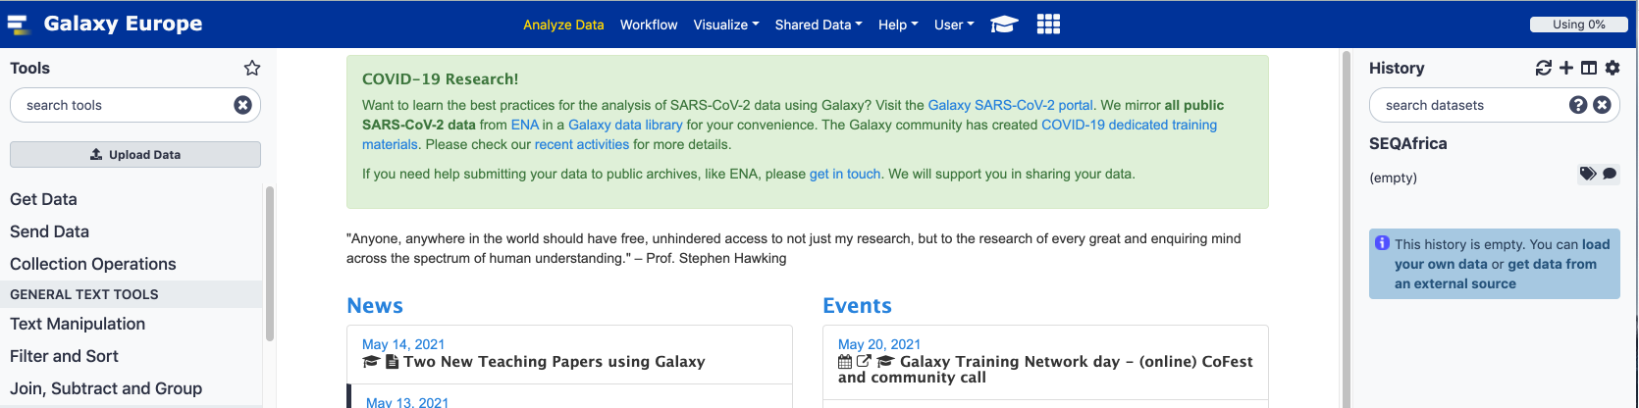
Loading Data
Once you’re in the right history select “analyze data”
To upload your data select “upload data” in the tool bar

Slide 8
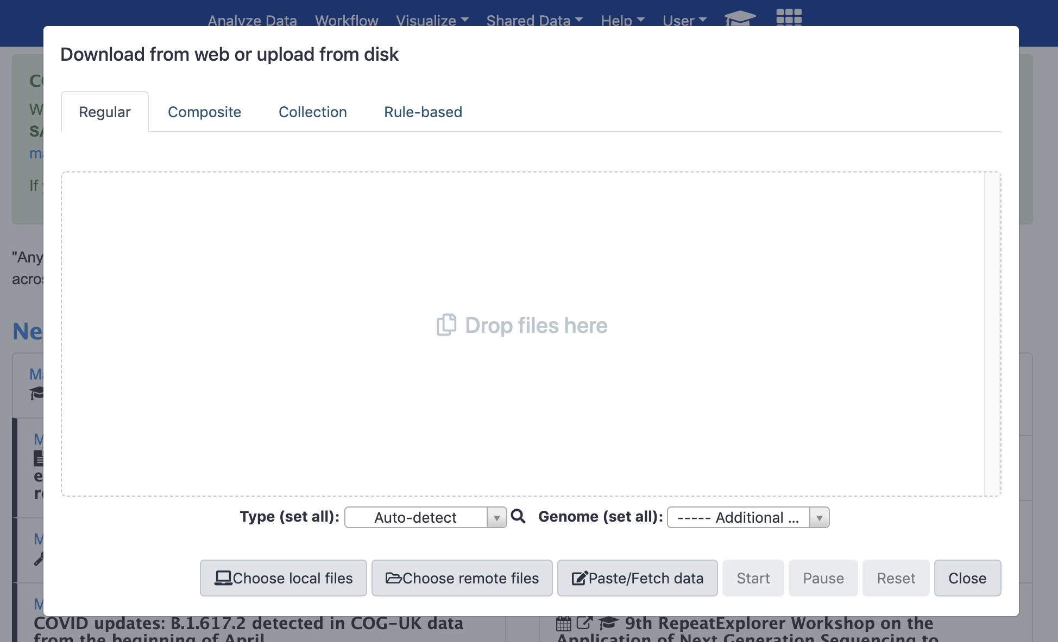
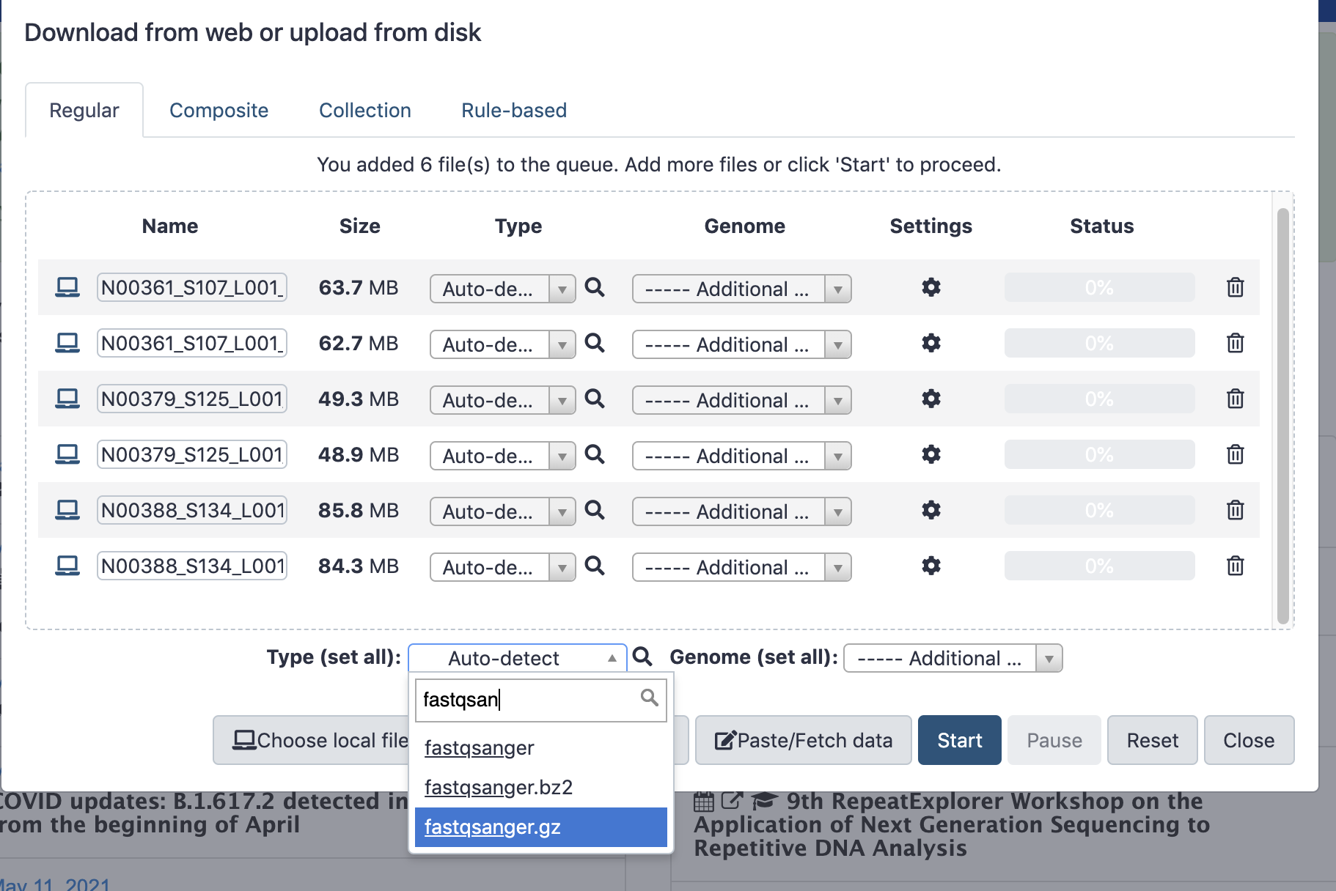
Loading Data
Select “choose local files” if you have the files on your local machine

Slide 9
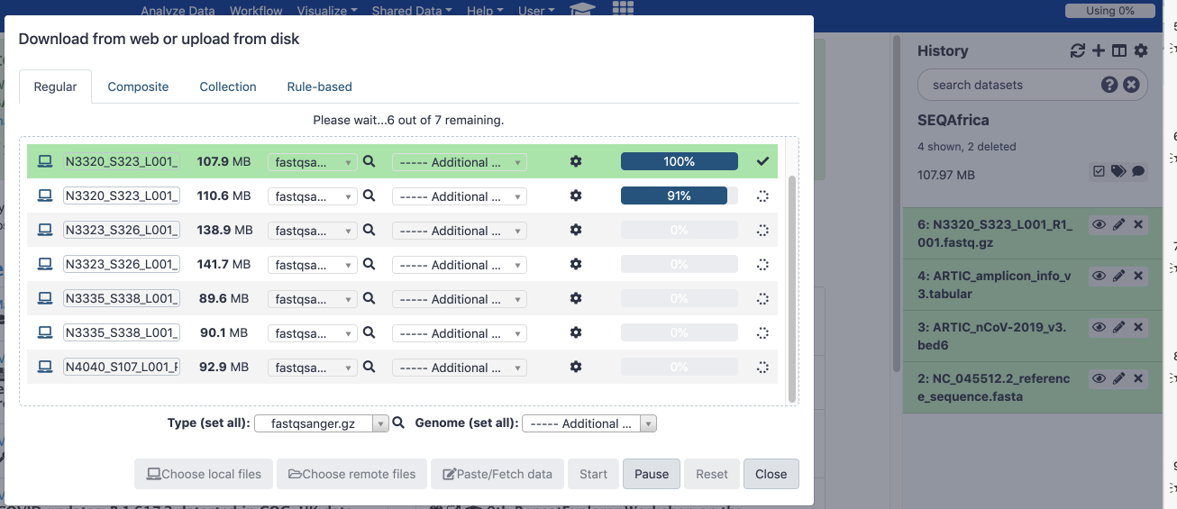
Loading Data
Files will automatically be added to your current working directory

Slide 10
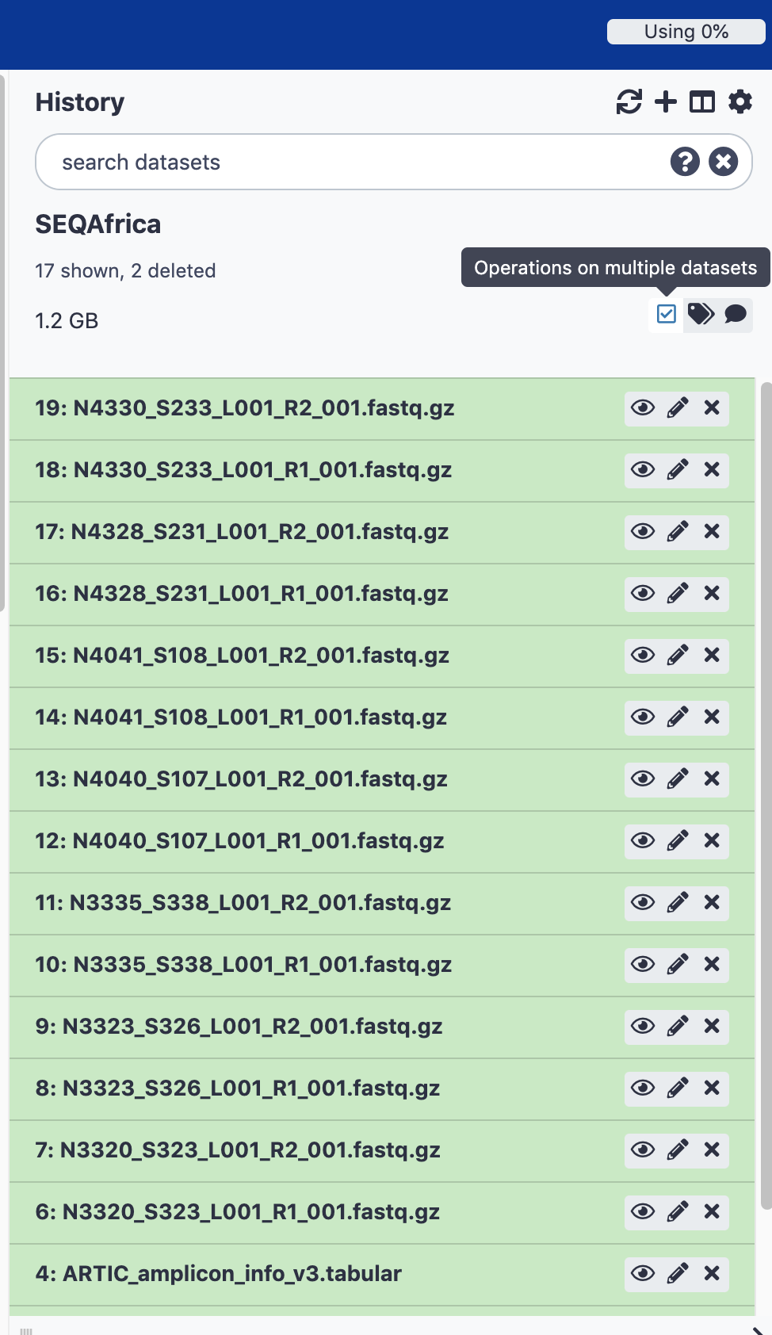
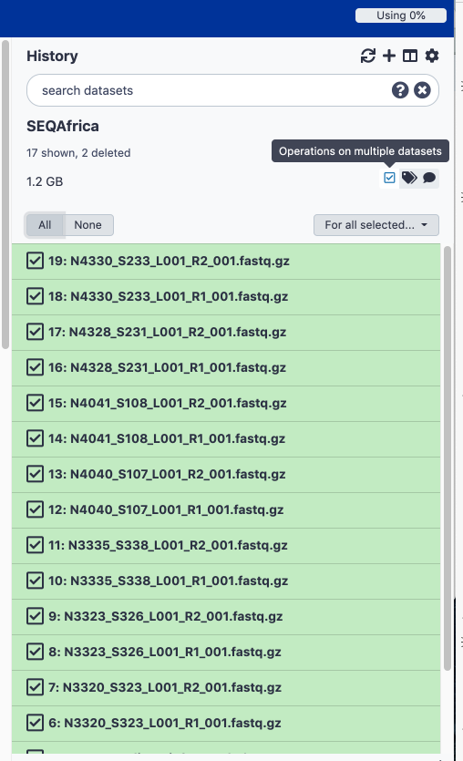
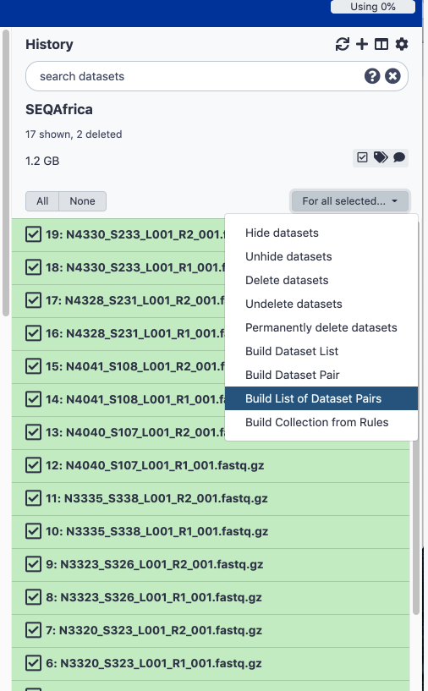
Pairing Illumina Data
Illumina (MiSeq and NextSeq) generate two files per sample (forward and reverse) you need to first pair these reads before doing any downstream analysis

Slide 11
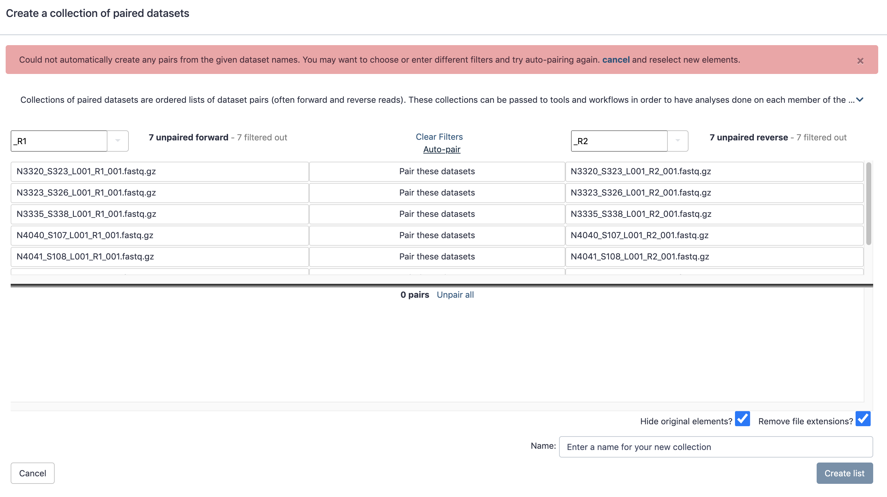
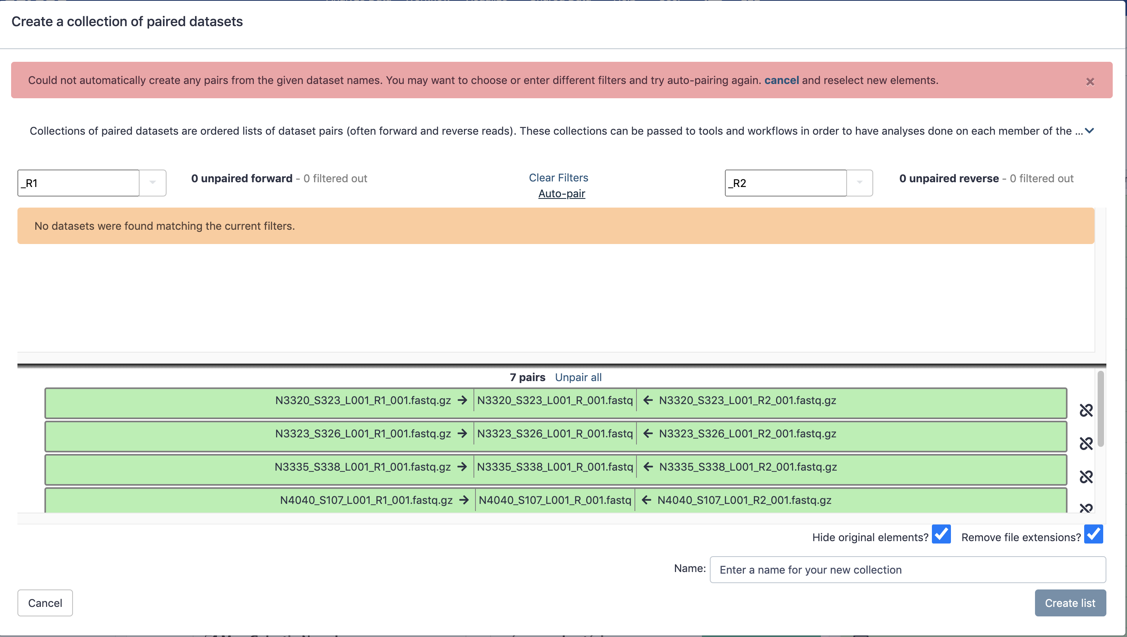
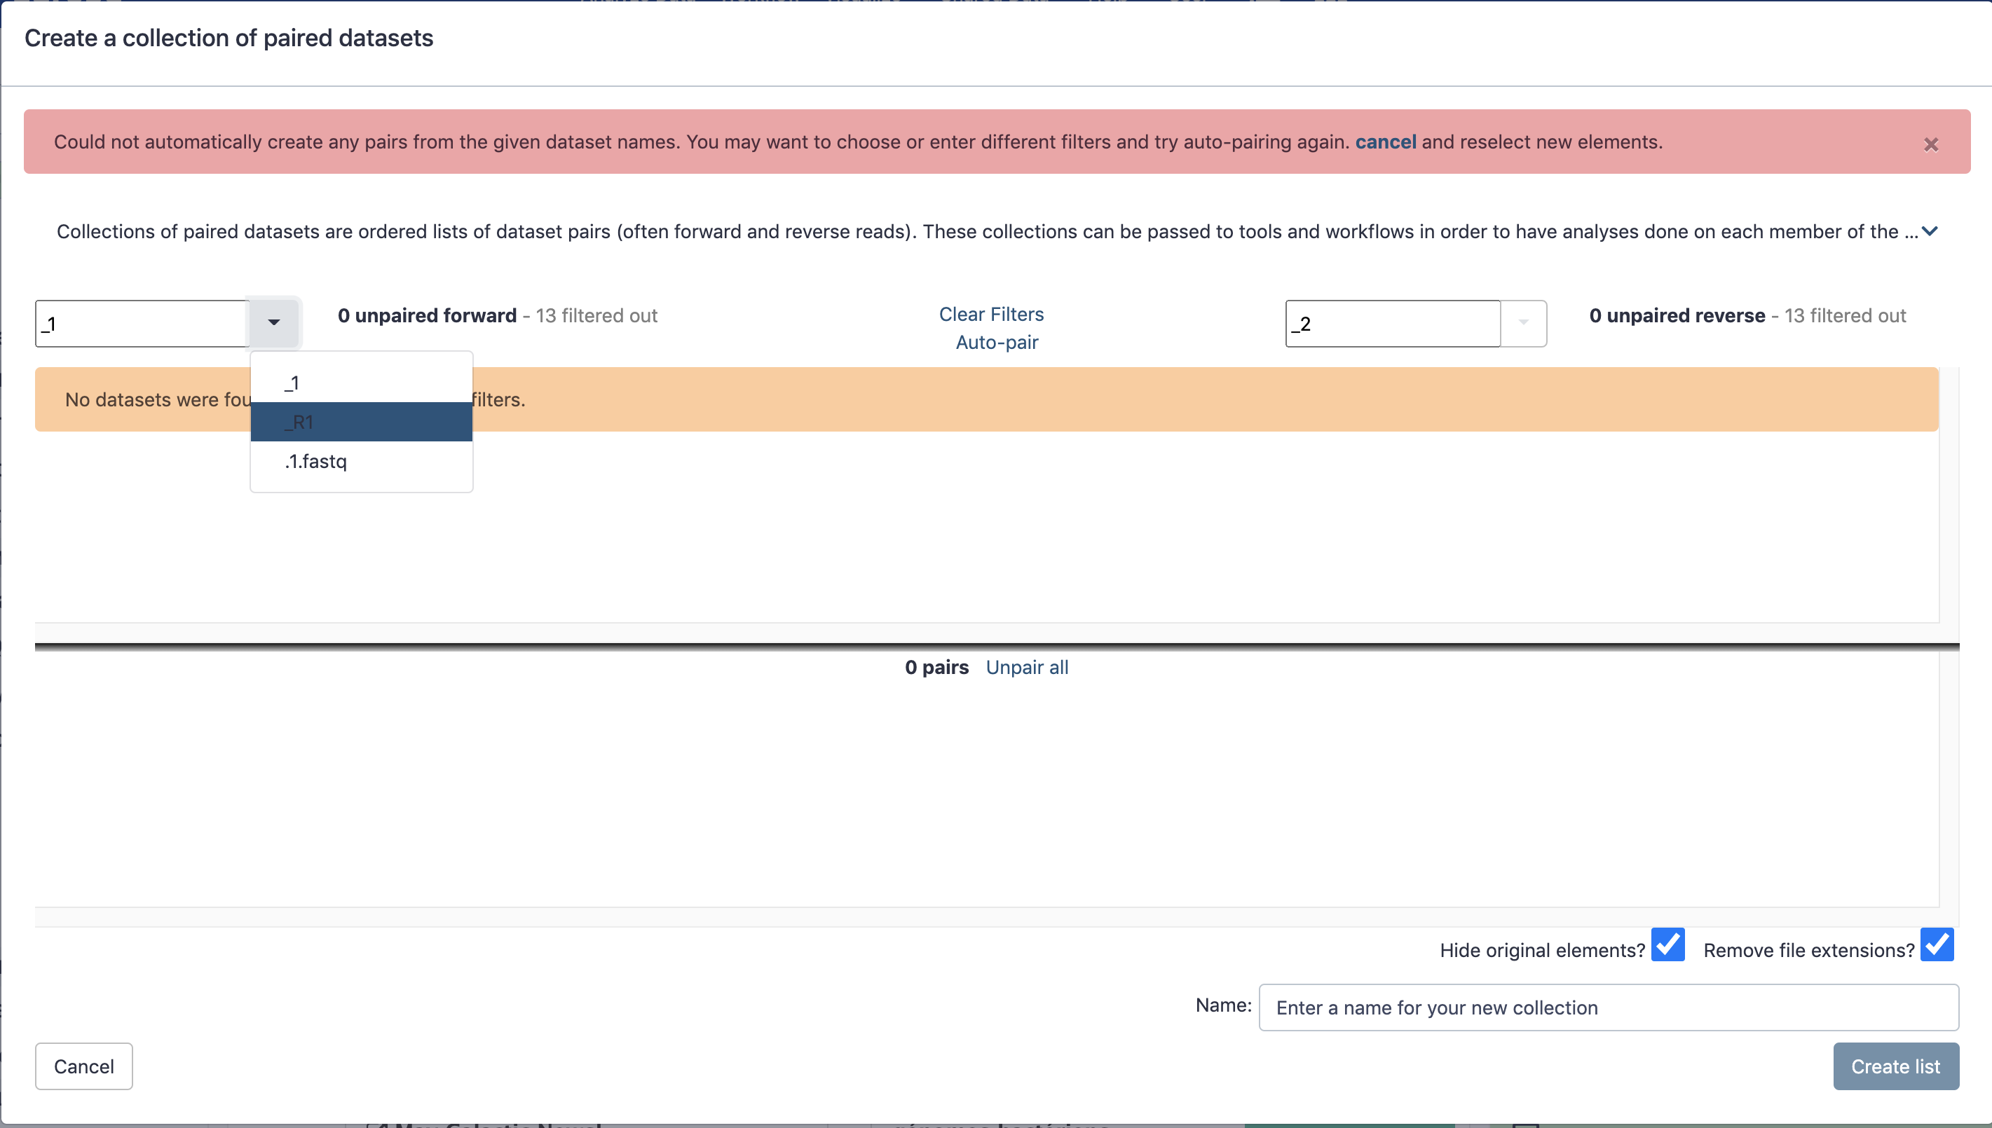
Pairing Illumina Data
Illumina (MiSeq and NextSeq) generate two files per sample (forward and reverse) you need to first pair these reads before doing any downstream analysis
The default for galaxy is to use _1 as the forward identifier but Illumina uses _R1 and _R2
By selecting _R1 and _R2 you should then automatically find your forward and reverse pairs
Select auto-pair if the pairing looks right, name your collection and click “create list”

Slide 12
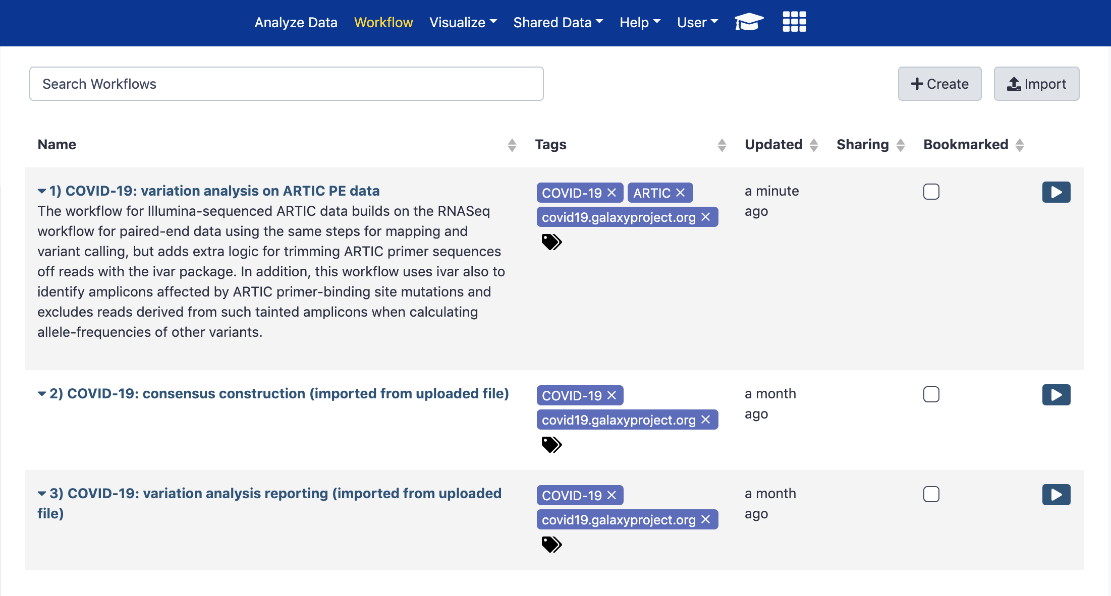
Three workflows in Galaxy
We use three workflows that have been developed by the covid19 galaxy project to analyse our data, all based on the ARTIC protocols.
Workflow 1 generates:
Quality data for each sample
Maps all reads against a reference (NC_045512.2) and outputs a BAM file of mapped reads
SNP or variant information for each sample (snpEff)

Slide 13
Three workflows in Galaxy
We use three workflows that have been developed by the covid19 galaxy project to analyse our data, all based on the ARTIC protocols.
Workflow 2 generates:
Consensus fasta file for each sample – this will be used for downstream lineage (pangolin) and clade (nextclade) assignments

Slide 14
Three workflows in Galaxy
We use three workflows that have been developed by the covid19 galaxy project to analyse our data, all based on the ARTIC protocols.
Workflow 3 generates:
Variant data in tab delimited files
Variant frequency plot

Slide 15
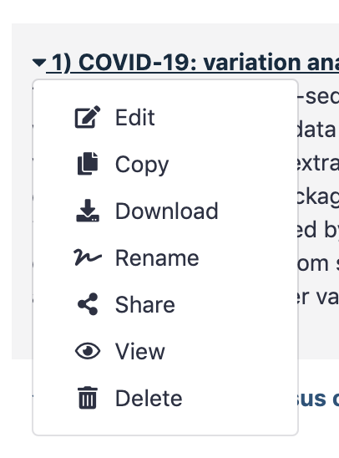
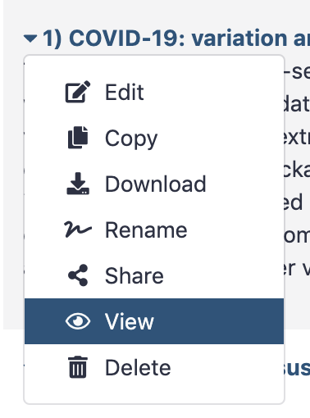
Three workflows in Galaxy
We use three workflows that have been developed by the covid19 galaxy project to analyse our data, all based on the ARTIC protocols.
You can also edit, rename or view workflows

Slide 16
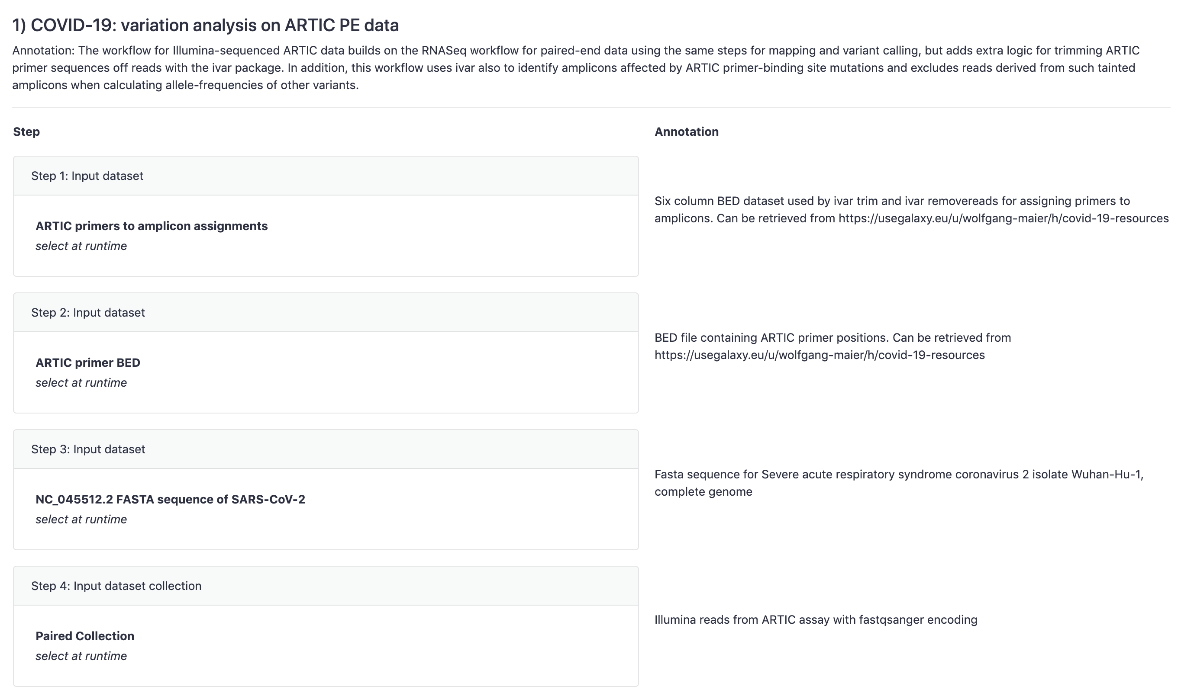
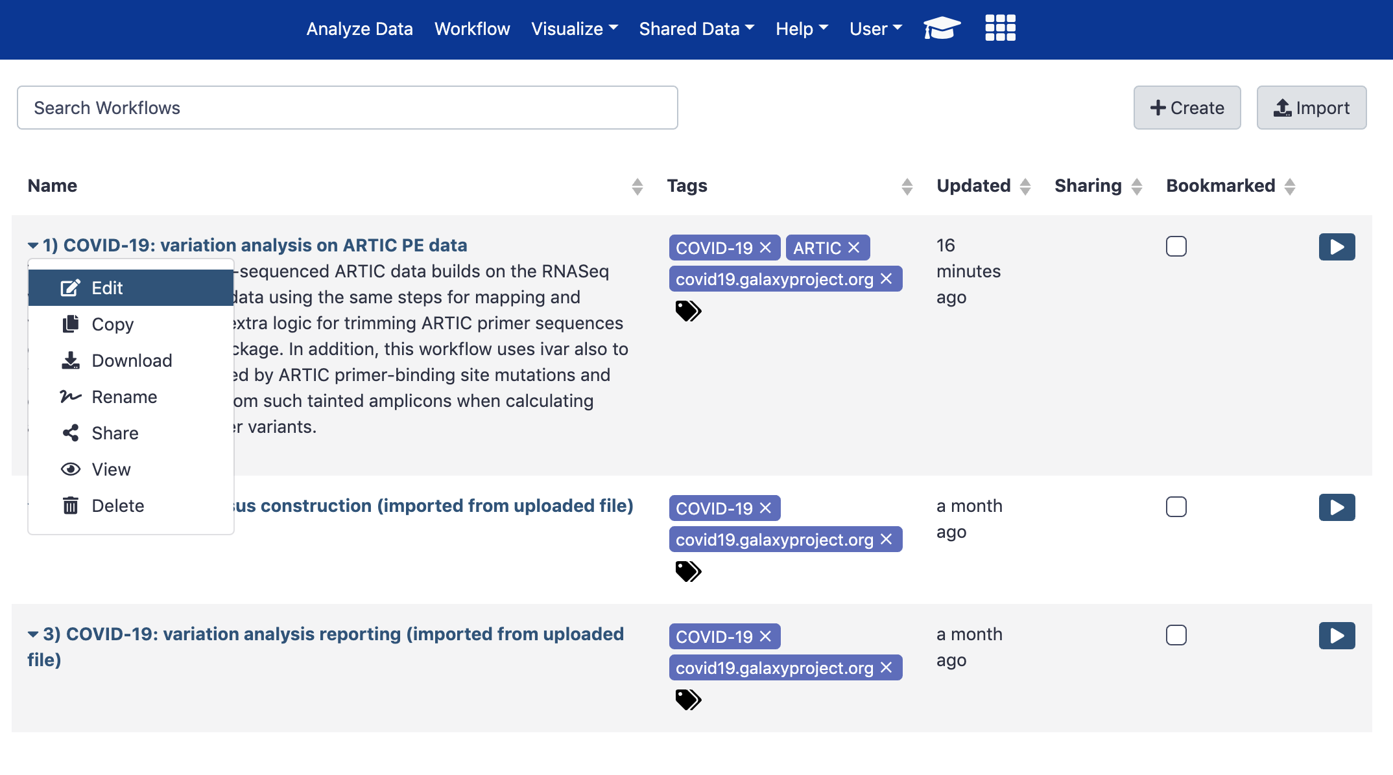
Three workflows in Galaxy

Slide 17
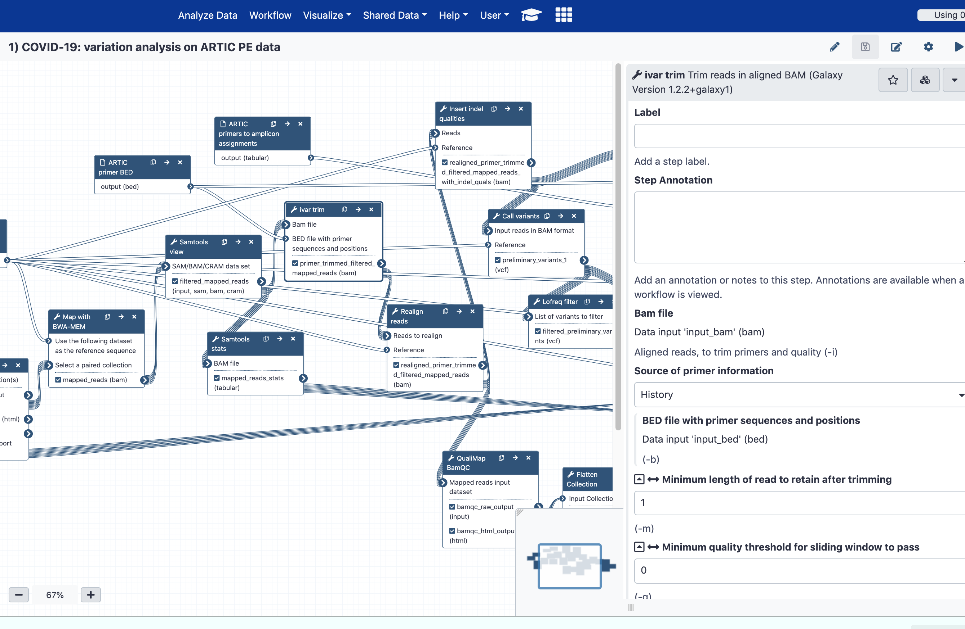
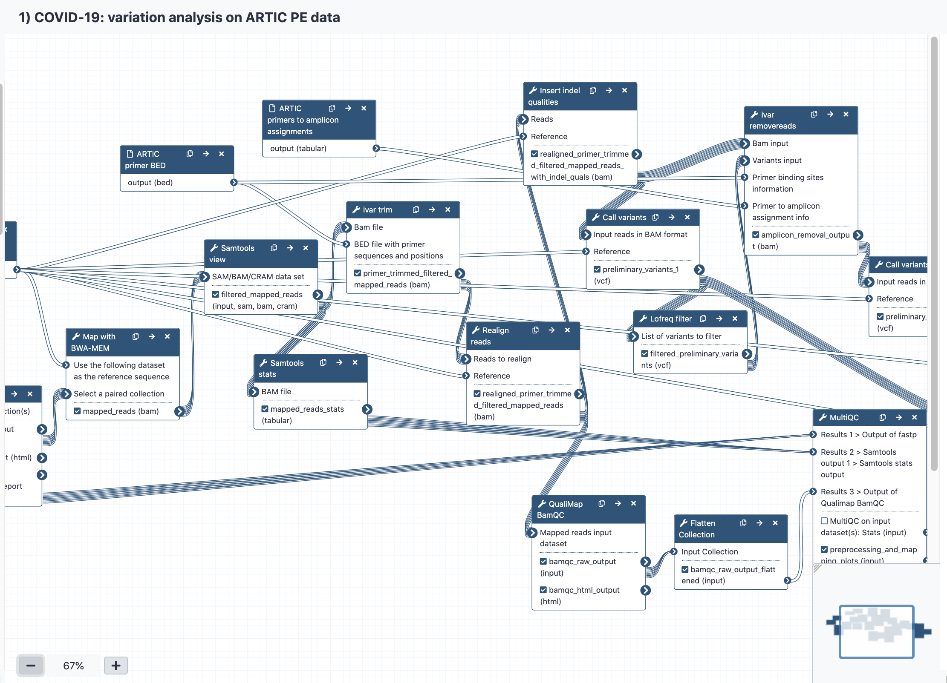
Editing workflows in Galaxy
Selecting this button will allow you to change versions of the tools if you need to use an earlier or later version
You can also edit settings

Slide 18
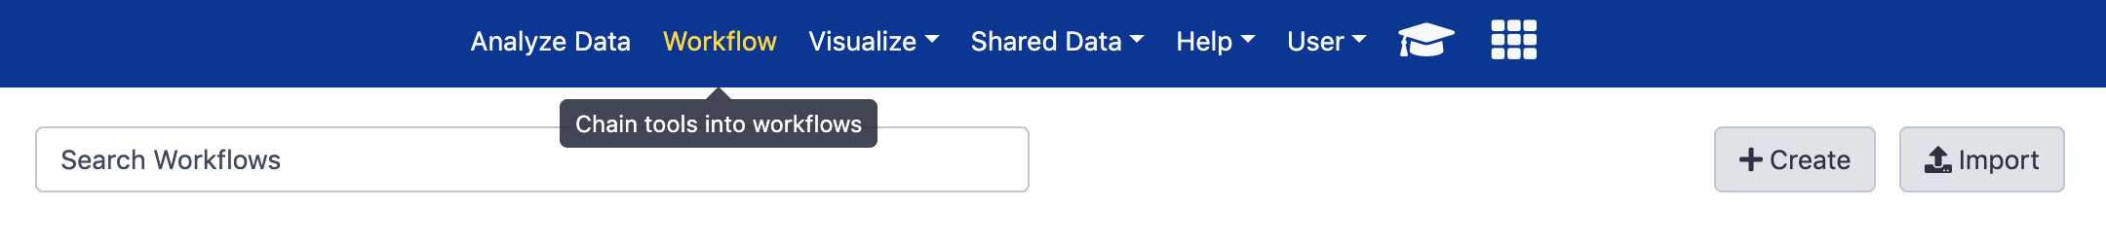
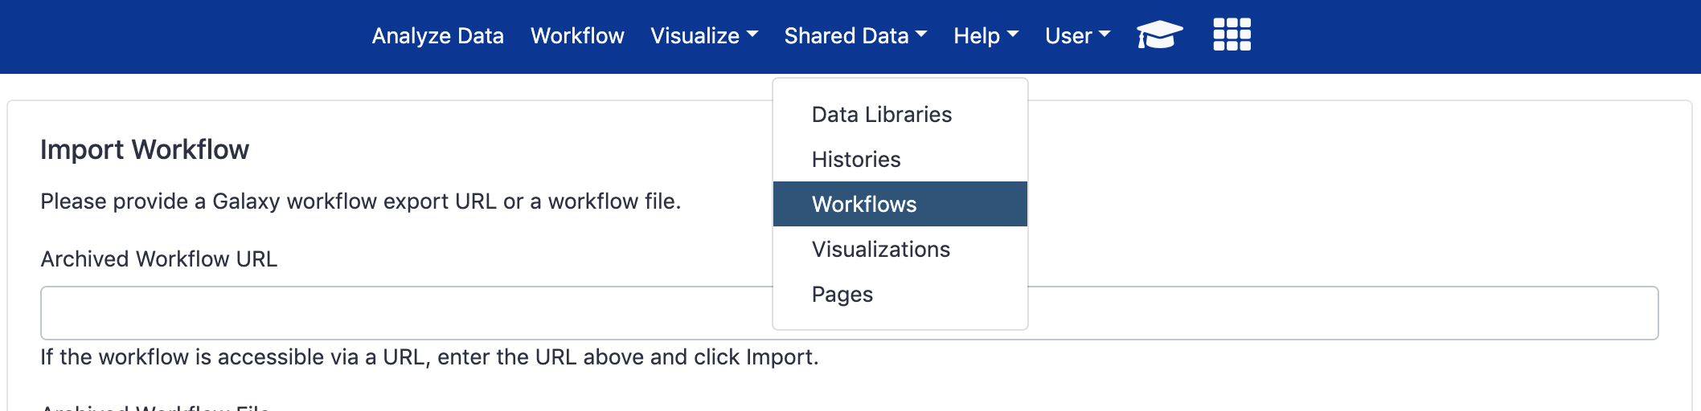
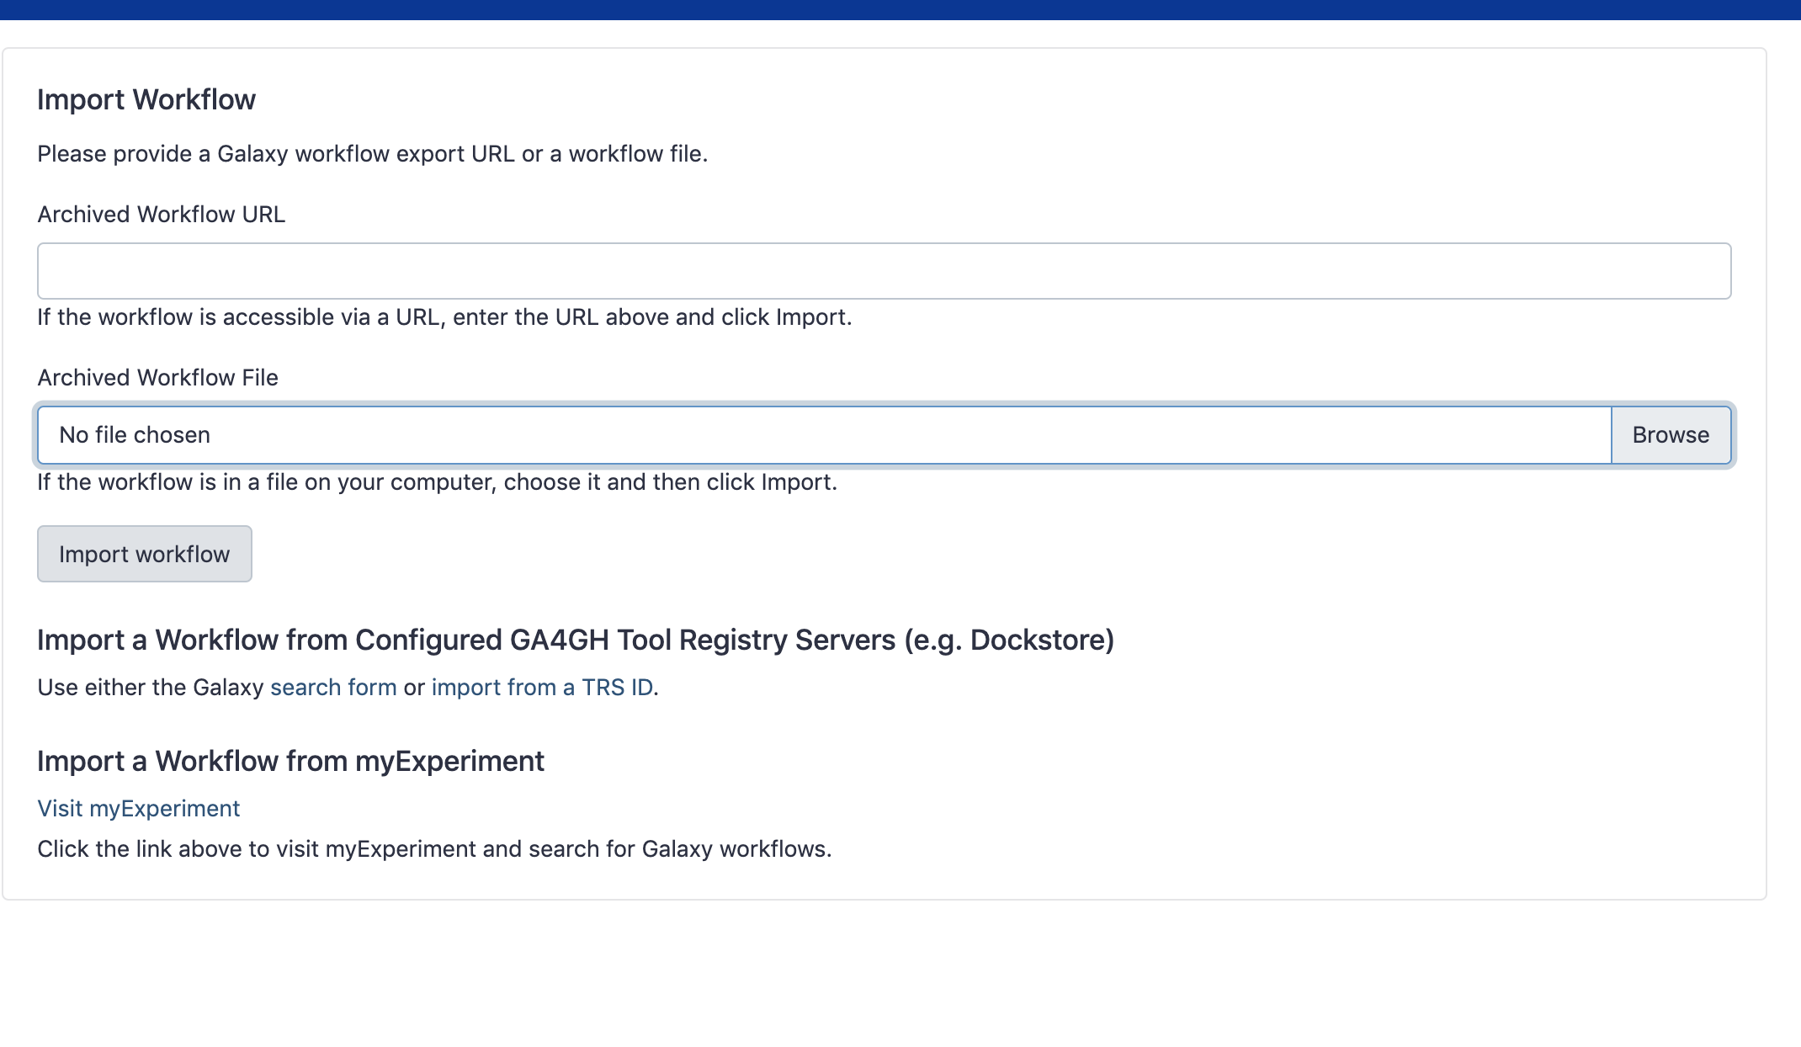
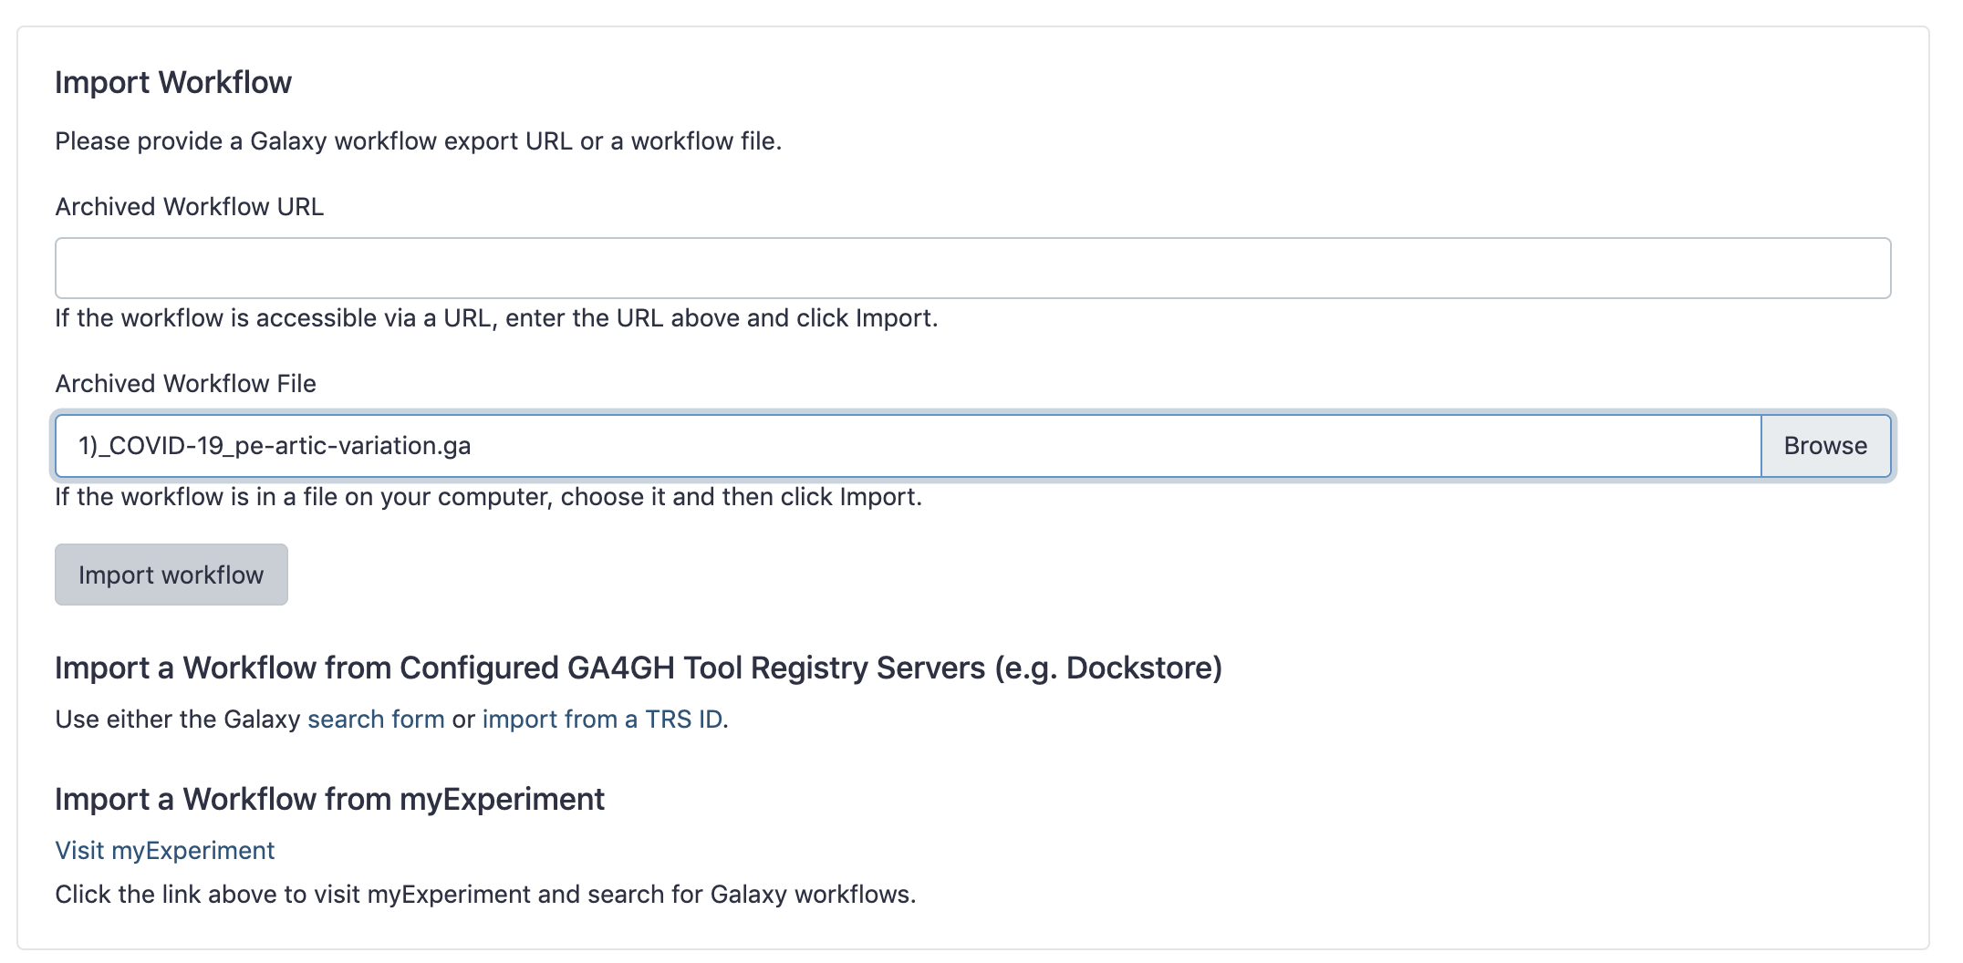
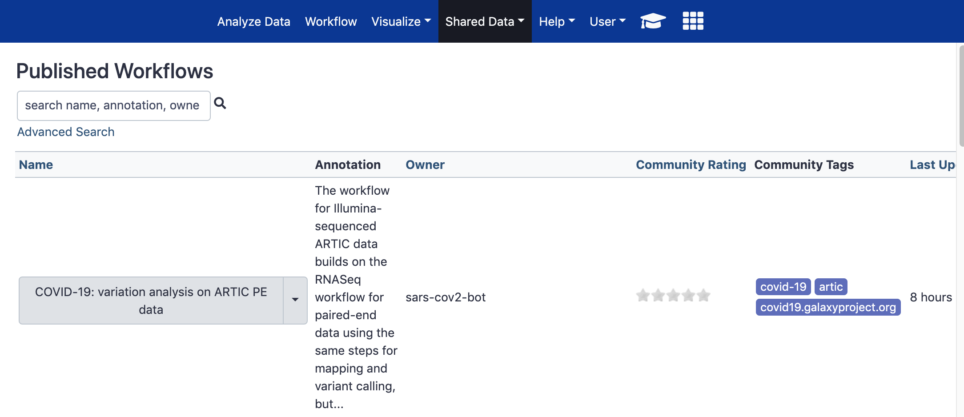
Getting workflows
Getting workflows:
You can either create your own workflows if you want to connect different tools
Import workflows you’ve saved or downloaded elsewhere
Import workflows from published / shared data

Slide 19
Running workflows in Galaxy
To run a workflow you simply click the play button

Slide 20
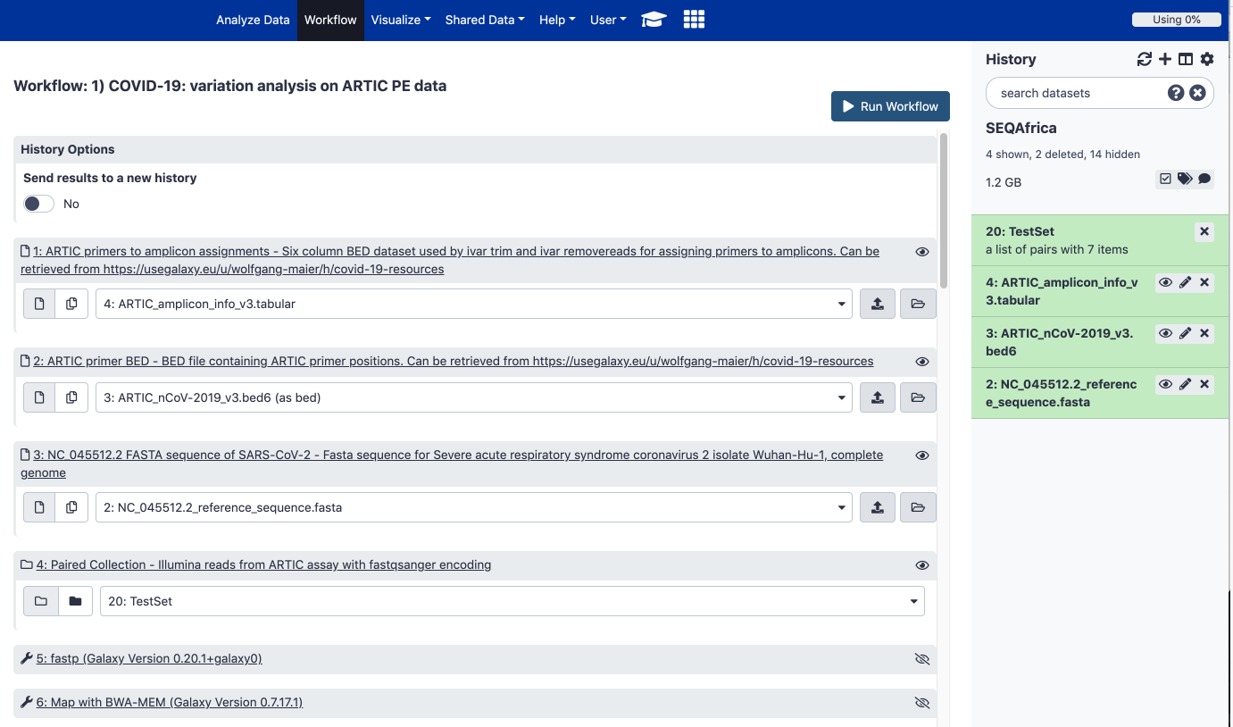
COVID-19: variation analysis on ARTIC PE data
For the first workflow you will need the following files:
ARTIC amplicon info (version 3).tabular
ARTIC v3 bed file
NC_045512.2 reference fasta file
Your paired dataset list
1
2
3
4

Slide 21
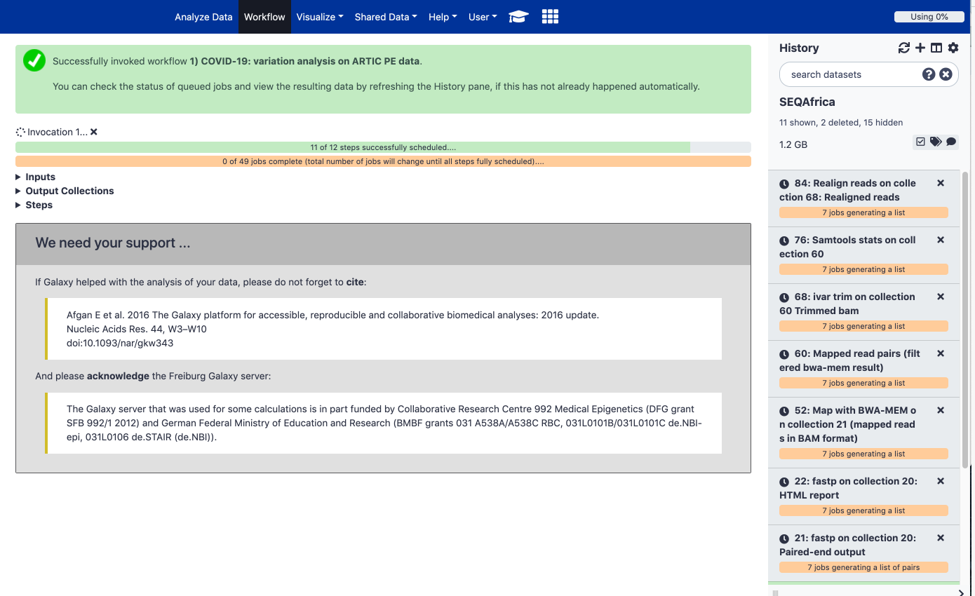
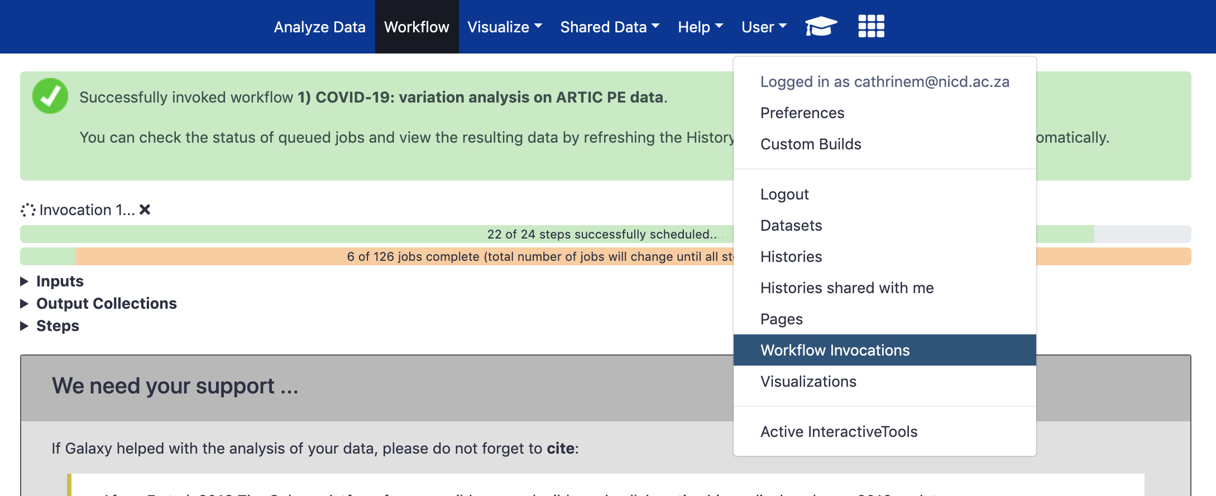
COVID-19: variation analysis on ARTIC PE data
Invocations refers to the scheduling of jobs
Jobs are each of the tasks that need to be run for a workflow to be completed
Outputs are automatically added to your current history
You can check on different workflow invocations you’ve launched by clicking on ”workflow invocations” under the User tab

Slide 22
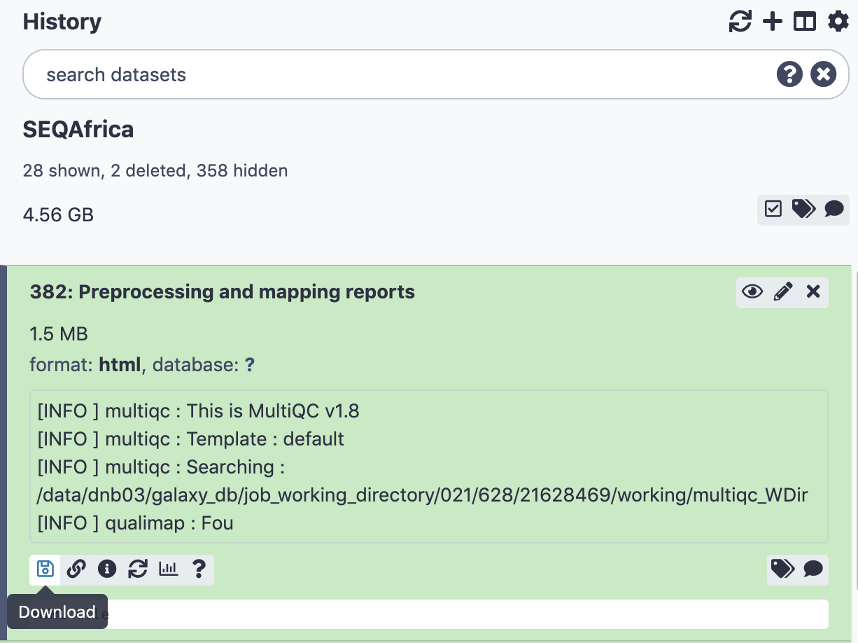
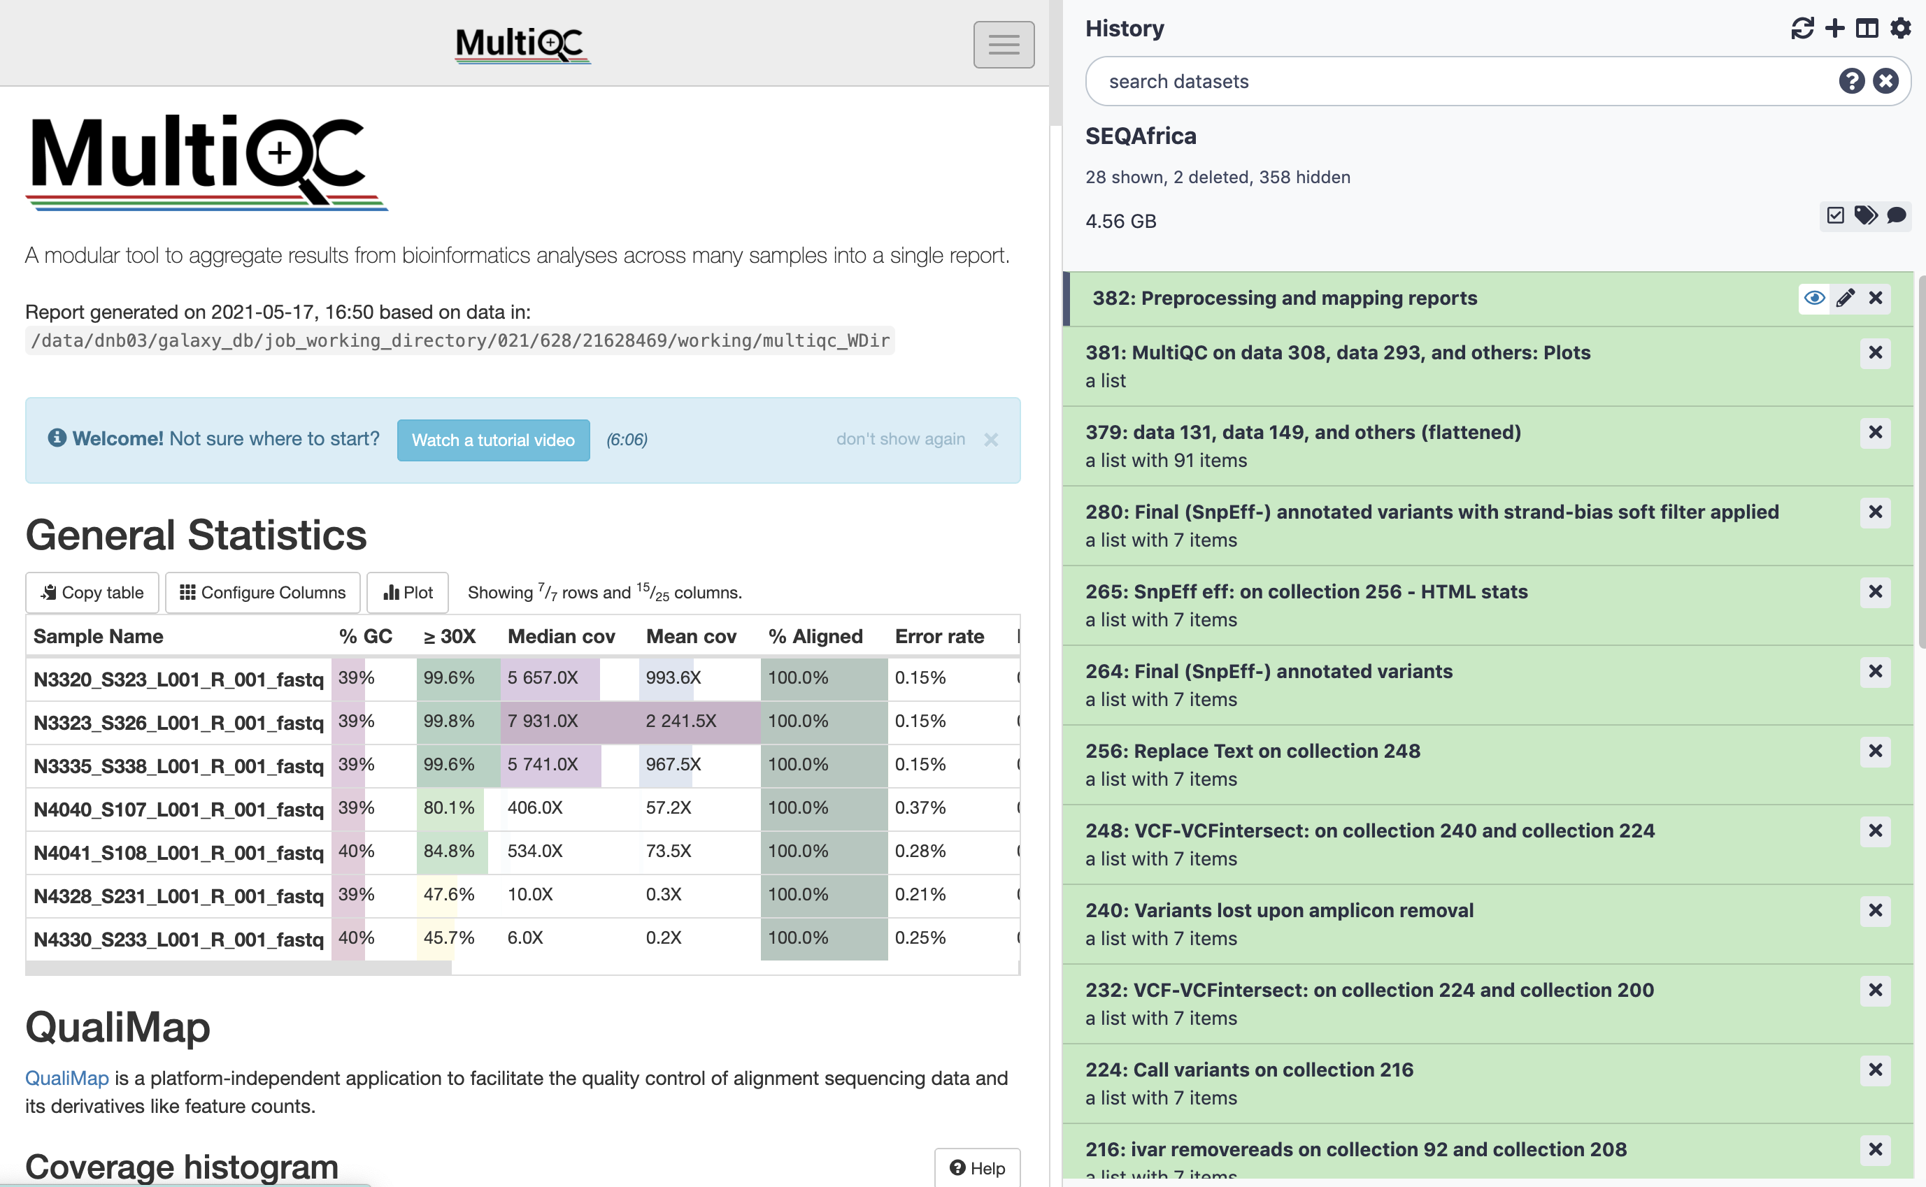
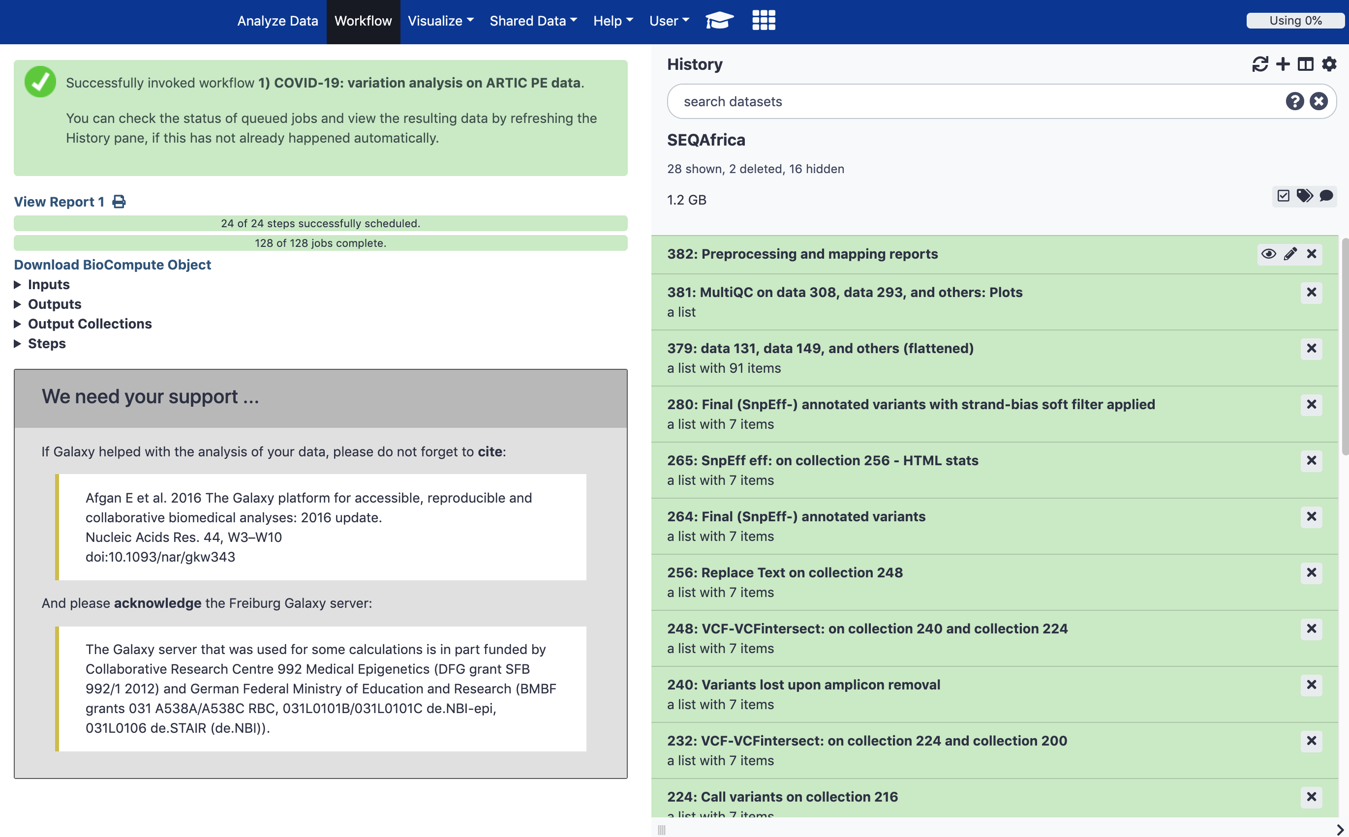
Navigating output files
All output files will automatically appear in your history
If you click on each item you’ll see a list of the outputs for each sample
You can either view the items in galaxy or download them

Slide 23
Navigating output files
The most important output files are:
Quality files:
  Preprocessing and mapping reports
  QualiMap BamQC Report
  Raw data for QualiMap BamQC
Mapped reads:
  Fully processed reads for variant calling (Bam file)
Variant Calls:
  Final (SnpEff-) annotated variants with strand-bias soft filter applied

Slide 24
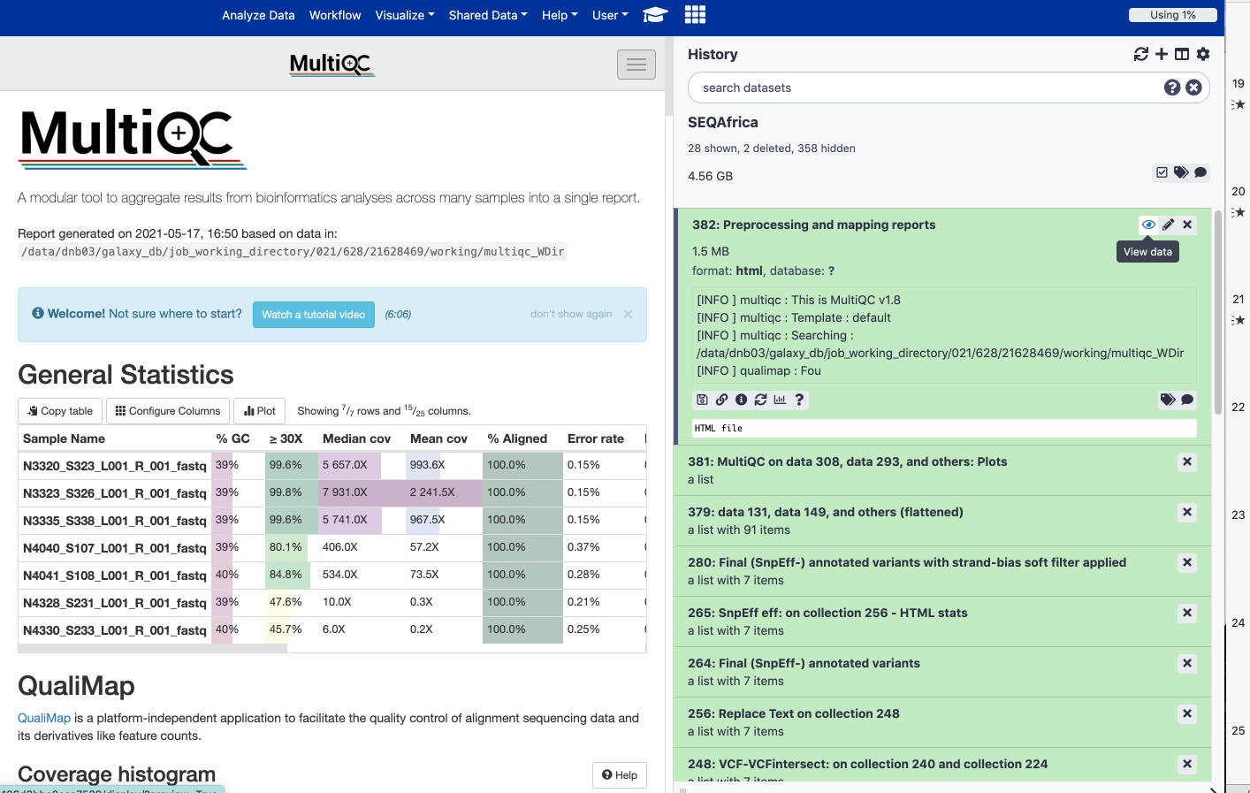
Quality Files

Slide 25
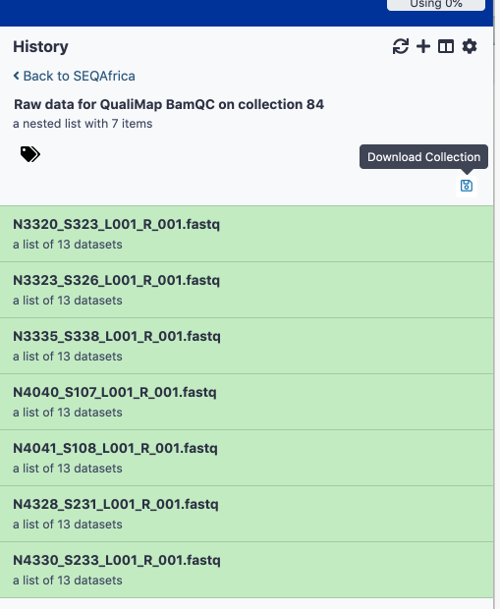
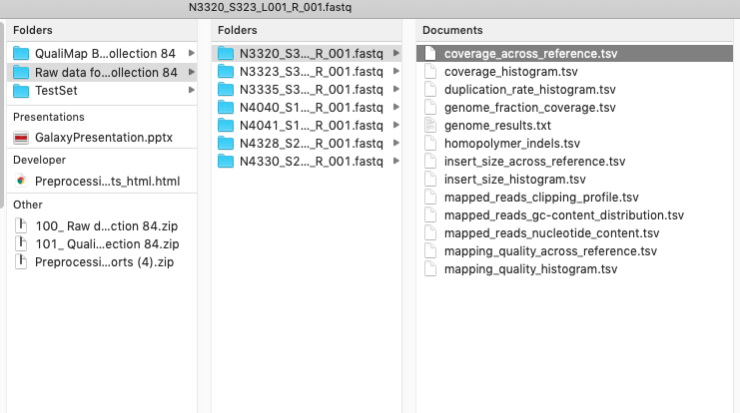
Quality Files

Slide 26
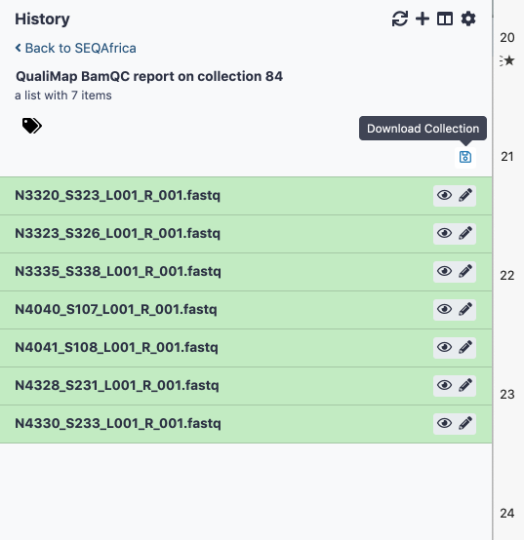
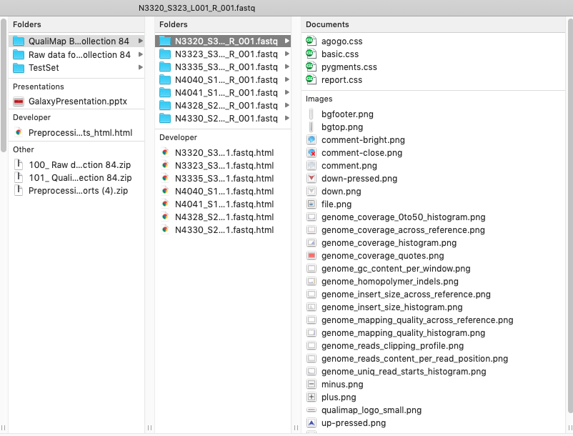
Quality Files

Slide 27
Good vs Bad Quality
Good
Genome Coverage
Bad

Slide 28
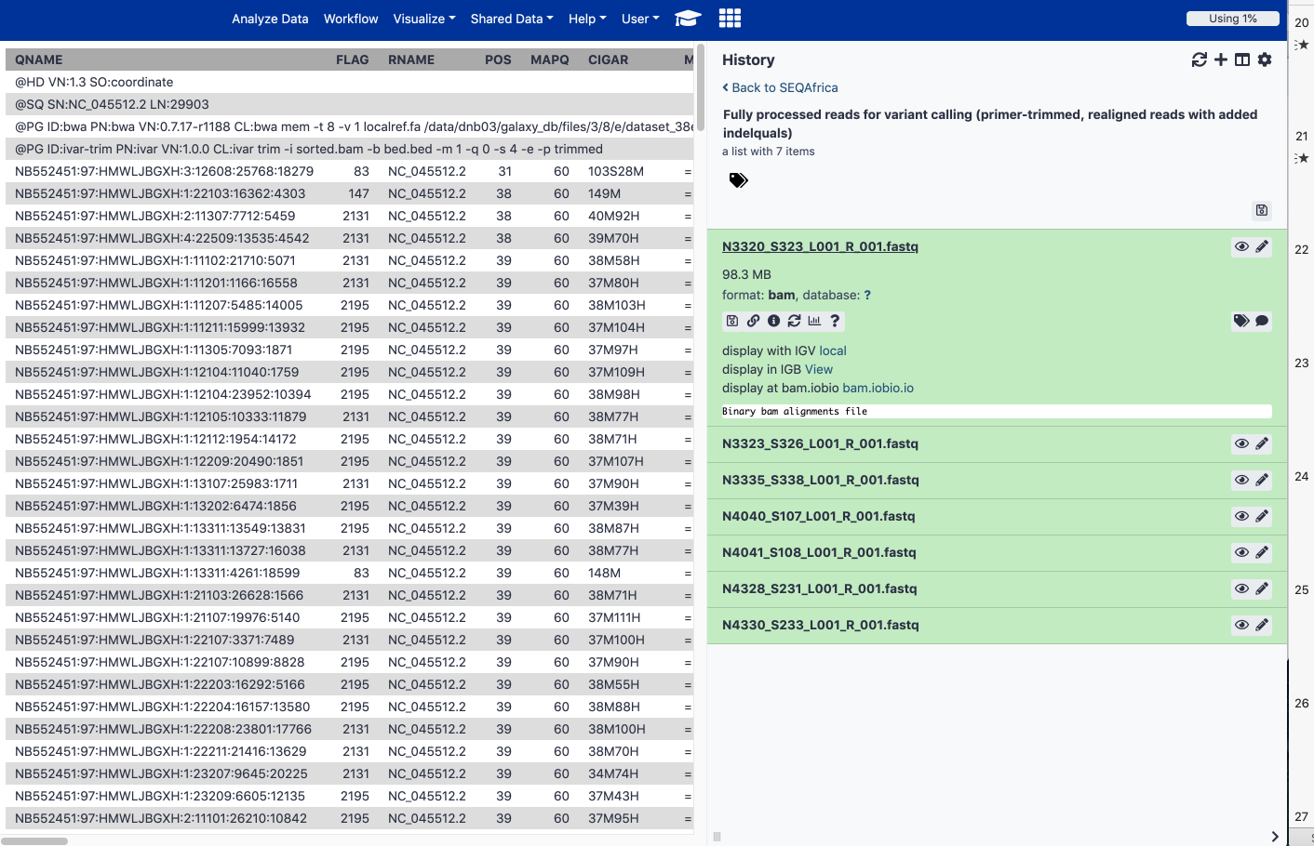
BAM Files

Slide 29
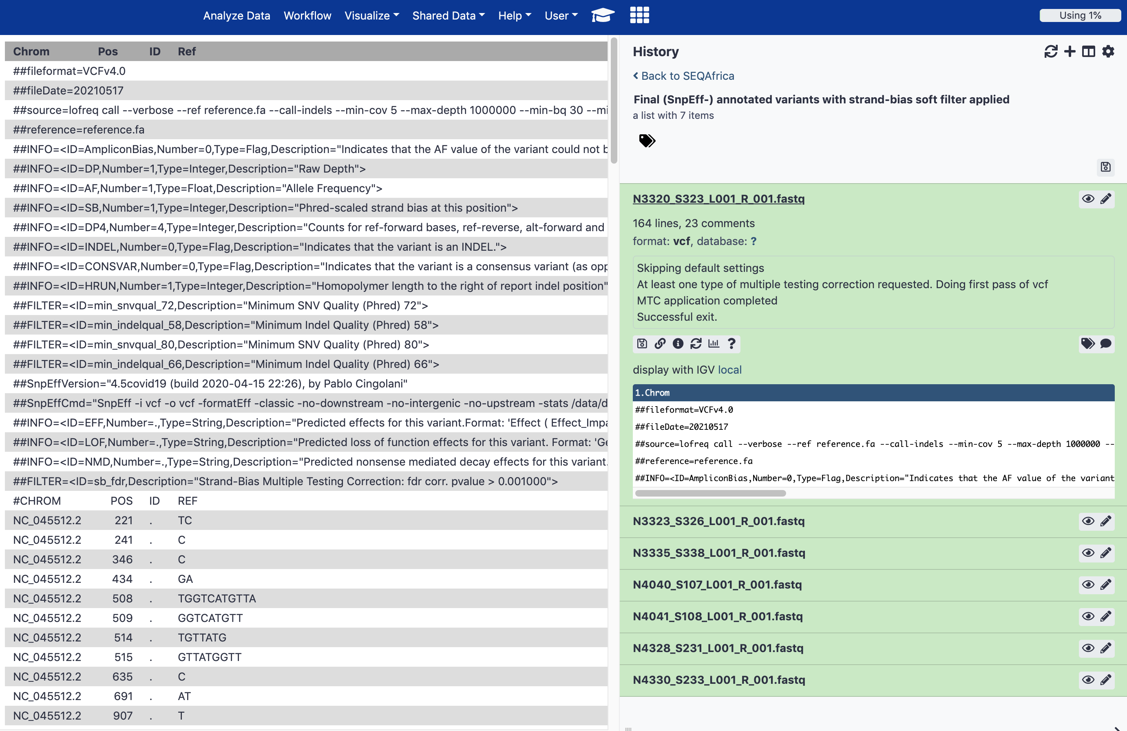
snpEff Files

Slide 30
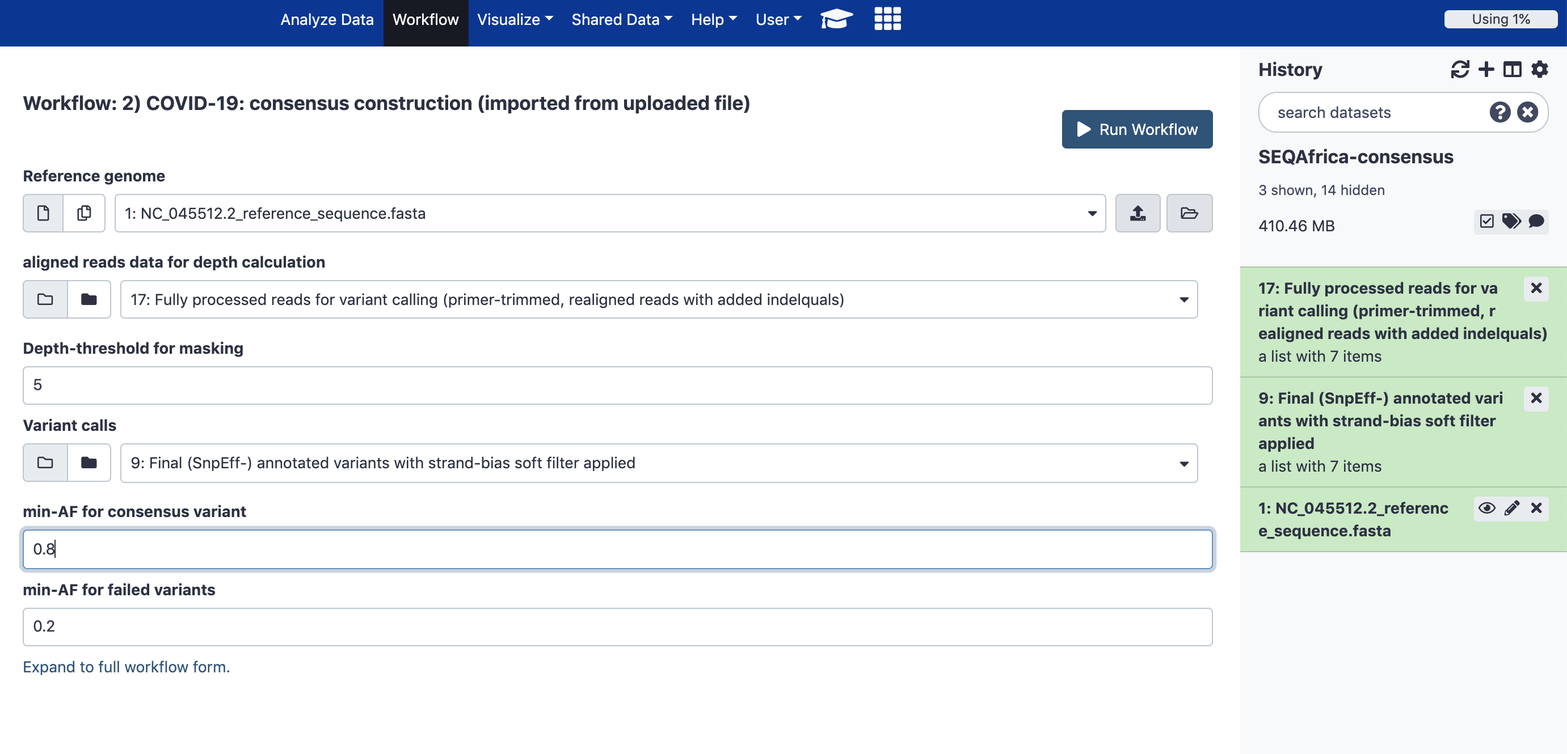
COVID-19: consensus construction
For the second workflow you will need the following files:
NC_045512.2 reference fasta file
Mapped read BAM file (output from workflow 1)
Variant snpEff (output file from workflow 1)
1
I find it easier to run the different workflows in a new history
2
3
Can reduce to 0.6

Slide 31
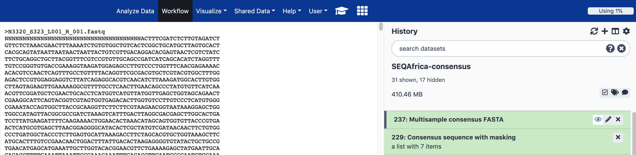
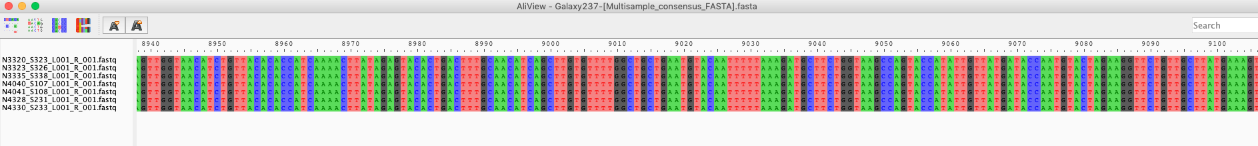
COVID-19: consensus construction
Two important outputs from workflow 2:
Multisample consensus fasta
Consensus sequence with masking
Example of the consensus sequences which can be viewed using AliView or any other sequence software

Slide 32
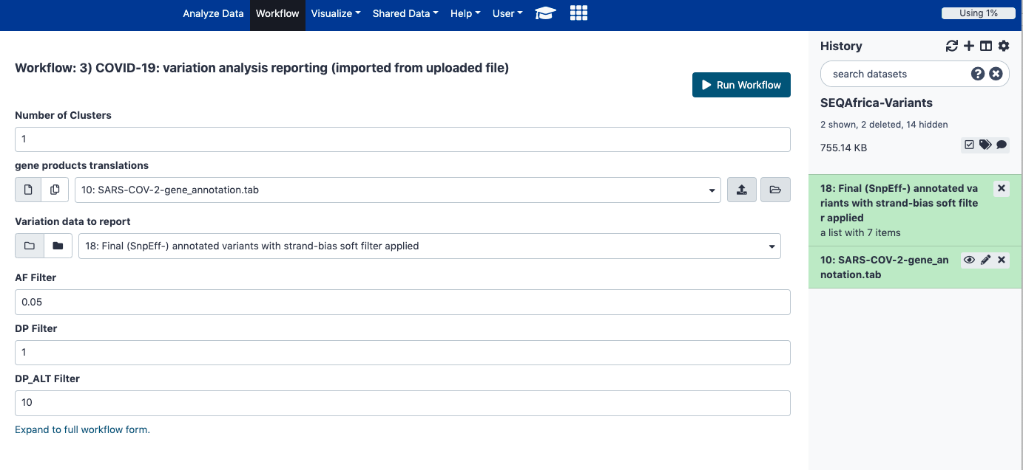
COVID-19: variation analysis reporting
For the third workflow you will need the following files:
Amplicon/gene product information (tabular)
Variant snpEff (output file from workflow 1)
1
2

Slide 33
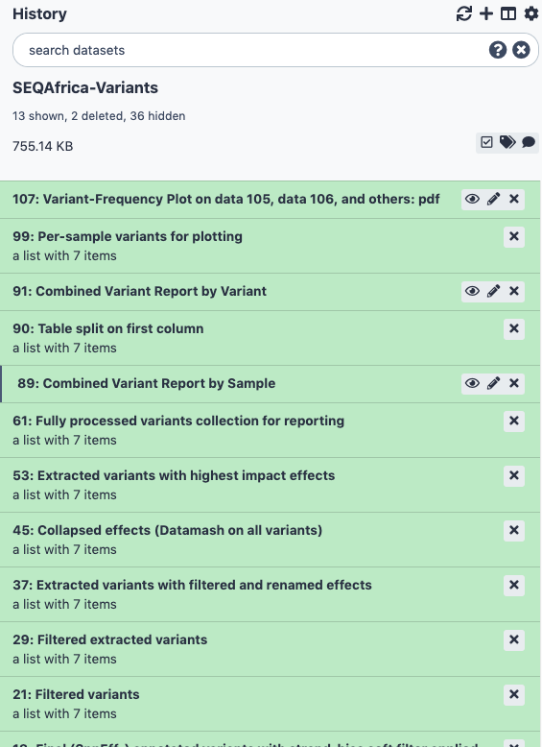
COVID-19: variation analysis reporting
The most important output files are:
Variant Information:
  Per-sample variants for plotting
  Combined Variant report by Variant
  Combined Variant report by Sample
Variant frequency plot

Slide 34
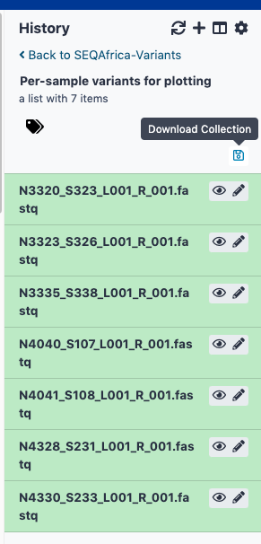
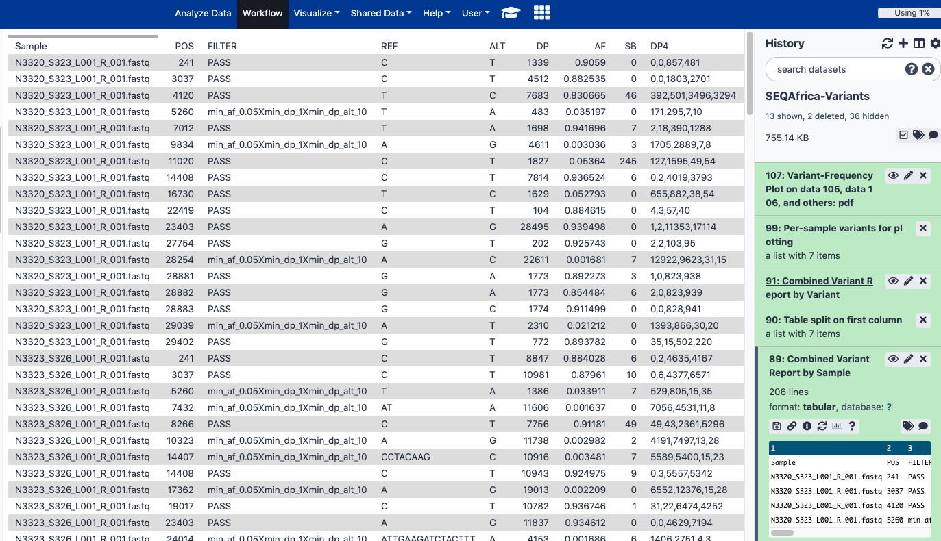
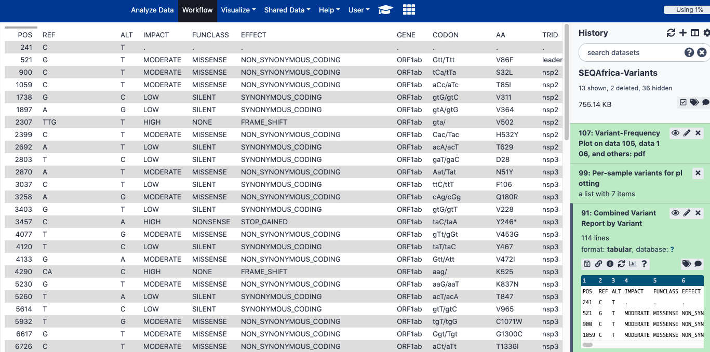
COVID-19: variation analysis reporting

Slide 35
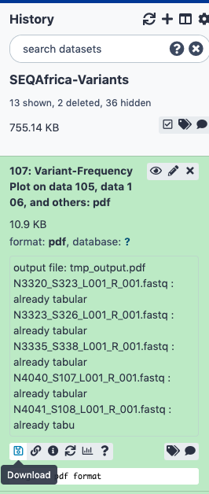



COVID-19: variation analysis reporting

Slide 36
Conclusions
Galaxy is a powerful tool that allows you to analyze large datasets without having a lot of bioinformatics background
COVID-19 galaxy project has many workflows specifically for ARTIC SARS-CoV-2 sequencing
By the end of this module you should be able to:
  Create a galaxy account
  Create new histories
  Upload data Illumina and other relevant datasets
  Navigate between workflows
  Start a workflow to map raw data to a reference
  Create a consensus fasta file - used for lineage and clade assignments.
  Create variant information files and variant frequency plots

