Slide 1
Module 3
SARS-CoV-2 whole genome sequencing
Sequencing using NextSeq 550
Dr Arshad Ismail
Zama Khumalo
Thabo Mohale
National Institute for Communicable Diseases, South Africa
Date : 19 May 2021

Slide 2
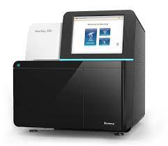
Sequencing Workflow
Sequencing
Washing of the Machine
Step 1
Create Sample Sheet
Step 2
Loading of Libraries
Step 3
Run - QC Metrics
Step 4

Slide 3
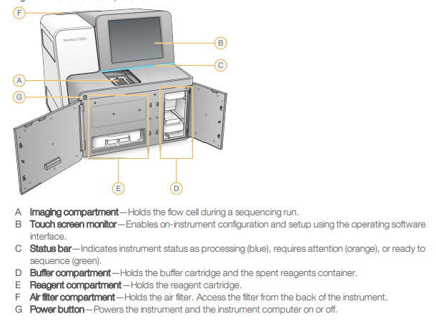
NextSeq 550
Specifications
Run Time | 12–30 hrs
Maximum output | 120 Gb
Maximum Reads per Run | 400 million
Maximum Read Length | 2 × 150 bp

Slide 4
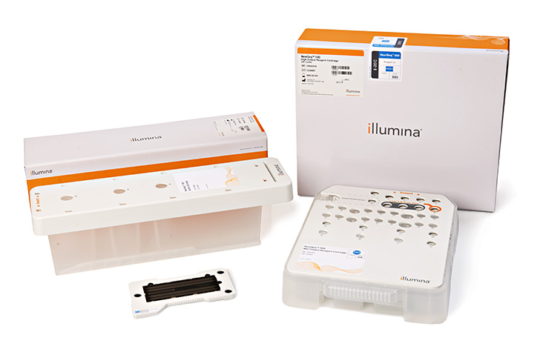
Sequencing Kit Components
1. Buffer Cartridge
1
2. Loading Cartridge
2
3
3. Flow cell

Slide 5
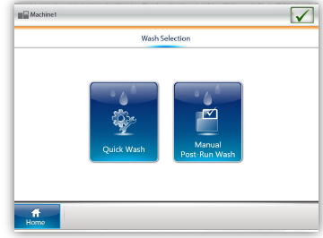
STEP 1
Washing of the Machine
Quick Wash
  Quick wash is performed before every sequencing Run
  A wash solution of 40 ml of laboratory-grade water mixed with 20 µl Tween 20 (0.05% Tween 20 final concentration)
  Wash takes about 20 minutes

Slide 6
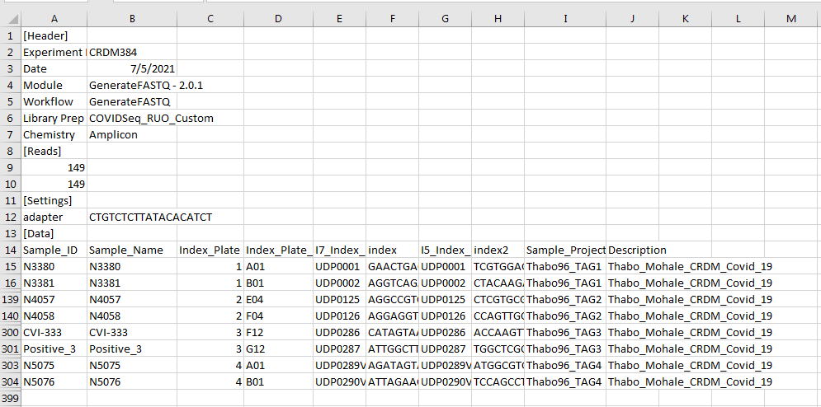
STEP 2
Sample Sheet
Loading a sample sheet onto the NextSeq 550

Slide 7
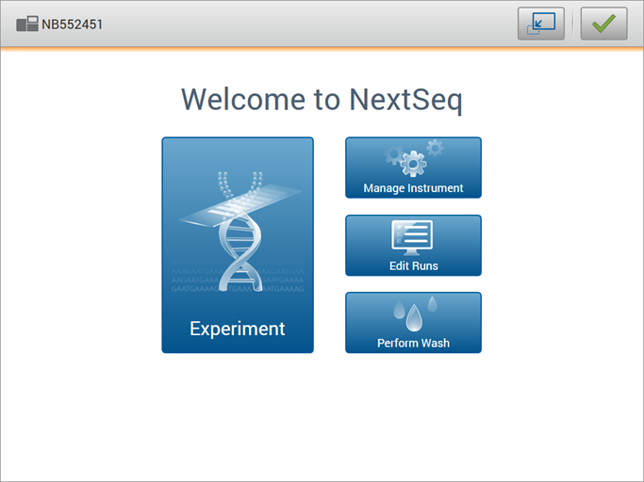
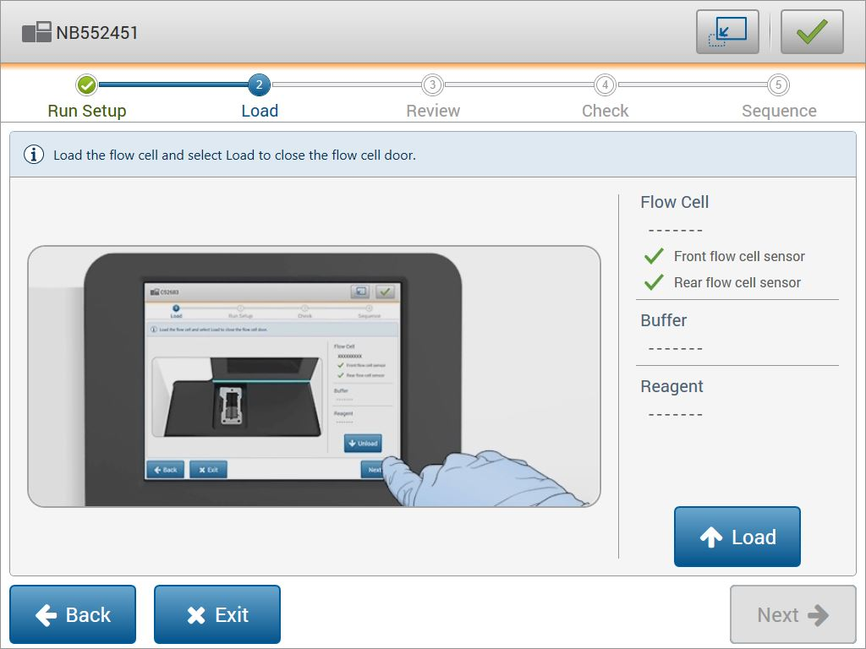
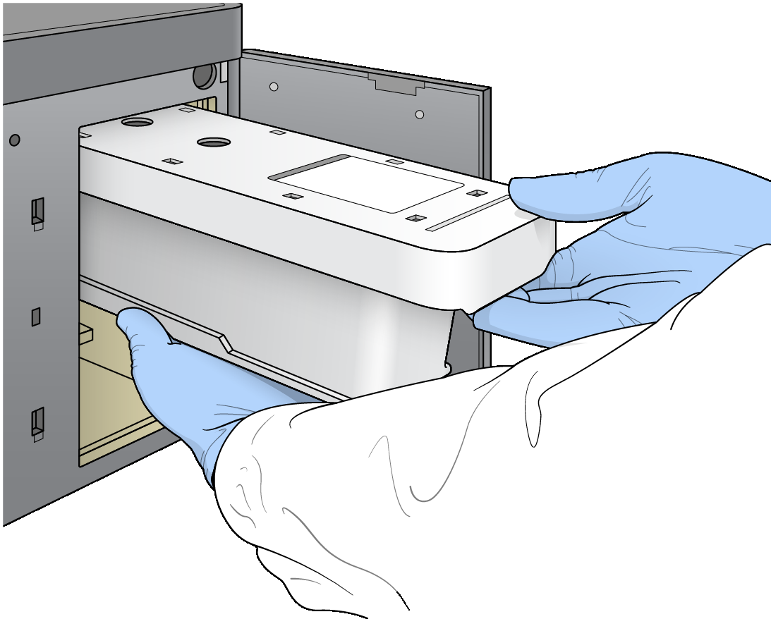
STEP 3
Cleaning & inspecting of the Flow Cell
Illumina NextSeq Control Software
Loading of Buffer Cartridge
Loading Flow cell in the compartment

Slide 8

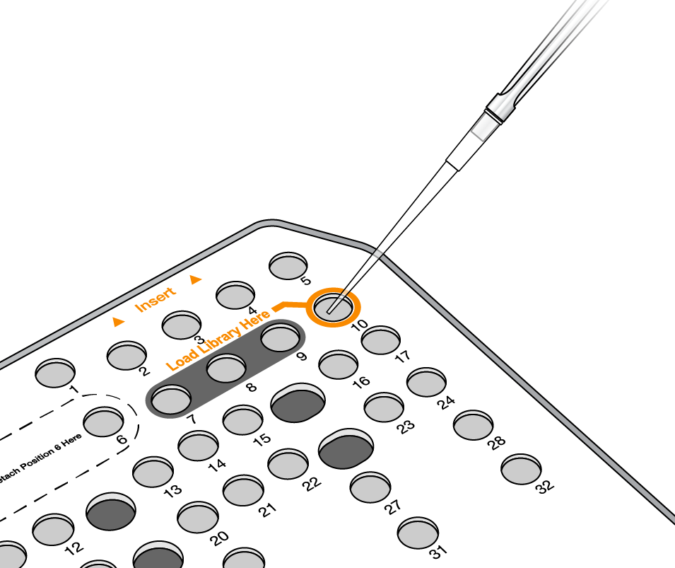
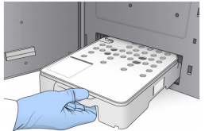
STEP 4
Loading of Libraries
Loading Libraries into Reagent Cartridge
Pierce foil with a new pipette on the well-marked “Load Libraries Here”
Add libraries (650 µl x2 ) to the bottom of the well
Gentle tap the cartridge
Slide the reagent cartridge into the reagent compartment until the cartridge stops,
Close the reagent compartment door

Slide 9
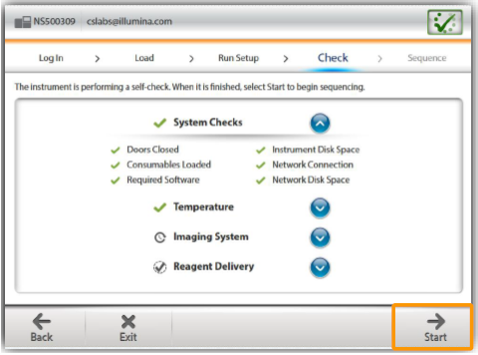
NextSeq 550 system check

Slide 10
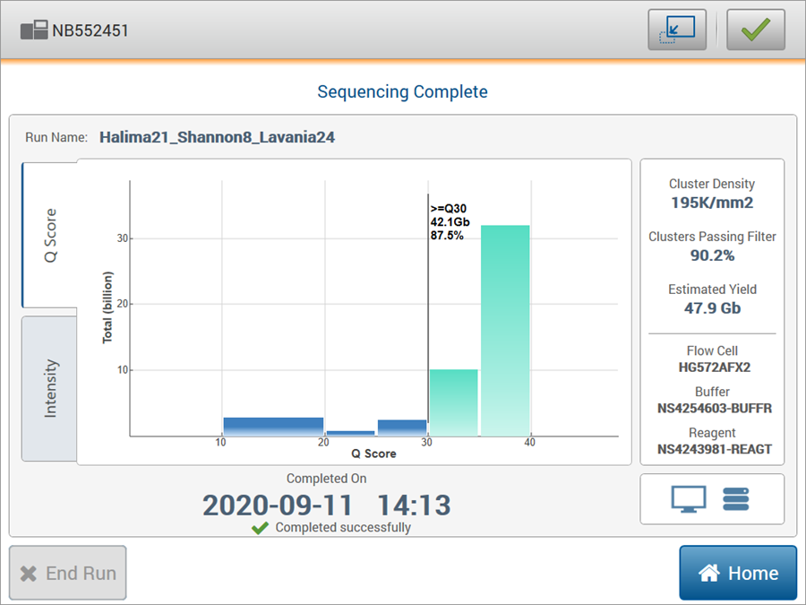
Run QC Metrics

Slide 11
Data analysis
This concludes the wetlab portion of the Illumina CovidSeq workflow
In the next session - in silico part of DNA sequencing, where softwares are used to assemble and analyze the raw data output of the next-generation sequencers

Slide 12







