Slide 1
Module 3 SARS-CoV-2 whole genome sequencing
Library Preparation using CovidSeq kits
Zama Khumalo
Thabo Mohale
National Institute for Communicable Diseases, South Africa
Date : 17 May 2021

Slide 2
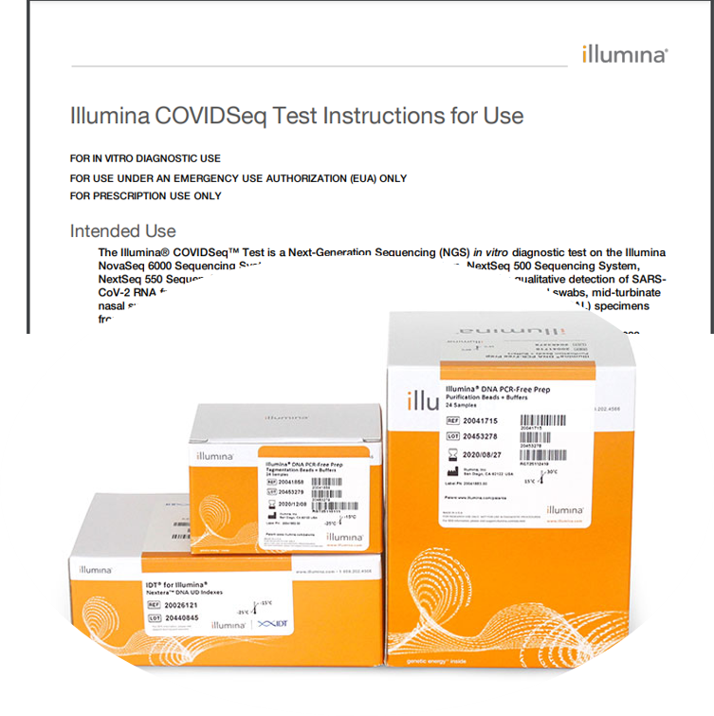
CoviSeq Library Prep Kit
The Illumina COVIDSeq™ (RUO) is a high-throughput amplicon-based NGS
Is designed to sequence the whole genome of SARS-CoV-2 using a tiling PCR approach with overlapping primers
98 primers (20-30bp)
Is based on a publicly available ARTIC protocol

Slide 3
Library Preparation Workflow
Tagment PCR Amplicons
Post Tagmentation & Clean Up
Step 1
Day 1
Amplification of Tagmented Amplicons
Library Prep
Pooling and Purification of Libraries
Step 2
Quantification & Normalization of Libraries
Step 3
Pooling & Dilution of Libraries
Step 4
Day 2
Sequencing
Step 5
Loading the Run

Slide 4
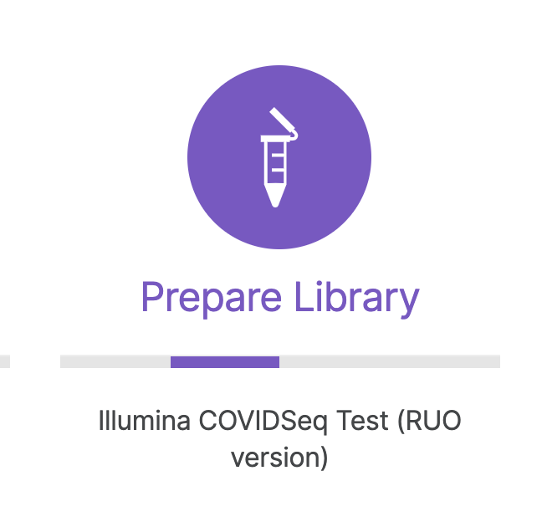
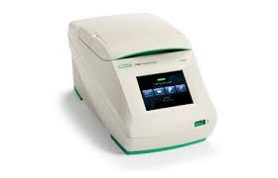
STEP 1
Tagment PCR Amplicons
Process that fragments and tags the PCR amplicons with adapter sequences
Post Tagmentation & Clean Up
This step washes the adapter-tagged amplicons before PCR amplification (TSB – Tagmentation Stop Buffer)
Amplification of Tagmented Amplicons
PCR amplification using unique index adapters
(Set 1-4 -multiplexing)

Slide 5
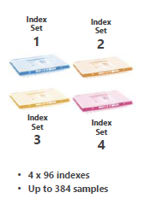
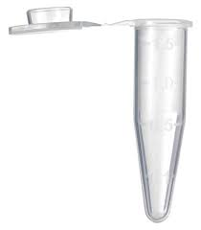
STEP 2
1
Pooling &
Purification of Libraries
Pool libraries from each 96-well plate into an Eppendorf tube
Libraries of optimal size are then bound to magnetic beads, and fragments that are too small or large are wash away (80% EtoH)
2
3
4

Slide 6
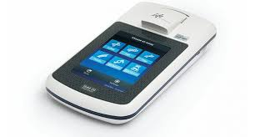
STEP 3
Quantification & Normalization of Libraries
Quantification of library pool using a Qubit dsDNA HS Assay kit.
ng/ul
1 2 3 4
Fragment analysis using TapeStation 4200
350 bp
Final Concentration = 4nM

Slide 7
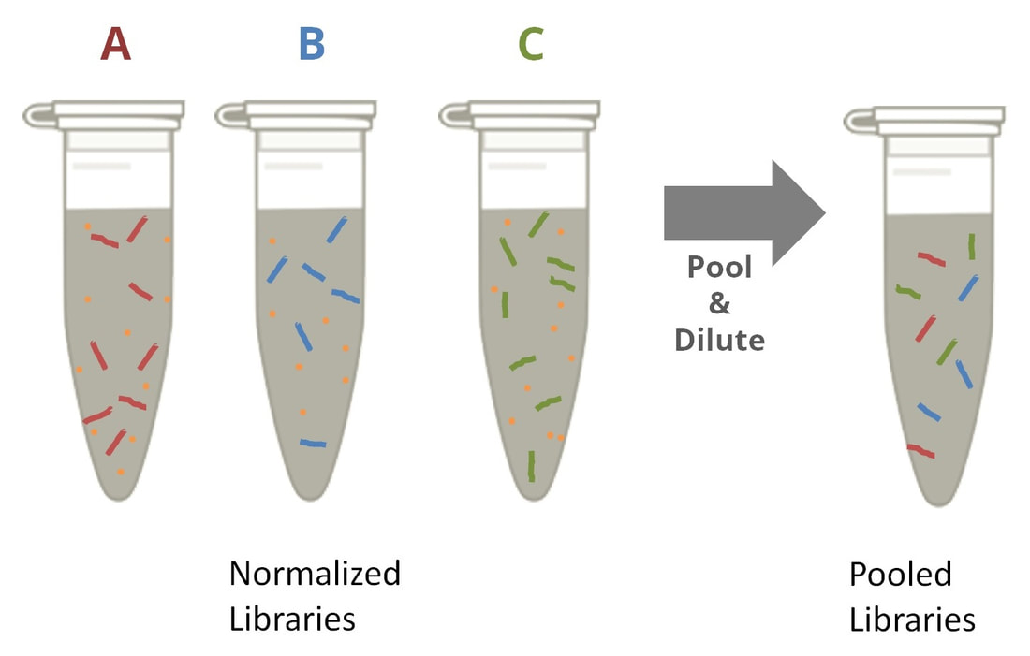
STEP 4
1 2 3 4
Pooling of normalized Libraries
Pool normalized libraries into 1 tube
This step produces a final pool of 384 samples diluted to a starting concentration of 4 nM
Libraries are ready to be denatured and diluted to the final loading concentration (1.4 pM)

Slide 8
STEP 5
Sequencing
Final Concentration | 1.4
 | pM (µL)
20 pM denatured DNA library | 91
Pre-chilled HT1 | 1207
20 pM PhiX* control spike-in (2%) | 2
Total Volume | 1300
Denaturation
Pooled libraries are denatured (0.2N NaOH) to create single strands ready for sequencing
Dilute denatured libraries to 20 pM using Hybridization Buffer
The 20 pM is further diluted to 1.4pM
*PhiX- well-characterized bacteriophage genome

