Slide 1

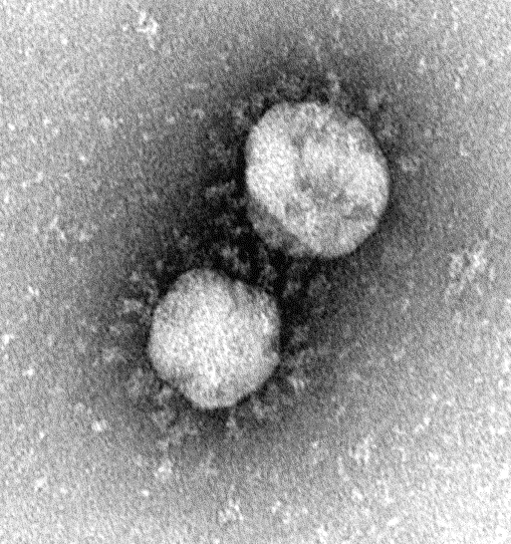
SARS-CoV-2 genomic surveillance
From respiratory sample to SARS-CoV-2 genome
17 May 2021
SEQAFRICA Module 3
Jinal N. Bhiman, PhD
Centre for Respiratory Diseases and Meningitis,
National Institute for Communicable Diseases,
A division of the National Health Laboratory Service
Image: Monica Birkhead, CEZPD, NICD

Slide 2
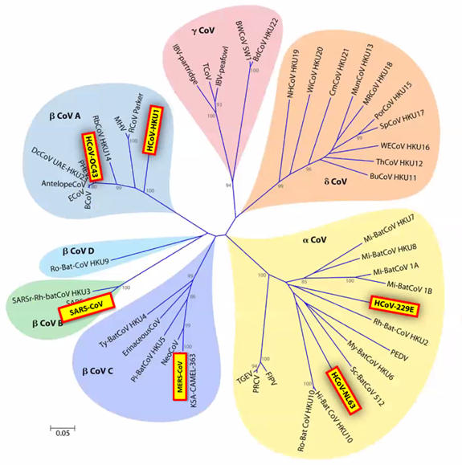


Coronavirus phylogeny
Nidovirus family
Coronaviridae
  Alpha, beta and gamma
  Single strand positive sense RNA
  26-32 kbp genomes
Human coronaviruses pre-2019
  Common cold coronaviruses “CCC” (HKU1, OC43, 229E, NL63)
  SARS-CoV and MERS-CoV
Chan et al 2015 Clin Micobiol Rev

Slide 3
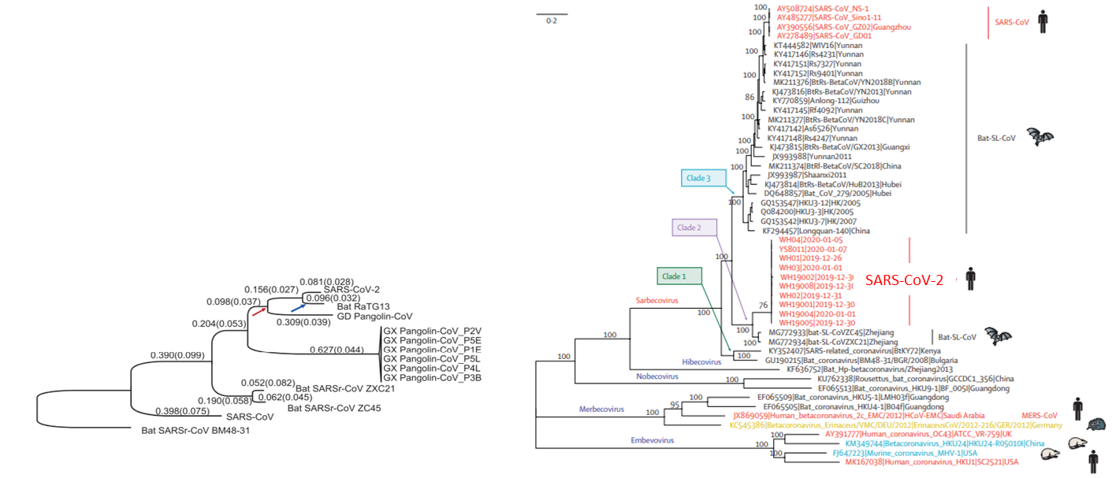
SARS-CoV-2 origin and animal reservoir
Zoonotic origin
80% sequence identity to SARS-CoV-1
Most closely related to bat or pangolin betacoronaviruses (>95% similarity)
Lu et al 2020 Lancet, Tang et al 2020 Natl Sci Rev

Slide 4
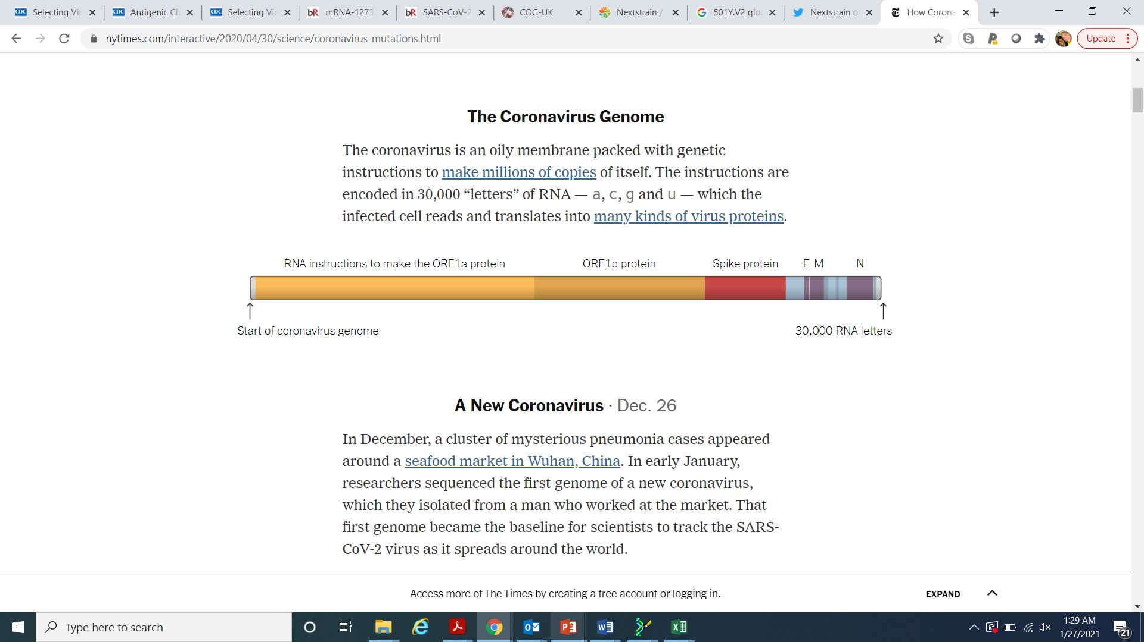
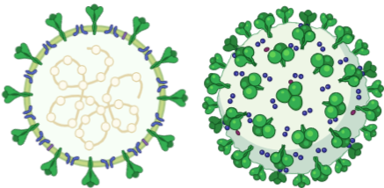
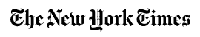
SARS-CoV-2 genome
SARS-CoV-2 genome encodes 29 viral components
  4 structural proteins, 16 non-structural proteins, 9 accessory proteins
Spike (S)
Membrane (M)
Nucleocapsid (N)
Envelope (E)
Created with BioRender.com

Slide 5
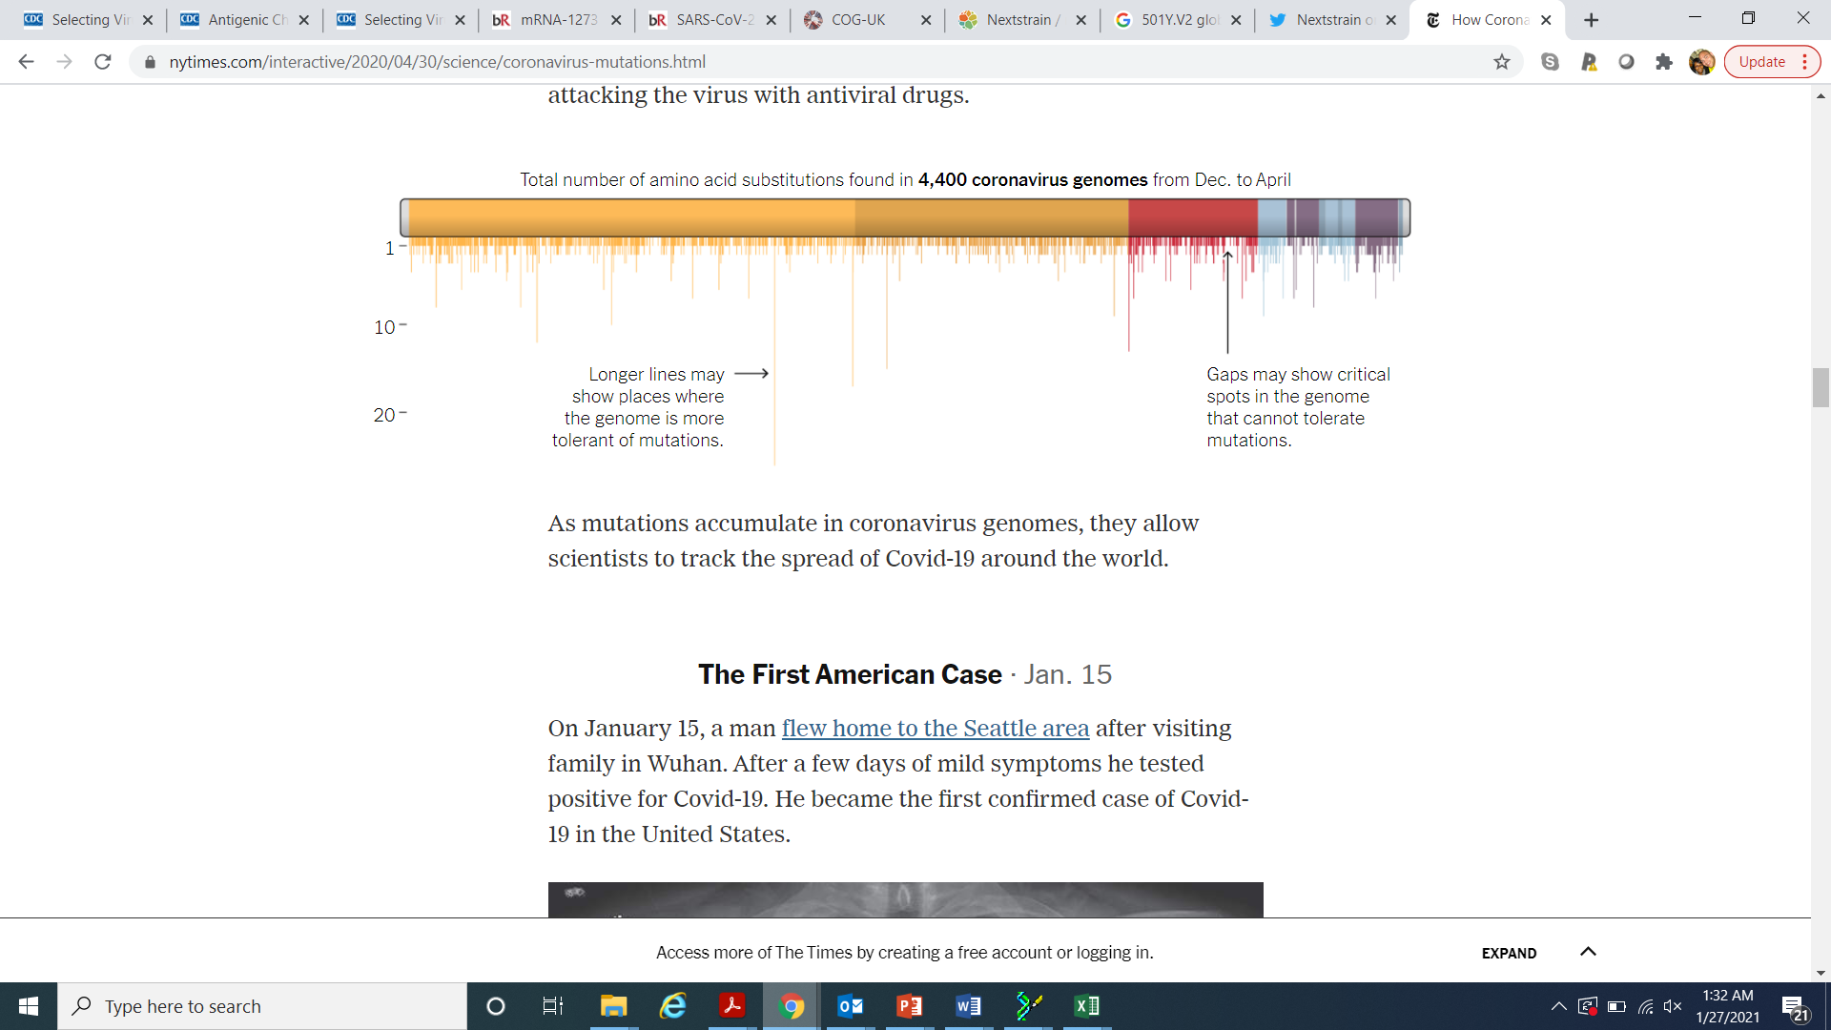
SARS-CoV-2 evolution
SARS-CoV-2 is in a continual state of evolution
Mutations occur regularly during the viral replicative cycle
  1 change per week
  Substitution rate of 0.00084 per site per year (half that of influenza A and a quarter that of HIV-1)
Most of the changes have not conferred a selective advantage
Mutations » viral diversification » classification
Number of mutations

Slide 6
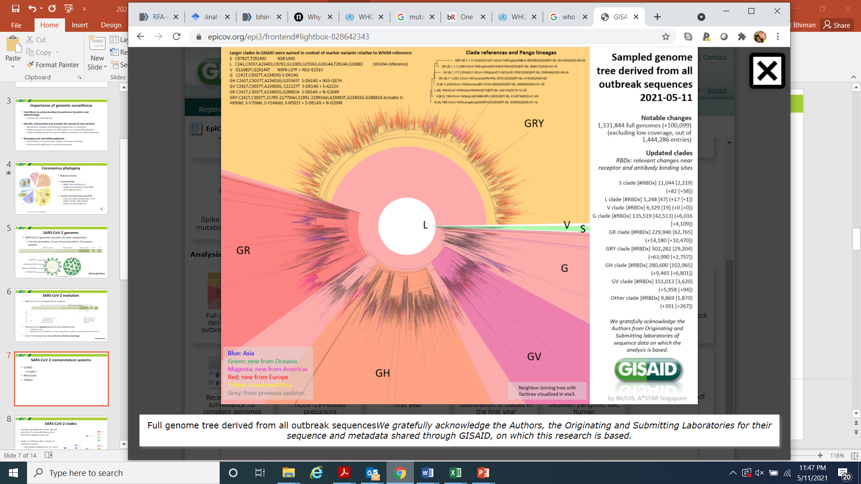
GISAID SARS-CoV-2 nomenclature
Global Initiative on Sharing All Influenza Data
8 main clades
Clades assigned based on marker variants relative to original Wuhan Hu-1 sequence

Slide 7
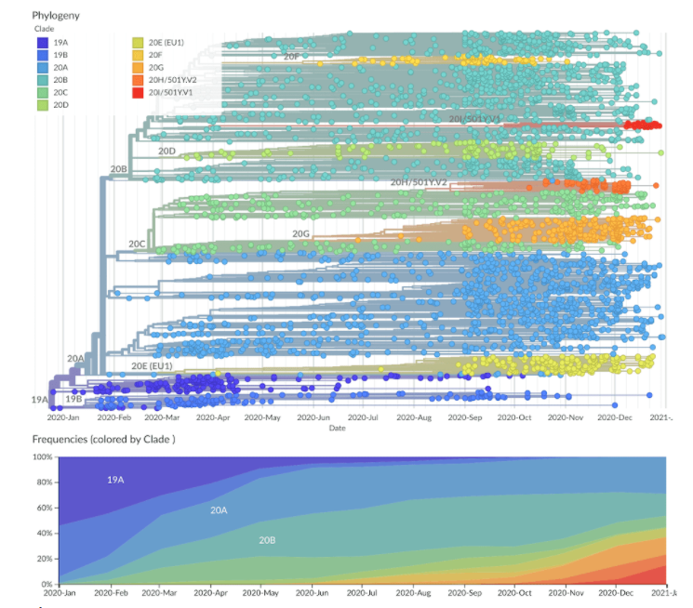
Nextstrain SARS-CoV-2 nomenclature
9 main clades
A clade reaches >20% global frequency for 2 or more months
A clade reaches >30% regional frequency for 2 or more months
A VOC (‘variant of concern’) is recognized (applies currently to 501Y.V1 and 501Y.V2)

Slide 8
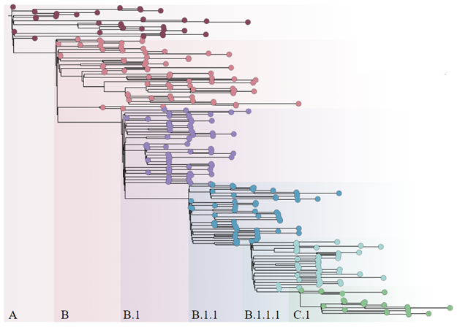
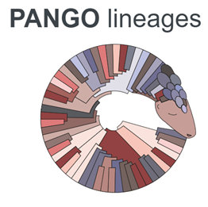
PANGO SARS-CoV-2 nomenclature
5 base lineages
  Over 1,000 sub-lineages
PANGO lineage = cluster of sequences associated with an epidemiological event
  introduction of the virus into a distinct geographic area with evidence of onward spread
Designed to capture the emerging edge of the pandemic and are at a fine-grain resolution suitable to genomic epidemiological surveillance and outbreak investigation.

Slide 9
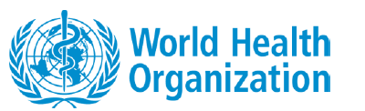
Variant of interest
Working Definition of “SARS-CoV-2 Variant of Interest”
A SARS-CoV-2 isolate is a variant of interest (VOI) if it is phenotypically changed compared to a reference isolate or has a genome with mutations that lead to amino acid changes associated with established or suspected phenotypic implications;
AND
has been identified to cause community transmission/multiple COVID-19 cases/clusters, or has been detected in multiple countries;
OR
is otherwise assessed to be a VOI by WHO in consultation with the WHO SARS-CoV-2 Virus Evolution Working Group.

Slide 10
Variant of concern
Working Definition of “SARS-CoV-2 Variant of Concern”
A VOI (as defined above) is a variant of concern (VOC) if, through a comparative assessment, it has been demonstrated to be associated with
  Increase in transmissibility or detrimental change in COVID-19 epidemiology;
  Increase in virulence or change in clinical disease presentation; or
  Decrease in effectiveness of public health and social measures or available diagnostics, vaccines, therapeutics.
OR
assessed to be a VOC by WHO in consultation with the WHO SARS-CoV-2 Virus Evolution Working Group.

Slide 11
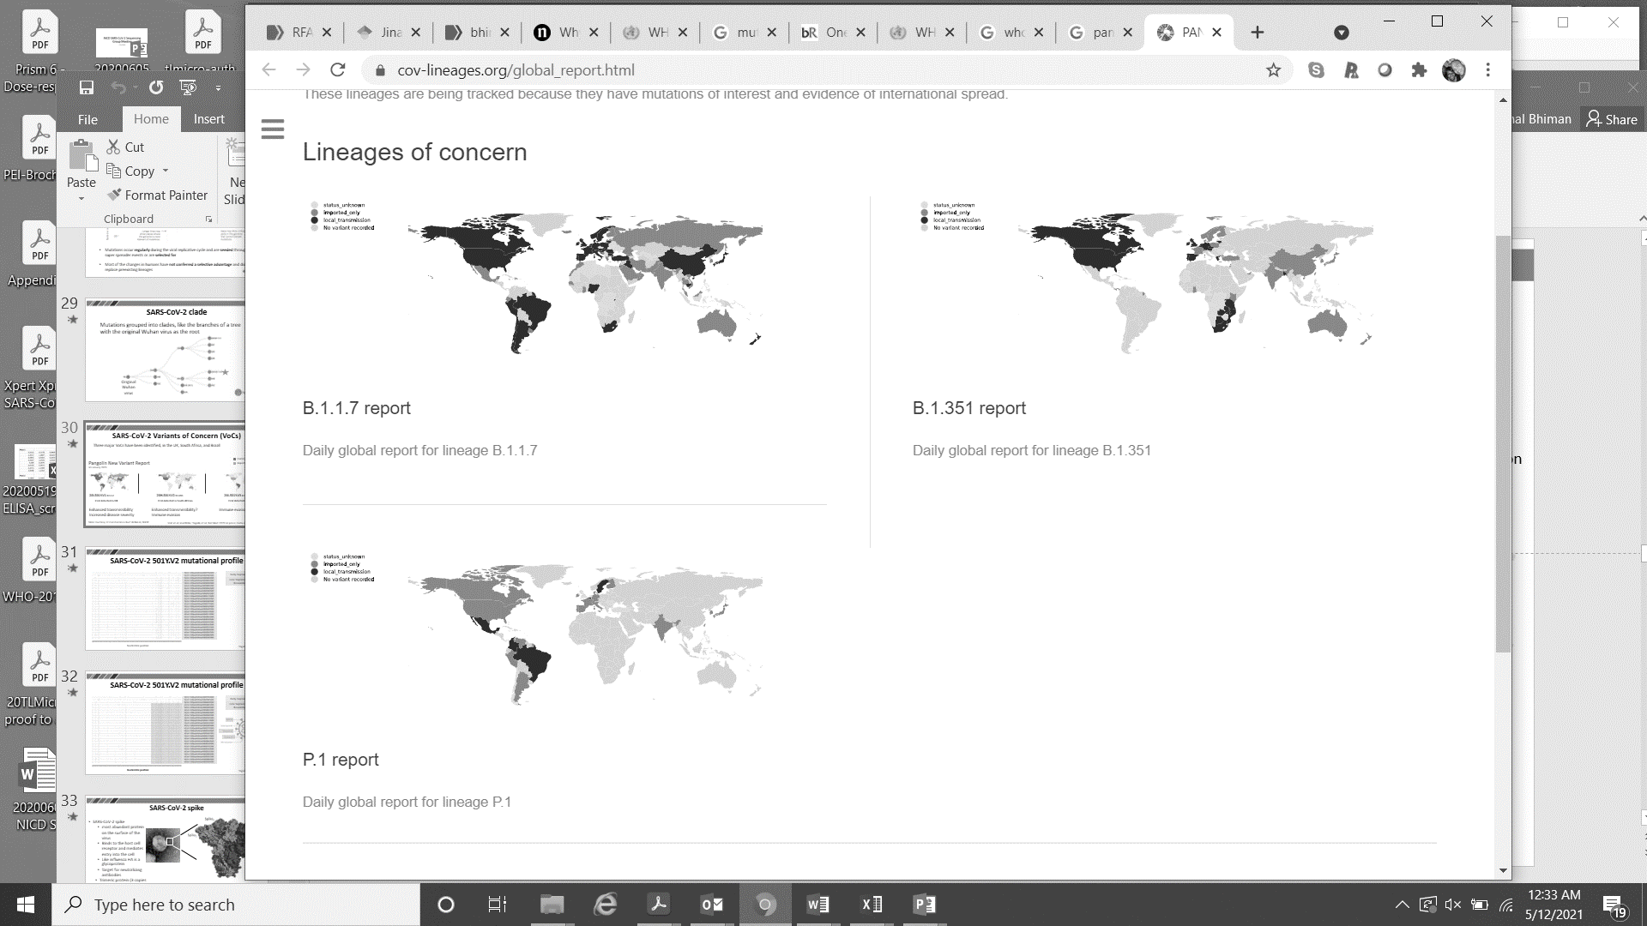
SARS-CoV-2 Variants of Concern (VoCs)
Three major VoCs have been first detected in the UK, South Africa, and Brazil
Community transmission
Lineage of concern
11 May 2021
Imported transmission
20I.501Y.V1 _{B.1.1.7}
20H.501Y.V2 _{B.1.351}
20J.501Y.V3 _{P.1}
First detected in UK
Now present in 124 countries
First detected in South Africa
Now present in 84 countries
First detected in Brazil
Now detected in 45 countries
Enhanced transmissibility
Increased disease severity
Enhanced transmissibility
Immune evasion
Immune evasion
Volz et al, medRXiv; Tegally et al, Nat Med 2021 in press; Faria et al, Virological

Slide 12
Variants of Interest (VOIs)
First detected in
  Multiple locations: B.1.525
  Brazil: P.2
  Senegal/Gambia: B.1.416
  US: B.1.526, B.1.526.1, B.1.427 and B.1.429
  India: B.1.617, B.1.617.1, B.1.617.2 and B.1.617.3
    B.1.617.2 under consideration for classification as a VOC

Slide 13
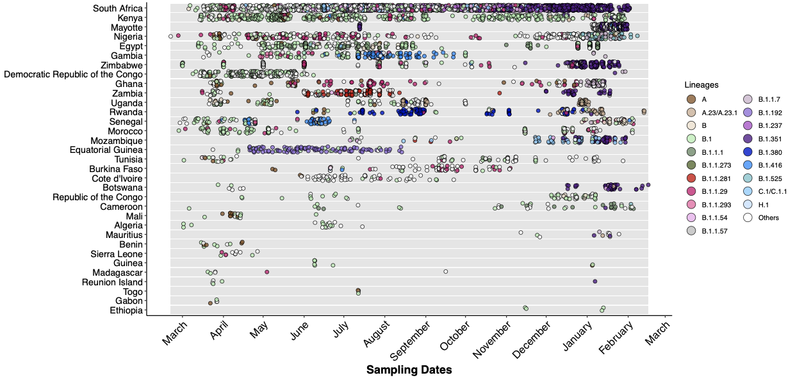
Temporal sampling of viral genomes in Africa

Slide 14
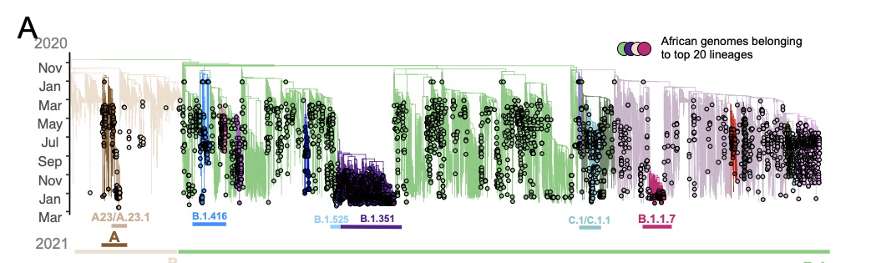
Major diversity of lineages in Africa
Maximum likelihood tree topology containing 8,214 high quality African genotypes analyzed against a backdrop of global reference sequences. Variants of interest and concern are highlighted on the phylogeny.
Slide courtesy of Tulio de Oliveira

Slide 15
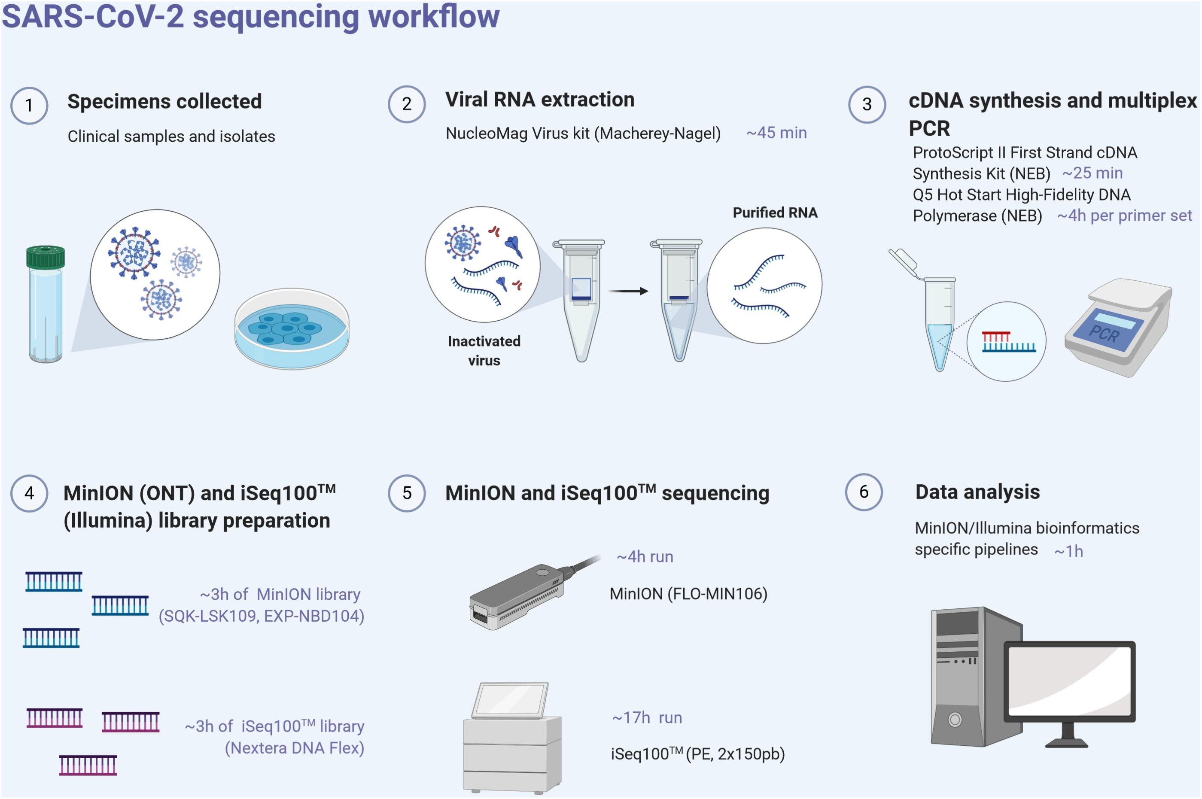

Wet lab sequencing method
1
2
3
SARS-CoV-2 PCR⁺ respiratory specimen
RNA extraction
QIAamp viral RNA mini kit
cDNA synthesis and tiling PCR
SuperScript IV
Q5 Hot Start High Fidelity
OR COVIDSeq
4
5
Library prep
Nextera DNA Flex
OR
COVIDSeq
Sequencing
Illumina NextSeq
Figure adapted from Hourdel et al, Frontiers in Microbiology, 2020

Slide 16
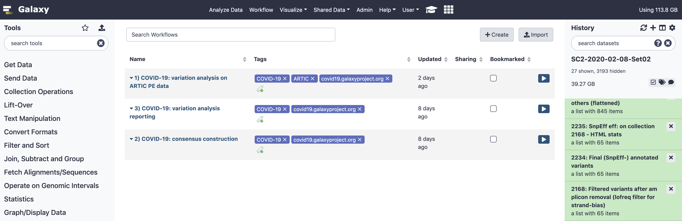
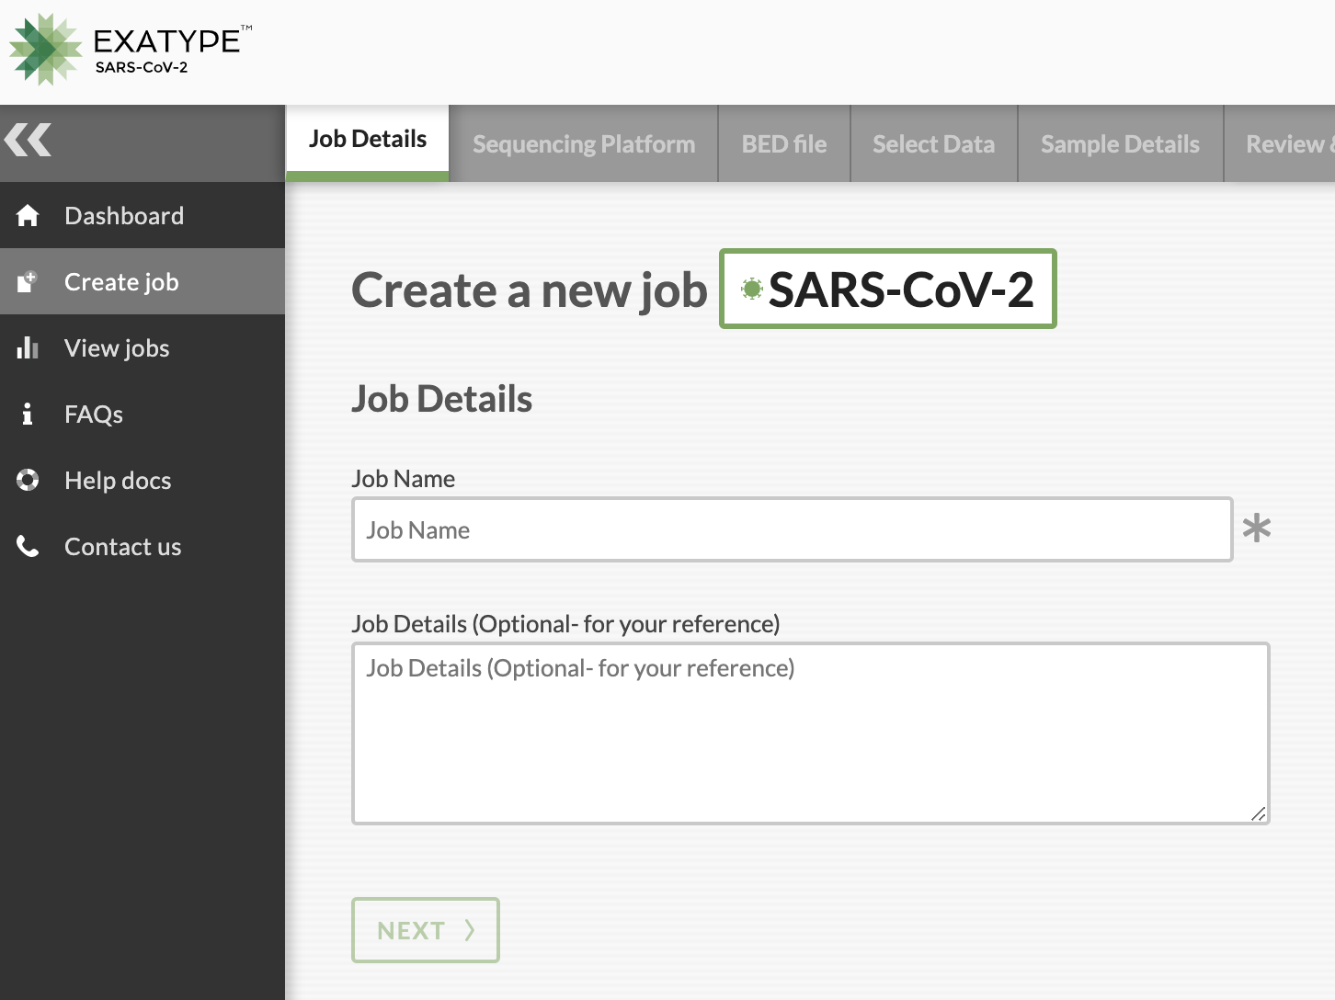
Bioinformatics sequencing method
Galaxy pipeline (online or local)
1
Variant calling
Consensus fasta file generation
Clade assignments and identification of mutations
2
External online (Exatype) pipeline
3

Slide 17
Galaxy vs Exatype workflows
Overall similar outputs

Slide 18
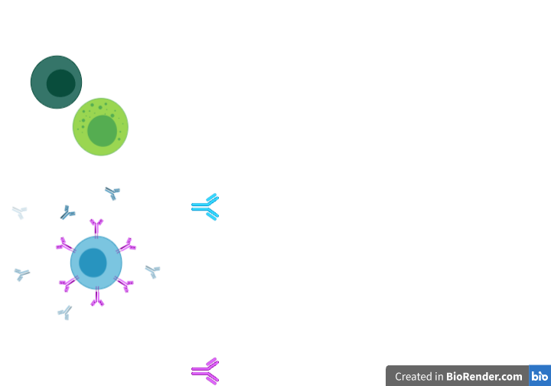
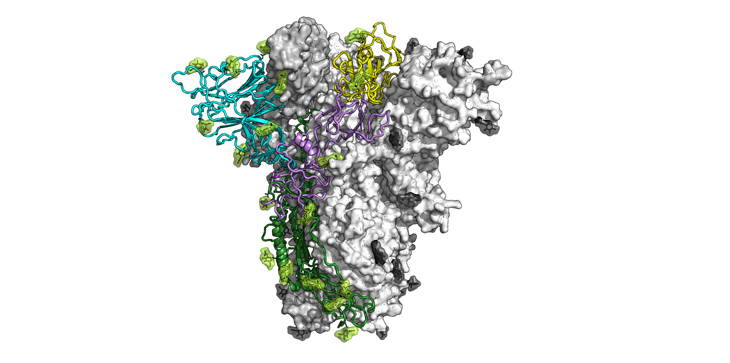
Immunodominant neutralizing targets spike
Receptor Binding Domain
RBD
N-Terminal Domain
NTD
Slide courtesy of Constantinos Kurt Wibmer, NICD

Slide 19
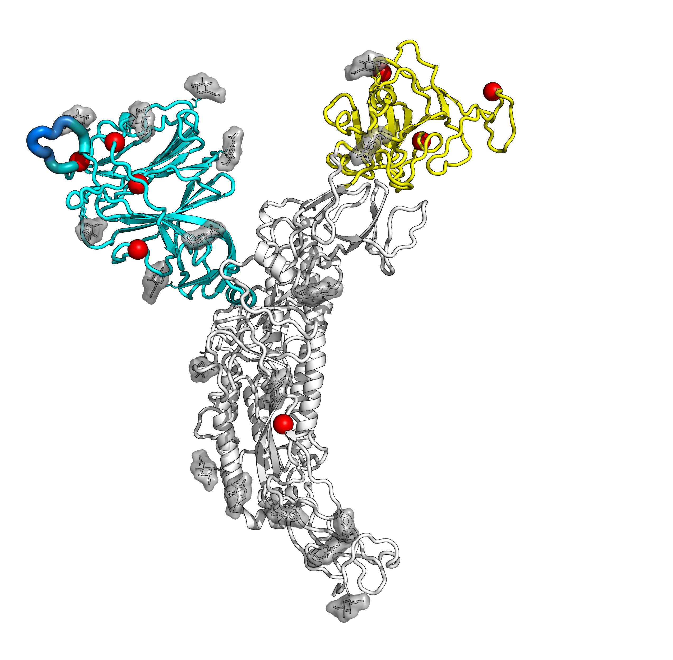
Mutations Specific to 501Y.V2 (B.1.351)
NTD
N501Y
E484K
L18F
K417N
R246I / Δ242-244
D80A
RBD
D215G
D614G
A701V
Slide courtesy of Constantinos Kurt Wibmer, NICD

Slide 20
Importance of genomic surveillance
Contribute to understanding transmission dynamics and epidemiology
  Estimate R0, outbreak size
Identify, characterize and monitor the spread of new variants
  Mechanistic changes and biological implications of mutations
  Preliminary data on impact on effectiveness of vaccines/therapeutics
  Understanding changes in transmissibility and impact on clinical outcomes
Managing and controlling epidemic
  Identification of transmission clusters and virus mutations
  Informing the updating of vaccine immunogens

Slide 21
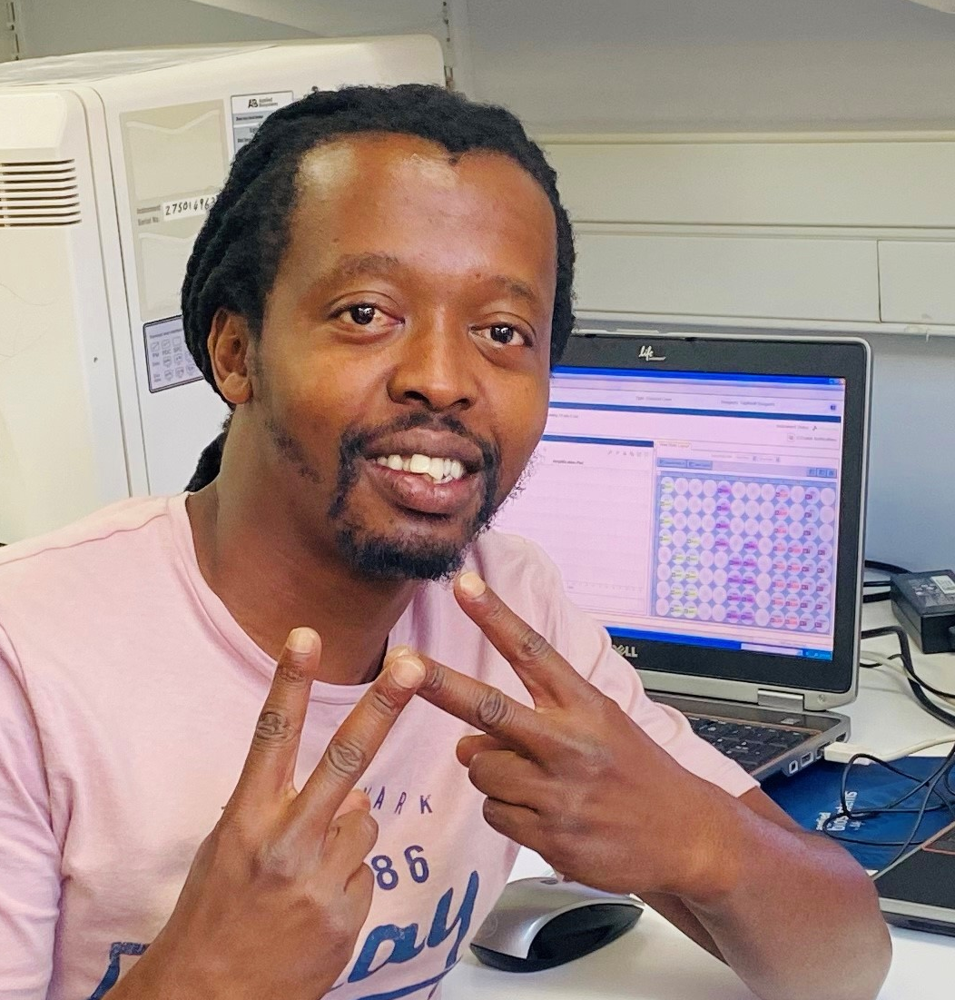




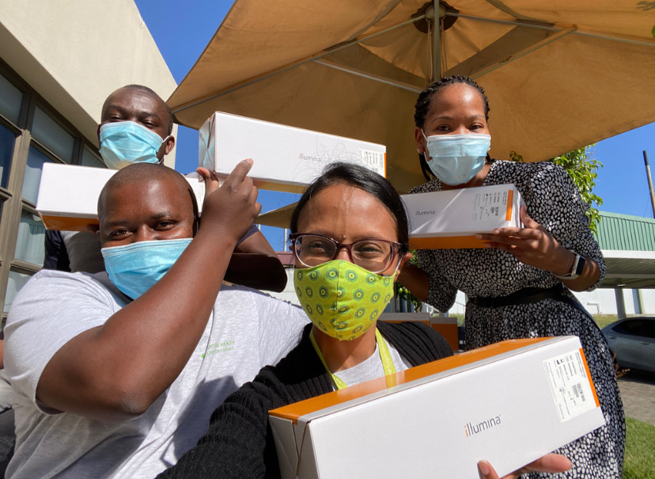

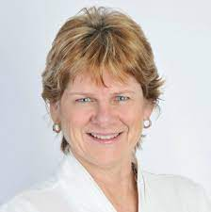
Acknowledgments
Thabo Mohale Arshad Ismail Cathrine Scheepers Mushal Allam Stanford Kwenda
Daniel Amoako
Noxolo Ntuli
Boishoko Mahlangu
Anele Mnguni
Zamantungwa Khumalo
Amelia Buys
Linda de Gouveia
Noluthando Duma
NICD SARS-CoV-2 Sequencing Group
Anne von Gottberg Lynn Morris

Slide 22
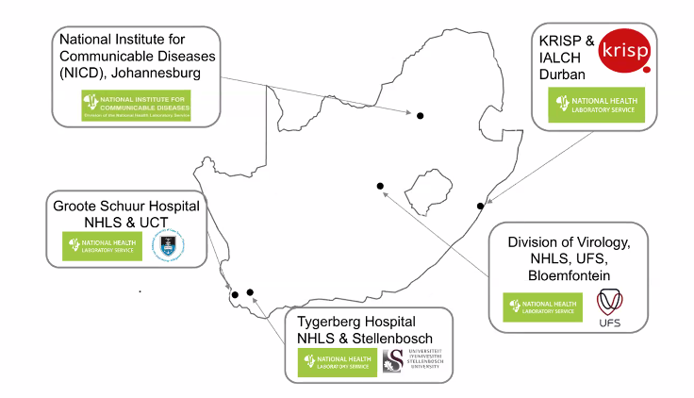







National sequencing collaborators and funders
NGS-SA
Adriano Mendes
Allison J. Glass
Andries Dreyer
Christa Viljoen
Elias Bereda
Eugenne Elliott
Florah Mnyameni
Florette K. Treurnicht
Gloria Selabe
Howard Newman
Jeannette Wadula
Kathleen Subramoney
Lia Rotherham
Marianne Wolfaardt
Marietjie Venter
Michaela Davis
Simnikiwe Mayaphi
Warren Lowman
Zinhle Makatini

