Slide 1
WGS workflow: from isolate to analysis – Day 4
Data sharing
29 March 2021
Pernille Nilsson

Slide 2
Virtual Housekeeping
Please turn off your cameras and microphones – this will help with bandwidth and maximise audibility.
Do frequently use Slack to share comments and ask questions. Keep the chat constructive, respectful and on topic!
For Q&A’s use Slack to submit your questions! Please upvote (give a thumbs-up) to the questions that you like.
The session is being recorded for distribution to participants as a post course resource as well as for future iterations of the course.
Notes:
Like for everyone, the COVID-19 pandemic presented many challenges for the Fleming Fund. We are primarily a programme focusing on bacteriology, so was there much we could do to support the response? And was it our place?
While we initially thought that there wasn’t much cross over between bacteriology and laboratory capacity, feedback showed that the programme’s inherent design and funding of activities have contributed to national pandemic responses. Grantees and governments reported renovating and upskilling laboratories, training staff and supporting cross-governmental collaboration were most useful.
In some country grants, like Nepal, Fleming Fund resources were used to support the COVID response directly, such as biosafety cabinets, PPE, a deep freezer, and even a microbiologist.
We also flexed specific grants, such as the Regional Whole Genome Sequencing Grant, to be used for the COVID response. This is a very exciting investment, because it means that genome sequencing is being used to track the spread of COVID-19 across Africa in real-time.
Fellows have also been working hard on the COVID response in their own countries, in addition to their Fleming Fund responsibilities.
“Although COVID-19 is not a focus of the Fleming Fund Country Grant in Timor-Leste, their team has indirectly helped the country respond to COVID-19. Strengthening the laboratory system, in particular the National Health Laboratory, has provided vital support to the Ministry of Health in their efforts to protect the health of the Timorese people.”
“Support from the Fleming Fund has helped increase sequencing capacity and analysis within the NICD. “Increasing sequencing in Africa is huge. There are many countries that haven’t done this before and now we can support them,” said Jinal. The Fleming Fund is also funding a bioinformatics scientist who will be able to help other countries interpret the genomics data.”

Slide 3
Agenda Monday 29nd March 09:00 – 11.15
Day 4: Monday – 29 March – Data sharing Link to Teams/Zoom/Platform
08.45 – 09.00 | Joining the call – Assistance will be provided at this time to help participants join
09.00 – 09.15 | Welcome and Introduction (Live)
09.15 – 10.15 | [11] Data sharing practices and repositories: Introducing how and where to make raw sequencing data and assembled genomes publicly available. GenBank (NCBI, ENA, Enterobase etc.) (Pre-recorded Lectures and Live demo). | Tolbert Sonda/Marco van Zwetselaar (KCRI, Tanzania) & Ayorinde Afolayan (UI, Nigeria)
10.15 – 10.30 | BREAK
10.30 – 11.00 | Going through results from all exercises (Live) | Shannon Williams (NICD, South Africa) Beverly Egyir (NMIMR, Ghana) Pernille Nilsson (DTU, Denmark) Anthony Smith (NICD, South Africa)
11.00 – 11.30 | Q&A and Wrap-up (Live)
11.30 – 11.45 | Concluding remarks and close (Live)
Lectures
Exercises
SurveyMonkey

Slide 4
[11] Data sharing practises and repositories Tolbert Sonda (KCRI, Tanzania) Marco van Zwetselaar (KCRI, Tanzania) Ayorinde Afolayan (UI, Nigeria)
ATCGAT
ATCGAT

Slide 5
BREAK
11:10 -11:20 CET

Slide 6
[2E] QC on DNA extraction Shannon Williams (NICD, South Africa) Beverly Egyir (NMIMR, Ghana)
ATCGAT
ATCGAT

Slide 7
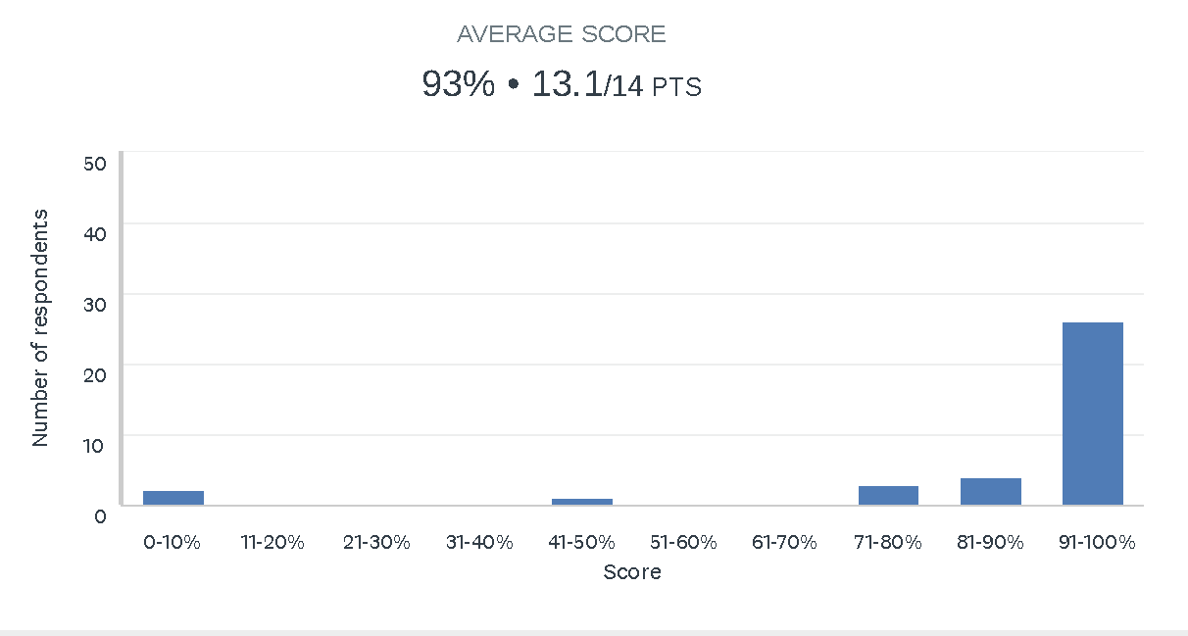
[2E] QC on DNA extraction
36 respondents

Slide 8
[5E] QC of sequencing data Pernille Nilsson (DTU, Denmark)
ATCGAT
ATCGAT

Slide 9
[5E] QC of sequencing data
27 individual respondents
4 FastQC reports
Basically 3 questions:
Would you exclude the read from downstream analysis?
If yes, for what reason (from list of options)?
If you chose to exclude, how would you proceed after reviewing the QC report (from list of options)?

Slide 10
[5E] QC of sequencing data
2 sequence files with bad/poor QC
Sequence Run 1 E.coli R1
Sequence Run 1 E.coli R2
2 sequence files with good QC
Sequence Run 2 E.coli R1
Sequence Run 2 E.coli R2

Slide 11
[9E] Exercise: Using Enterobase Anthony Smith (NICD, South Africa)
ATCGAT
ATCGAT

Slide 12
Q&A

Slide 13
Coursera E-learning
Antimicrobial resistance - theory and methods
21 short video lectures
https://www.coursera.org/learn/antimicrobial-resistance
Whole genome sequencing of bacterial genomes - tools and applications
19 short video lectures
https://www.coursera.org/learn/wgs-bacteria

Slide 14
The exercise surveys will be open until Friday 2 April 2021 12:00 PM CET
Access to video recordings of each day through Jottacloud
Course evaluation Survey
Survey Monkey
Certificates of attendance
Concluding remarks

Slide 15
Contact us for more information
seqafrica@food.dtu.dk
pnil@food.dtu.dk
(Pernille Nilsson, Project Manager)
rshe@food.dtu.dk
(Rene S. Hendriksen, Technical Lead)
antimicrobialresistance.dk/seqafrica.aspx
@AfricaSeq

