Slide 1
Introduction to Data Sharing
Tolbert Sonda, t.sonda@kcri.ac.tz
Data Management and Bioinformatics Unit
Kilimanjaro Clinical Research Institute, Tanzania

Slide 2
Learning objectives
To get an idea of data sharing and definitions
To understand the importance (goals) of data sharing in research
To describe practices hindering data sharing
To appreciate existence of data sharing legal frameworks

Slide 3
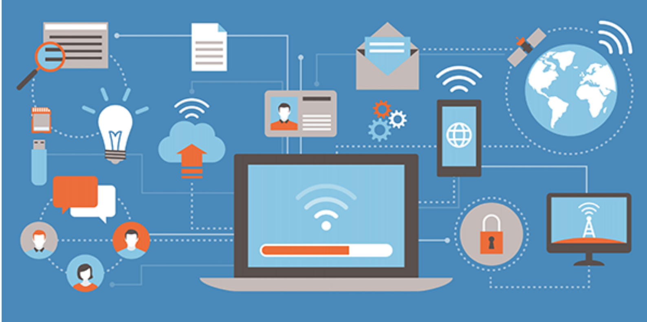
Data sharing concept
Terms involved:
Internet
Computers
Security
Institutions
Participants
Data files
Confidentiality
https://elementalcompliance.com/2019/06/11/voluntary-information-sharing-report-published/

Slide 4
Data sharing: Definitions
The practice of making data used for scholarly research available to other investigators https://en.wikipedia.org/wiki/Data_sharing
A collection of practices, technologies, cultural elements and legal frameworks that guide research data transfer between organisations digitally https://eudatasharing.eu/what-data-sharing

Slide 5
Data sharing adds VALUE to data
Full VALUE addition can only be achieved if data shared is FAIR:
Findable
Accessible
Interoperable
Reusable
Picture by PLOS One

Slide 6
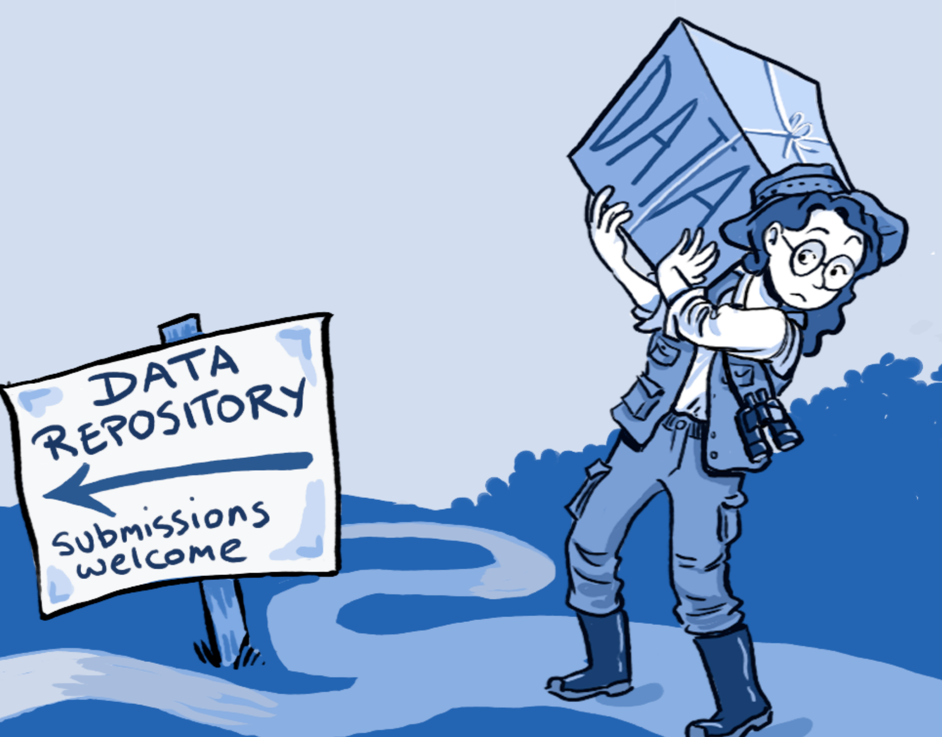
Data sharing barriers
Fears around intellectual property rights of data products, discoveries
Transparency, acknowledgement, and confidentiality of data use
Limited data skills in most developing countries https://pubmed.ncbi.nlm.nih.gov/20539861/
Legal frameworks: Data/Material Transfer Agreement (DTA/TMA)
https://en.wikipedia.org/wiki/Data_sharing

Slide 7
Data/Material Transfer Agreement (DTA/TMA)
Legal obligations of:
Data provider
Data recipient

Slide 8
DTA/TMA Legal Obligations
Provider
Transfer data immediately after signing DTA
Data remains owned by the PROVIDER
Provider liable for damages arising from use, storage and disposal of the DATA
Recipient
Agrees to use, store or dispose appropriately
No transfer or distribution to third party
Acknowledge data source in any publications
Recipient liable for damages arising from use, storage and disposal of the DATA

Slide 9
Conclusion
No individual scientist has all analytical methods, time and expertise to analyse all collected data
Unshared data is a good as a lost opportunity to transform scientific communication
The motive behind data sharing has to be working together and collaboratively

