Slide 1
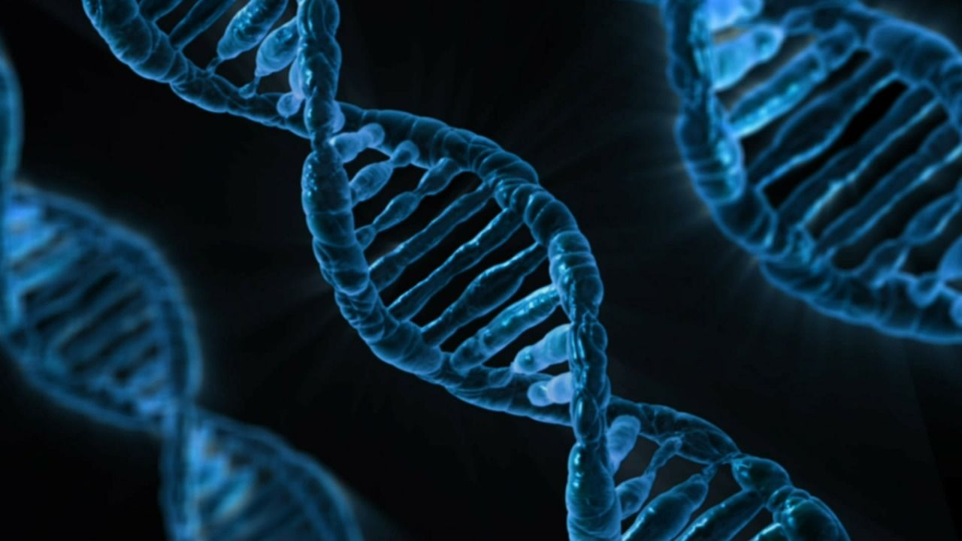
Module 2
Quantification DNA using Qubit Fluorometer
Beverly Egyir
Department of Bacteriology, Noguchi Memorial Institute for Medical Research, University of Ghana, Legon-Accra
22/03/2021

Slide 2
Quantification of DNA is a critical step to ensure optimal performance of the downstream processes of genotyping and NGS.

Slide 3
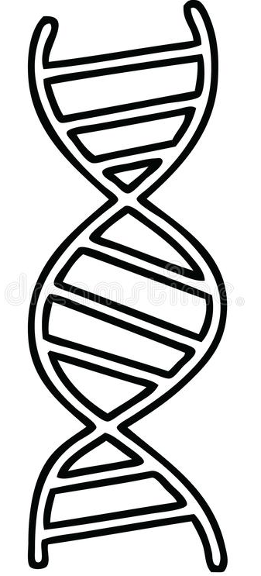
How does the the Qubit Fluorometer Work?
Fluorescent Dyes
/Fluorescent molecules
DNA-Dye complex emits Fluorescence
Photodetector picks up photo-signal
DNA
Credits:
Flow chart by
Frank Oteng, NMIMR, UG

Slide 4
Quantification of DNA using Qubit Fluorometer:
What do you need?
Extracted DNA sample
Working solution (contain the dye)
Standards (1 and 2)

Slide 5
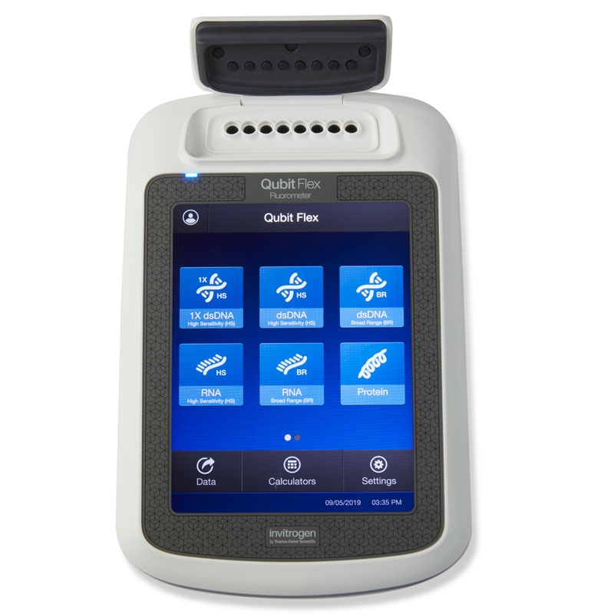
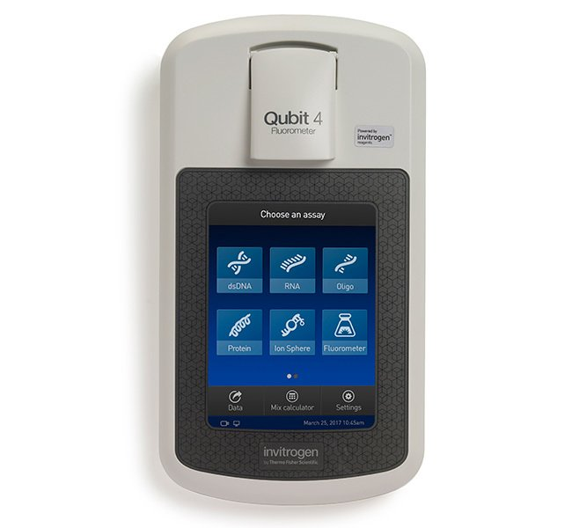
QUBIT Fluorometer
It can be used for the quantification of
dsDNA
RNA
Proteins
QubitFlex (multiple read per time)
Qubit 4 (single read per time)

Slide 6
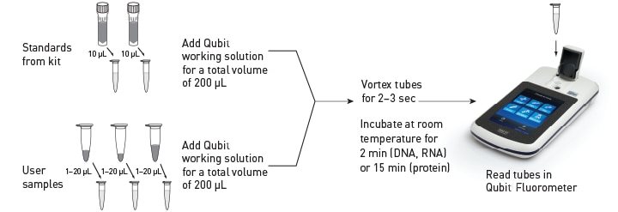
The Process: using Qubit Fluorometer
All reagents must be at room temperature before use

Slide 7
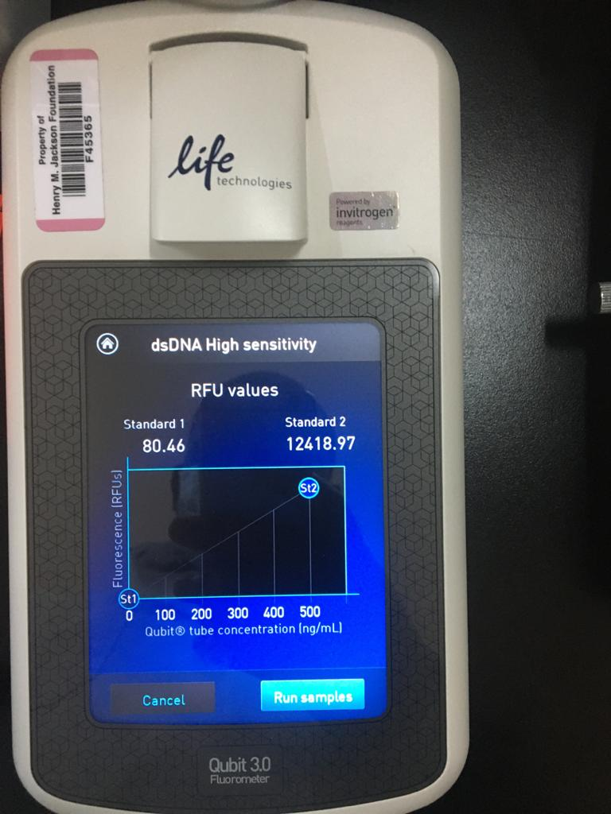
Standards output

Slide 8
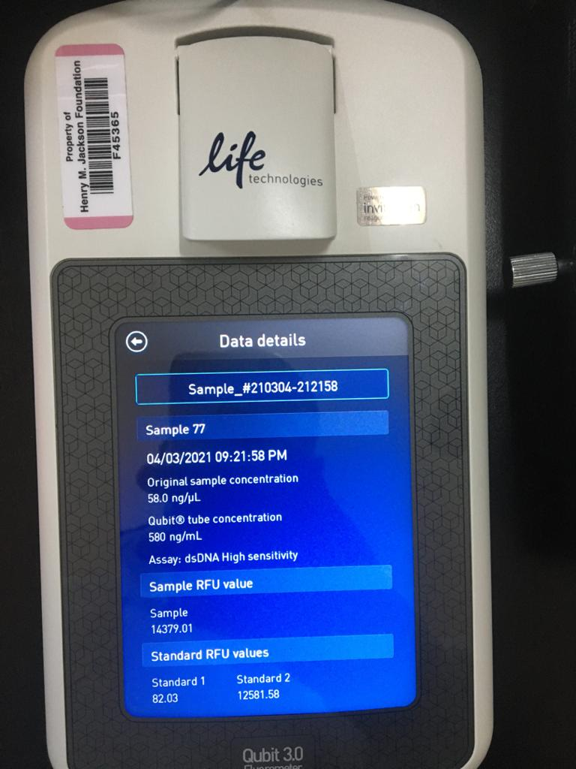
DNA concentration :good
Sample with DESIRED concentration
Dependent on library kit specifications.

Slide 9
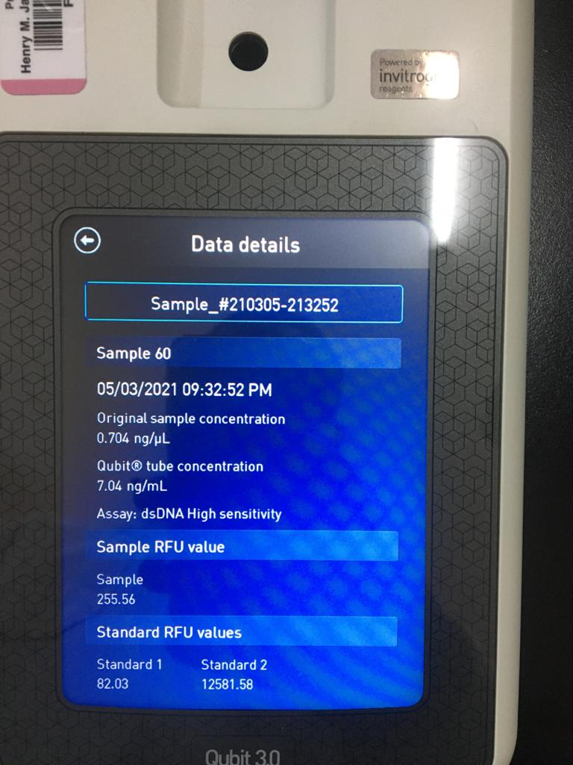
DNA concentration : low
Sample with
LOW concentration
Too low samples will have to re-extracted

Slide 10
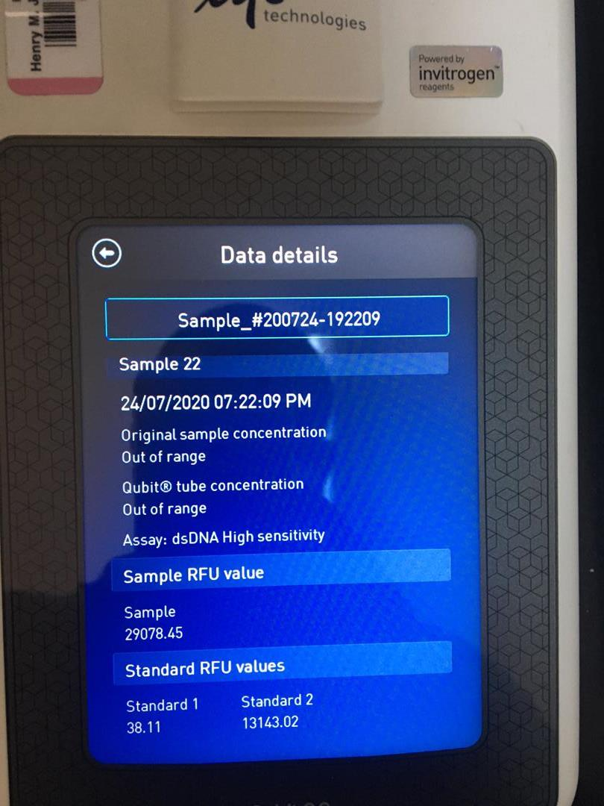
DNA concentration: out of range
Sample that cannot be quantified.
Samples with concentrations outside the limits of the standard will be out of range.
Out of range sample should be diluted and re- quantified

Slide 11
Advantages of qubit over nanodrop
It can measure intact dsDNA only unlike the nanodrop spectrophotometer.
The Qubit fluorometer is more accurate in measuring DNA than the nanodrop
The Qubit is also more sensitive (a sample containing as low as 10 pg/μl of DNA can be detected) than the nanodrop.

Slide 12
Note
Ensure that you are extracting DNA from pure colonies
Follow DNA extraction protocol diligently
The required DNA quantity (‘good’) is dependent on the library kit specifications or downstream activities.
https://www.youtube.com/watch?v=y7DLoGxg0k0
https://www.youtube.com/watch?v=gtSLkbaLlMU
https://www.youtube.com/watch?v=z5g6pAFAWEc

Slide 13
References
https://dna.uga.edu/qubit-2-0-fluorometer/
https://www.thermofisher.com/gh/en/home/industrial/spectroscopy-elemental-isotope-analysis/molecular-spectroscopy/fluorometers/qubit/qubit-fluorometer.html
https://www.selectscience.net/products/invitrogen-qubit-flex-ngs-starter-kit/?prodID=217168
https://ingenieriaybiotecnologia.com/new-qubit-products/

Slide 14







