Slide 1
Module 2 Introducing the workflow: Going from bacterial isolate to Genome- Synopsis of all the steps.
22 March, 2021
Anderson Oaikhena
Global Health Research Unit for Genomic Surveillance of Antimicrobial Resistance, University of Ibadan, Ibadan, Nigeria.

Slide 2
Objectives
Discuss all processes involved in Whole Genome Sequencing, from specimen collection to generation of genome sequences.
Importance of Metadata
Details and importance of each step
Quality Control metrics at each point

Slide 3
Overview
DNA Extraction, quantification and purity checks
Bacterial isolation, Identification, Antimicrobial susceptibility testing
Specimen/
Sample
collection
Metadata- Sample/
Isolate-related information
Library preparation: construction, indexing, amplification
Inferences
Library QC: qPCR, Fragment analyses.
Library pooling
Sequencing QC and analysis
Genome/Gene
Sequencing

Slide 4
Metadata
Collection of information relating to samples/isolate
Location of sampling
Patient demographics
Date and time of sampling and isolation
Isolate identity and characteristics
Antimicrobial susceptibility pattern
It is not possible to make extensive inferences about samples without comprehensive metadata
Metadata documentation is important and continuous- collected at all points, from sample collection to sequence analysis.

Slide 5
Specimen collection
Considerations for Specimen collection
Animal samples
Stool, blood, swabs, etc
Environmental samples
Waste water, hospital environment e.g sinks
Food, water
Water, food samples, soil, etc.
Human clinical samples
Blood, stool, cerebrospinal fluid, urine, etc.
Safety considerations
Biosafety equipment
Patient confidentiality
Metadata
Information relating to sampling location, type, source, etc
Sample transport
Biosafety
containment

Slide 6
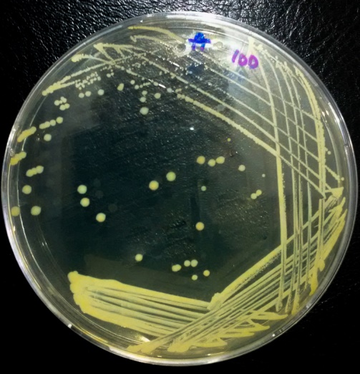
Bacterial isolation and Identification
Cultures consisting of isolates from a single colony
Streaking, pour plating, spreading
Identification
Conventional
Gram reaction
Colony morphology
Manual and semi-automated biochemical tests
MALDI-TOF
16S rRNA sequencing
Isolate storage
Short term: Slants, refrigeration
Long term: freezing, ultra freezing.
Transportation of isolates: within facility, across facilities and geographical locations.
Biosafety considerations

Slide 7
Antimicrobial Susceptibility Testing (AST)
Phenotypic methods
Disc diffusion
Broth microdilution
E-test
Semi-automated methods: Vitek/Phoenix

Slide 8
DNA Extraction
Phase separation: Phenol-chloroform extraction
Commercial kits: Several different kits but similar principles
Cell lysis
Separation of cell debris from nucleic acid
DNA isolation, purification and suspension
Different methods:
Mechanical lysis
Chemical lysis
Enzymes
Centrifugation
Chemicals
Ions
RNA degradation
Isopropanol/Ethanol
Membrane microcolumns
Magnetic beads
TE buffer/water

Slide 9
DNA Extraction QC: Quantity and Quality
Easy to conduct but data is not precise enough for fine analysis
Useful to infer DNA presence or absense
Useful for detecting contamination by protein, phenol, RNA
Outputs reliable DNA quantification
Requires expensive reagents
Unreliable for DNA quantification
Gel Electrophoresis
Absorbance
Fluorescence

Slide 10
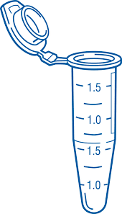
Library Preparation
Library: Total genomic DNA in the form of small pieces, usually originating from a single source.
Fragmentation
Adaptor ligation
Size selection
DNA fragments
Fragments with adaptors
Genomic DNA
Amplification
Fragment analysis
Library pool
Amplified library

Slide 11
Sequencing
Sanger sequencing- chain termination method
Shotgun sequencing
Next generation sequencing
Sequencing by synthesis- Illumina
Nanopore sequencing- Oxford Nanopore Technologies
Single molecule real time sequencing- PacBio
454 pyrosequencing- Roche
Semiconductor sequencing- Ion torrent

Slide 12
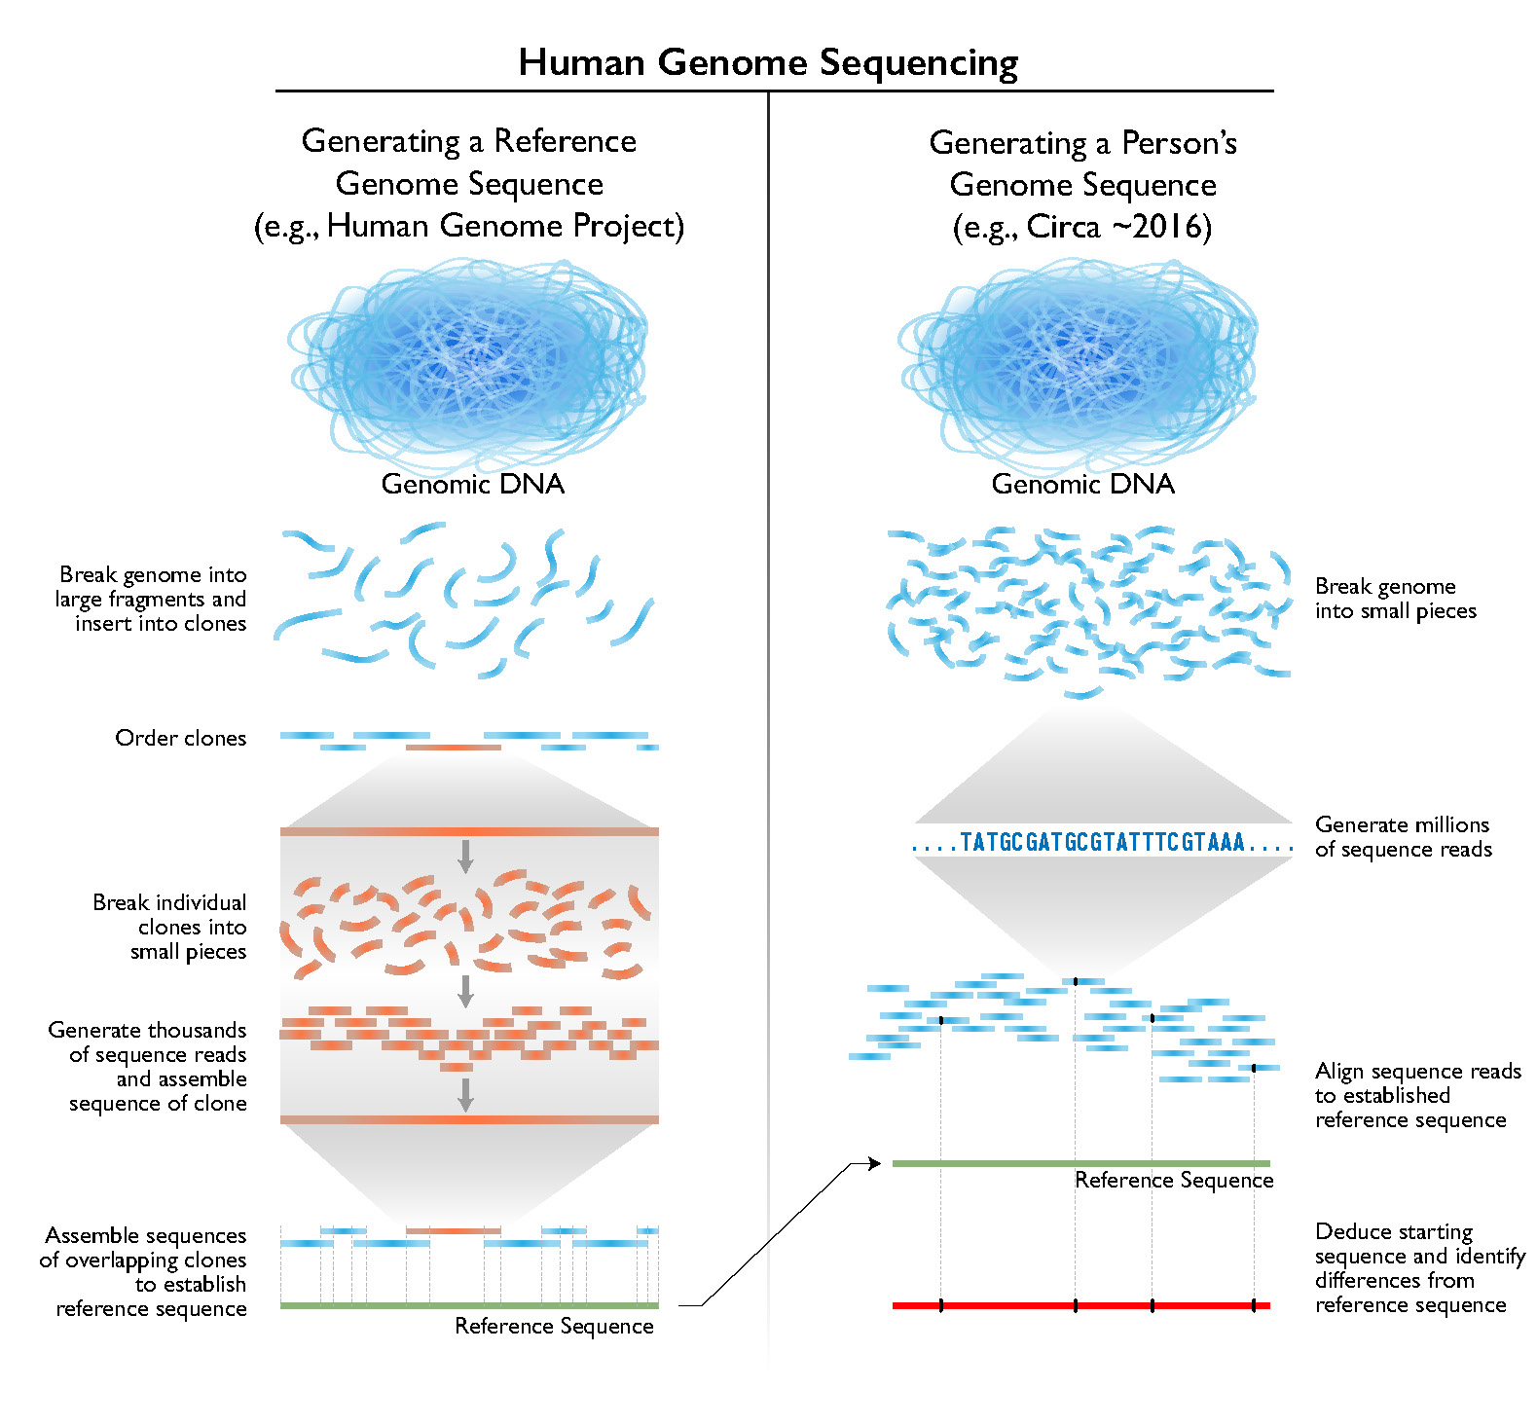
Sequencing
Generating reference genomes
Sequencing individual genomes

Slide 13
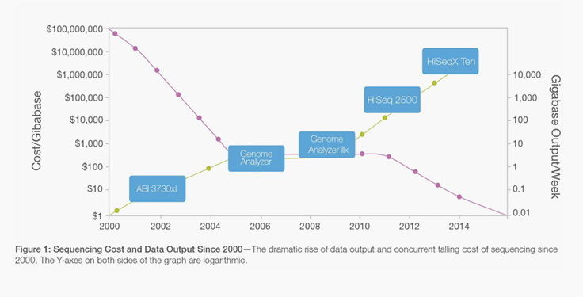
Merits of Next generation sequencing

Slide 14
Post Sequencing
Sequencing QC
Depth/Coverage
Size of output
Demultiplexing
Assembly
Sequence analysis/Bioinformatics
Inferences
Bioinformatic findings
Metadata

