Slide 2
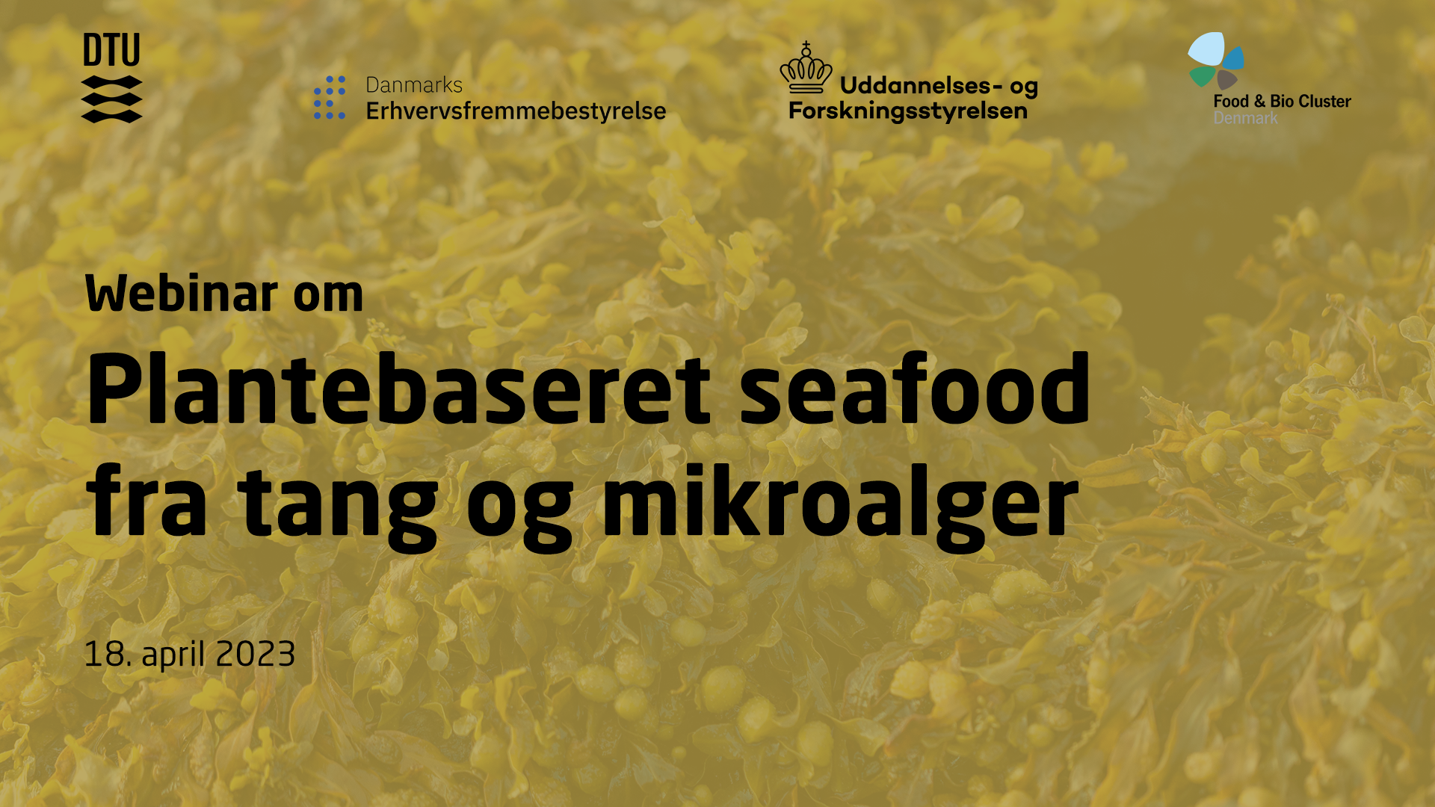

Slide 3
Tang og mikroalger som ”afgrøder”
Lektor Susan Løvstad Holdt og algeteam, DTU Fødevareinstituttet

Slide 4
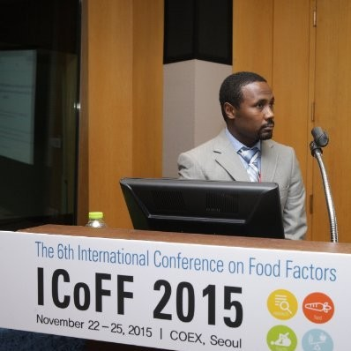
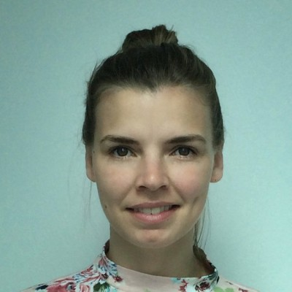
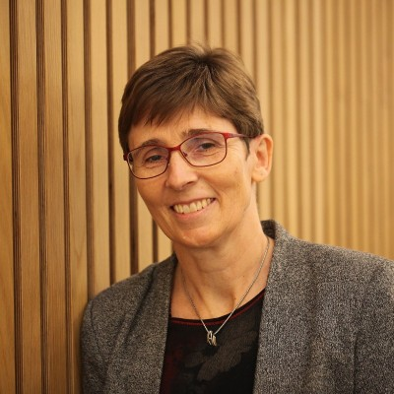
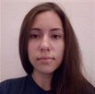
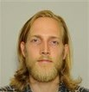
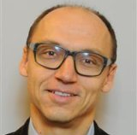
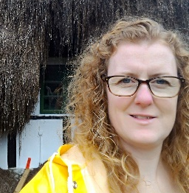
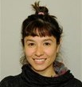
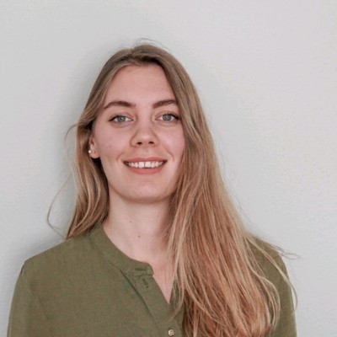
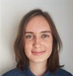
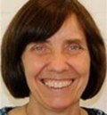
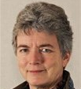
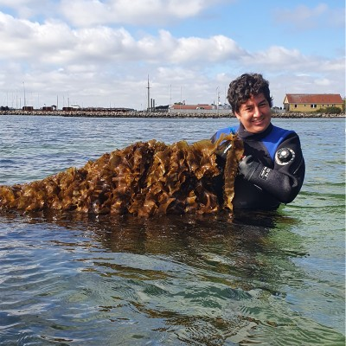
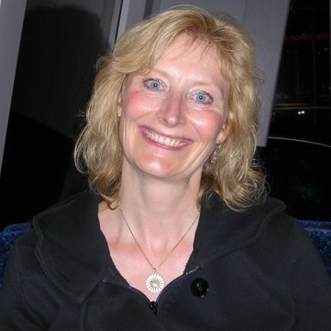
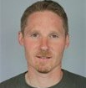
Algefolk fra DTU Fødevareinstituttet
Extraction, bioactivity, functional prop and application
Biomass optimization
Fermentation
Susan L. Holdt
suho@food.dtu.dk
Chair of the Seaweed Network in Denmark
Secretary General of the International Seaweed Association
Processing and shelf life
Chemical and microbial safety
Sensory and vitamins

Slide 5
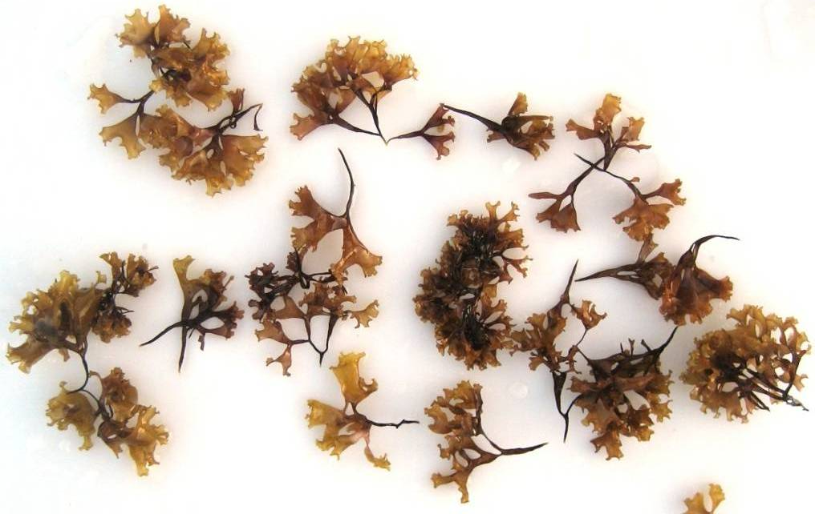
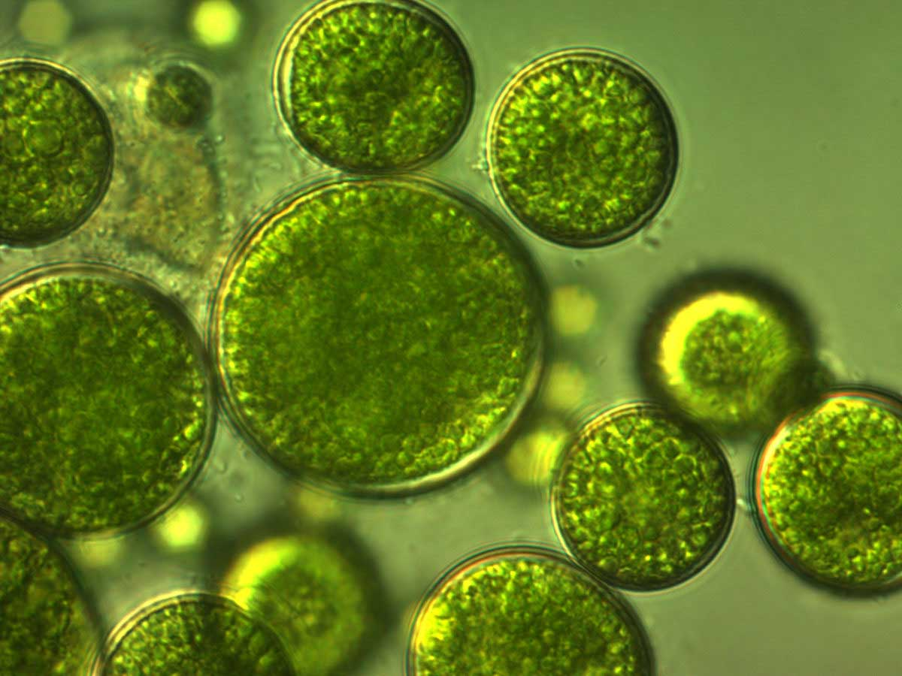
Menu
Tang og mikroalger som ”afgrøde” (dyrkning, høst, sæsonvariation, mv)
Novel food og lovgivning – hvad skal der til for at få godkendt nye fødevarer?

Slide 6
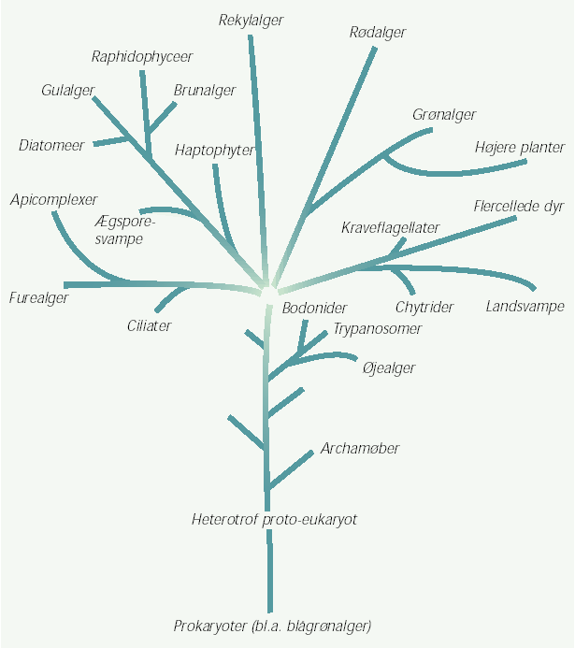
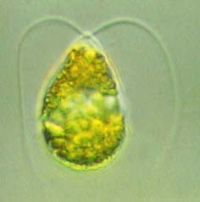
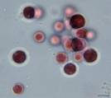
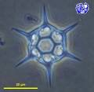
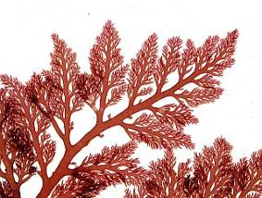
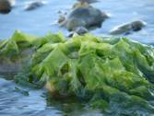
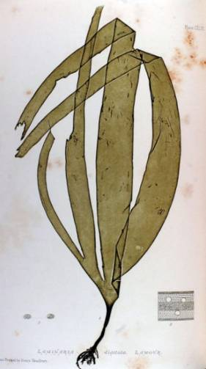
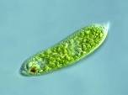
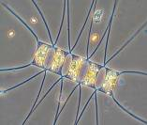
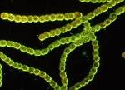

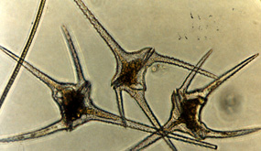
Diversitet
Figure 1

Slide 7
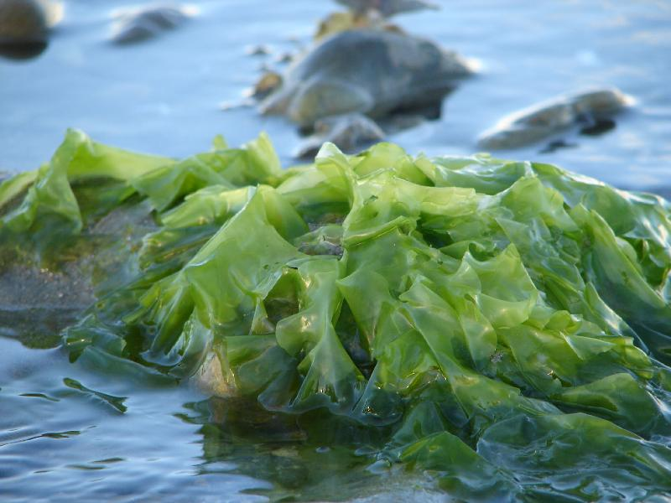
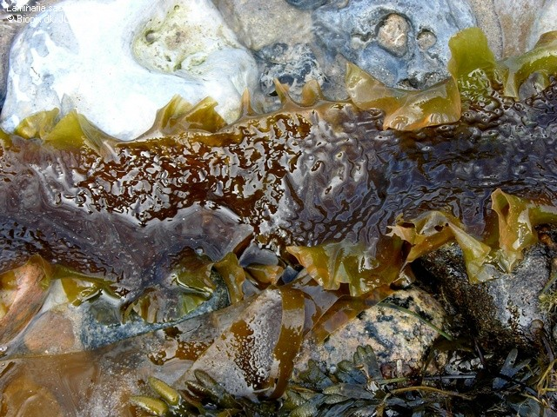
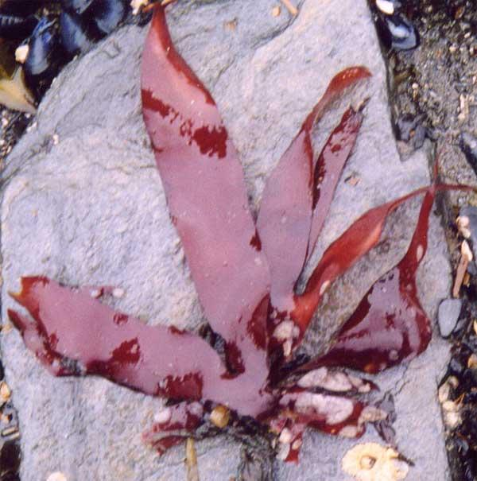
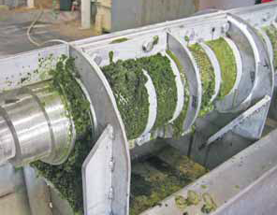
Mikroalger og tang
Pros
no need for land, fresh water supply or fertilizers (seaweed)
mitigation of CO₂, N and P
high photosynthetic efficiency
high productivity
use of entire crop
great source of bioactives/high-value functional ingredients
Cons
high water removal (~90%)
possible accommulation of heavy metals (PTE’s)
heterogeneous biomass (seaweed)
lack of specific processing technology
expensive
7

Slide 8
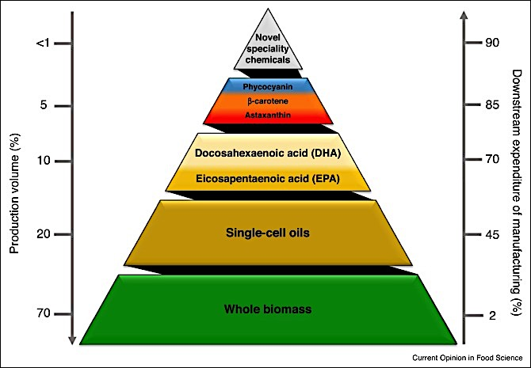
Produktion volumen, produkt værdi/udgifter
Pharma
Bioactives
Value
Lipids
Food
Feed
Energy

Slide 9
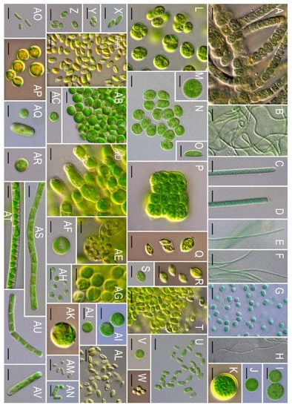
Mikroalger
Mikroalger er “fotosyntetiske” mikro-organismer (akvatiske eller terrestriske) Lysnergi til CO2 omdannes til biomass (str. få µm nogle hundrede).
Inkluderer også cyanobacteria (blågrønnealger), kiselalger og grønalger.
Ca. 200.000-800.000 arter i mange forskellige slægter af hvilke 50.000 arter er beskrevet
Microalgae represent a sustainable source of natural products. Over 15,000 novel compounds have been identified in microalgal biomass.

Slide 10
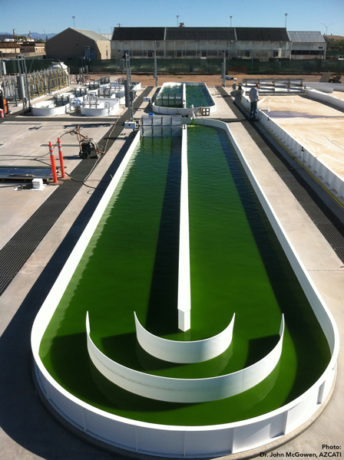
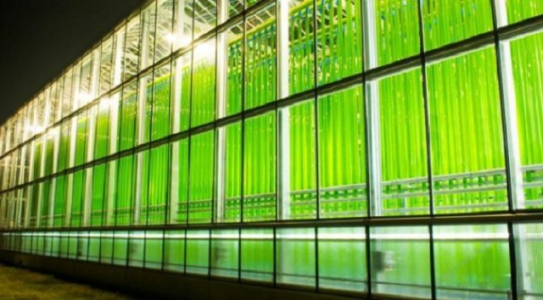
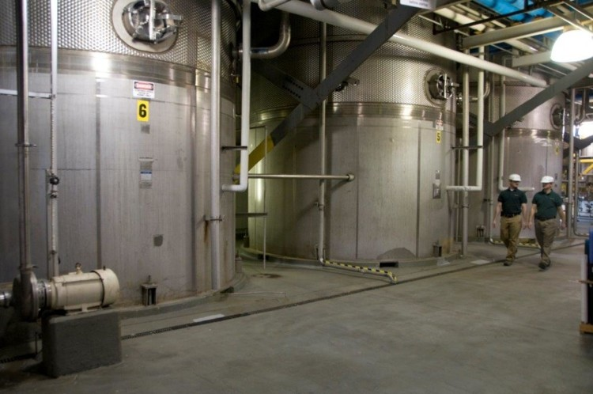
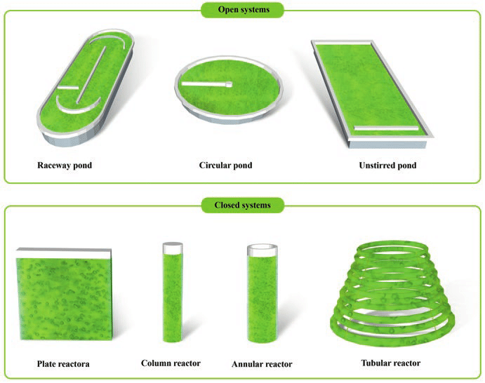
Dyrknings systemer for mikroalger
https://www.researchgate.net/figure/Examples-of-different-types-of-pond-systems-for-outdoor-microalgae-cultivation_fig4_333312797

Slide 11
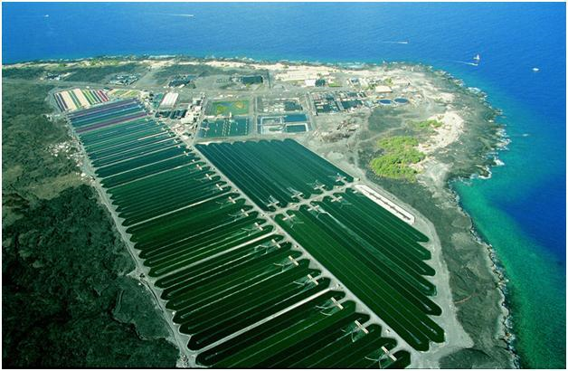
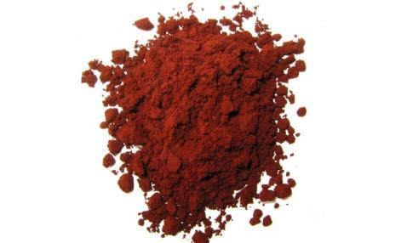
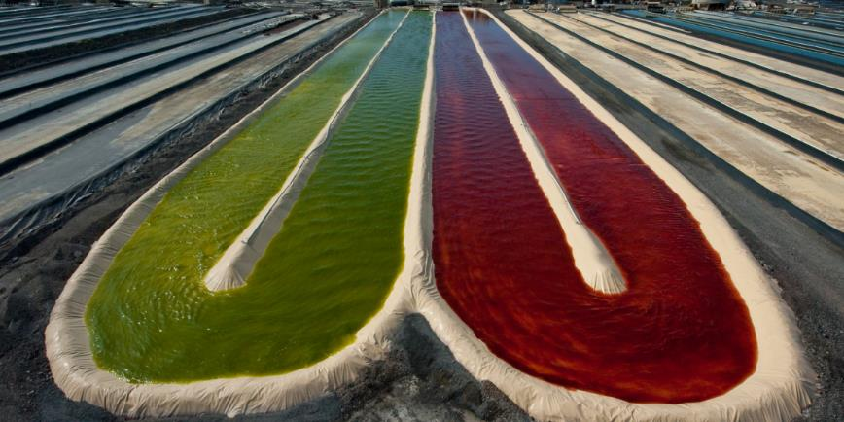
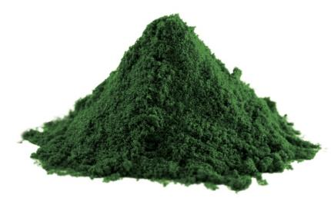
Cyanotech® Corporation, Hawaii
BioAstin® Hawaiian Astaxanthin®
Hawaiian Spirulina®

Slide 12
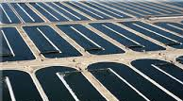
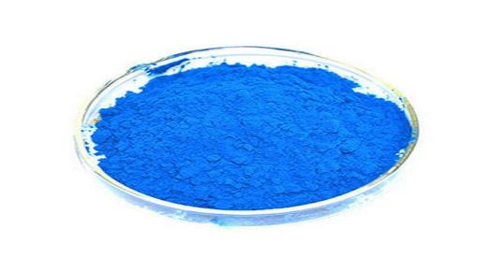
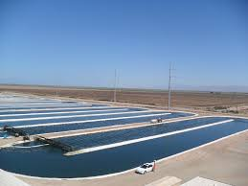
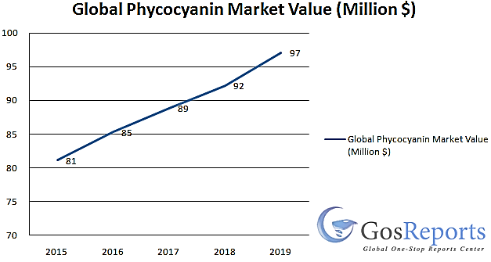
Spirulina dyrkning for phycocyanin
Earthrise in California, USA
LinaBlue in Tokio, Japan

Slide 13
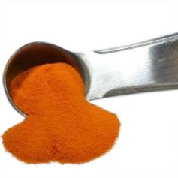
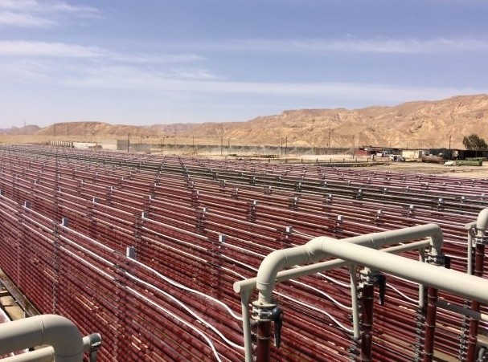
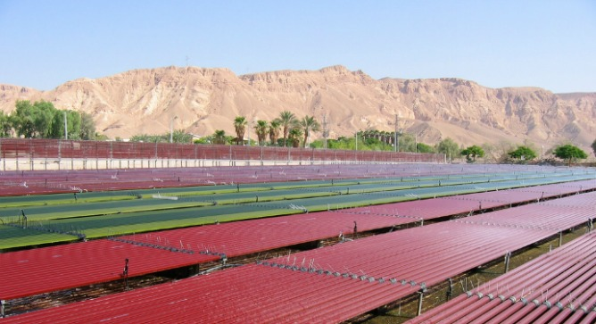
β-carotene og astaxanthin i Israel

Slide 14




Indendørs Chlorella i Danmark
Aliga, Denmark
Biotrino, Denmark

Slide 15

Overblik over produktions processer (mikroalger)
Growth medium + microalgal cells
Protein
Oil
Carbohydrates

Slide 16




Høst og tørring
Pre-concentration
up to 0.5% solids
up to 10x concentration factor
product is a fluid
Thickening
up to 5% solids
up to 10x concentration factor
product is a slurry
<- Dewatering stages ->
Dewatering
up to 15-25% solids
up to 5x concentration factor
product is a wet paste
Drying
up to 90-95% solids
product is a dry biomass

Slide 17

Tang
A loose term
Macroscopic (macroalgae)
Marine algae
Many shapes and sizes
Includes members of the red, brown and green algae
145 species used for food
No roots- can grow on different substrates- e.g. rope
Huge difference in biomasse composition

Slide 18


Composition
Storage: Starch, sucrose
Cell wall: Cellulose, hemicellulose, lignin
Storage: Starch
Cell wall: Mannan, ulvan, cellulose (lignin)
Storage: Floridian starch
Cell wall: Agar, carrageenan, cellulose
Storage: Laminaran
Cell wall: Alginate, cellulose, fucoidan
Figure 1
18

Slide 19







Biomasse høstes ud af vandet
Wild harvest
Cultivation
Polyculture in embayments in Yellow Sea region, China J. FANG
Foto: C. Wirenfeldt
Foto S. L. Holdt
Foto: C. Wirenfeldt
Foto Dansk Tang www.dansktang.dk/frisk-tang-til-restauranter/
Notes:
https://www.dansktang.dk/frisk-tang-til-restauranter/

Slide 20

Værdikæden for tang
SAFETY
Urd G. Bak 2019
Each company needs to work on the whole value chain
And also navigate in a lack of best practice and clear/no legislation

Slide 21



Biomasse…….Høst af naturlige forekomster

Slide 22




Naturlige forekomster

Slide 23



Naturlige forekomster
https://www.arramara.ie/irish-seaweed-resource-management/seaweed-harvesting-methods/

Slide 24



Industriel/storskala høst
https://doi.org/10.1007/s10811-010-9610-y https://cosmeticobs.com/fr/articles/portraits-8/les-algues-en-cosmetique-33-4015 www.tang.nu

Slide 25

Dyrkningsmetoder

Slide 26






Lukkede fotobioreaktorer
Full control of growth conditions
High maintanance
High costs (running and equipment)
AquaCare
Flat Panel Airlift Reactor in Stuttgart, Germany (Subitec)

Slide 27




Åbne tank dyrkninger
Cross section of different kinds of tanks used to cultivate seaweeds. The circulation of the algae is given by air bubbling, or by paddlewheels as depicted in the sketch at the right (Oliveira and Alveal 1990).
Control
Operational costs (cooling/heating, pumps)
Maintanance
AlgaPlus and Algaecenter Denmark

Slide 28






Dyrkning i det åbne hav/beskyttet
Biomass growth: thallus/seaweed
Little control
Less operational costs
Labour intensive- can be
Seaweed production in Indonesia:Kappaphycus alverezii produced to utilize carrageenan. left: Close-up of K. Alverezii tied onto ropes. Right centre: Seaweed on ropes at low tide. Right: The seaweed farmers harvest seaweed from the ropes at low tide.

Slide 29




Biomassevækst: Blad->Sporer->spiring
      Field cultivation or the other methods
      Less man power and inoculum biomass
      Laboratory-nursery
Spores from Palmaria palmata settled on vinylon string (2 mm in diam), (b) spores germinated in 3 weeks in nursery tanks
with added nutrient and aeration and transferred to the field at this stage, (c) harvestable thalli after 4 months of field cultivation
(a-c seeded and cultivated by Maeve Edwards). (d-e) Seeded string with Alaria esculenta coiled around culture rope and
(f) Alaria afer approximately 120 days culture at sea (Arbona and Molla 2006).

Slide 30

Dyrkning i det åbne hav/eksponeret
AT-SEA Finished EU project
2 partners within cultivation
5 partners within fabrics and textiles (e.g. woven materials)
3D materials/mats
Deployed horizontal
Direct seeding incl. polysaccharide ”glue”

Slide 31

Biomasse variation i tang

Slide 32

Protein: variation i indhold målt over 2 år
Factor of 5 recommended by Angell et al., 2016
Ca 4 til 18% protein per tørvægt i variation over de to år
Notes:
Significantly difference between nitrogene content

Slide 33







Høst lokalitet
14/07/2020
04/06/2020
11/06/2020
19/05/2020
06/05/2020

Slide 34


Jod
Geographical differences

Slide 35

Variation i mikroalge biomasse
Content of desired products may be changed manipulating environmental factors such as:
Temperature
Illumination
pH
Salt
Nutrients.
STRESS
Notes:
Sources:
Sieg, David, Algae for Ethanol: Small Business Applications of Algae. Available at: https://making-biodiesel-books.com/algae-ethanol/
Nigam, S., Rai, M.P. and Sharma, R., 2011. Effect of nitrogen on growth and lipid content of Chlorella pyrenoidosa. Am J Biochem Biotechnol, 7(3), pp.124-129.

Slide 36
Fremtidig succes: Hele værdikæden skal hjælpes
Legislation
  license to cultivate
  New species/novel food
Biological knowhow
  Cultivate (lifecycles and control)
  Breeding
  Harvest timing (seasonal variation)
Technology optimization
  Seeding
  Growing substrates
  Harvest
  Downstream processing
Logistics
Consumer awareness

Slide 37
Tang som målet/GOAL
Duarte et al 2022, https://doi.org/10.1038/s41893-021-00773-9

Slide 38
Novel food og lovgivning – hvad skal der til for at få godkendt nye fødevarer?
Lektor Susan Løvstad Holdt og algeteam, DTU Fødevareinstituttet

Slide 39




Regler og standarder
Need to have
  Fødevarelovgivningen
    Inkl…..
    Lovgivning omkring potentielt toksiske elementer
      Koncentration (mg/kg alge) og mængder (dagligt indtag)
    Novel Food
Nice to have
  Standardiseringen i EU
    Styrke virksomheder- konkurrencefordele (EU)
    ISO standarder
    License to trade
Need/nice to have
  Branchekoder
  Varedeklaration

Slide 40
Fra farm til gaffel
Introduction to relevant rules regarding:
Food safety
Hygiene in the primary production
Hygiene in the food processing
Novel food
Chemical contamination
Natural toxic compounds
Labelling and claim
Materials that comes in contact with the foods
Food regulation of EU (EF) 178/2002 of January 28, 2002.

Slide 41
Fra farm til gaffel
Introduction to relevant rules regarding:
Food safety
Hygiene in the primary production
Hygiene in the food processing
Novel food
Chemical contamination
Natural toxic compounds
Labelling and claim
Materials that comes in contact with the foods
Food regulation of EU (EF) 178/2002 of January 28, 2002.

Slide 42


Fødevaresikkerhed
The food cannot be marketed if dangerous (article 14)
The marketing cannot be misleading (article 16)
The food company has the responsibility to comply with the relevant regulations of food and do own-check (article 17).
Furthermore, should the food company ensure traceability (article 18), and ensure withdrawal of possible dangerous foods (article 19).
This is all described in Food regulation of EU (EF) 178/2002 of January 28, 2002.
https://www.youtube.com/watch?v=KTAg936uoic

Slide 43
Lovgivning for PTE
Food legislation | Limit (mg kg⁻¹ DM, ppm)
Toxic elements | France | EU | USA
Inorganic arsenic (As) | <3.0 | No regulation | <3.0
Lead (Pb) | <5.0 | <3.0 | <10.0
Cadmium (Cd) | <0.5 | <3.0 | No regulation
Mercury (Hg) | <0.1 | <0.1 | No regulation
Iodine (I) | <2000 | No regulation | <5000
Table 1. Table 1. Quality criteria applied to edible seaweed sold in France, regulations in the USA and for dietary supplements in EU( AFSSA. Opinion of the French Food Safety Agency on the recommended maximum inorganic arsenic content of laminaria and consumption of these seaweeds in light of their high iodine content. AFSSA Request no. 2007-SA-0007. 2009.)
PTE- potentially toxic elements
EU
Food supplement
Threshold values being developed
  …. For many years now

Slide 44
Lovgivning for PTE
Food legislation | Limit (mg kg⁻¹ DM, ppm)
Toxic elements | France | EU | USA
Inorganic arsenic (As) | <3.0 | No regulation | <3.0
Lead (Pb) | <5.0 | <3.0 | <10.0
Cadmium (Cd) | <0.5 | <3.0 | No regulation
Mercury (Hg) | <0.1 | <0.1 | No regulation
Iodine (I) | <2000 | No regulation | <5000
Table 1. Table 1. Quality criteria applied to edible seaweed sold in France, regulations in the USA and for dietary supplements in EU( AFSSA. Opinion of the French Food Safety Agency on the recommended maximum inorganic arsenic content of laminaria and consumption of these seaweeds in light of their high iodine content. AFSSA Request no. 2007-SA-0007. 2009.)
French recommendation
Seaweed as a food
Recommendation, but EU national food authorities use it as guideline…. (Because there is nothing better)

Slide 45
Jod
Geographical differences
Blanching reduced concentration to <1,000 mg/kg (despite initial conc)
Blanching makes sugarkelp comply with French recommendation
Food legislation | Limit (mg kg⁻¹ DM, ppm)
Toxic elements | France | EU | USA
Inorganic arsenic (As) | <3.0 | No regulation | <3.0
Lead (Pb) | <5.0 | <3.0 | <10.0
Cadmium (Cd) | <0.5 | <3.0 | No regulation
Mercury (Hg) | <0.1 | <0.1 | No regulation
Iodine (I) | <2000 | No regulation | <5000

Slide 46

Protein- hvilken metode som standard?
Factor of 5 recommended by Angell et al., 2016
SPN-factor=2.17±0.52 SPN-factor=2.84±1.06
SPN-factor = 2.5±0.87
Low=1.2 and high=4.4
N (Dumas) varies during seaeson
Protein concentration of approx. 1-12% on average (sum of total amino acids)
Our N-protien factor is 2.5 in average (lowest 1.2 and highest 4.4)
Conventional N-protien factor is 5
Notes:
Significantly difference between nitrogene content

Slide 47

Novel food- er det tilladt at sælge alger til konsum?
Food and food ingredients need to have a safety evaluation and approval if they have not been consumed in notable amounts for consumption in EU before May 15 in year 1997.
Novel foods need safety evaluation and authorization in EU before it can be marketed
Database “Novel Food Catalogue”- http://ec.europa.eu/food/safety/novel_food/catalogue/search/public/index.cfm
Many foods on the market is not authorized
Regulation of novel food of EU (EF) is number EU (EF) 258/97
about new foods and new food ingredients, and the list can be
searched by species in the novel food catalogue
(Novel food catalogue, 2016).

Slide 48


Novel food
Legislation
https://ec.europa.eu/food/safety/novel_food/legislation_en

Slide 49

Novel food- hvordan kan vi vide det?
The novel food catalogue
include food that have or have NOT yet been documented as commonly eaten before May 15 1997 in EU, or are authorized as novel food
But list is not complete (up to each stakeholder to find out):
  if recognized as food before the given date, then not on the list(!)
  if national authorizations
http://ec.europa.eu/food/safety/novel_food/catalogue/search/public/index.cfm

Slide 50

Novel food
Non-novel

Slide 51

Novel food- eksempel- accepteret for nylig

Slide 52


Novel food- eksempel
Status in 2017

Slide 53
Novel food- example
Non-novel
Dulse (Palmaria palmata) eating history:
Ole G. Mouritsen & Christine Dawczynski & Lars Duelund & Gerhard Jahreis & Walter Vetter & Markus Schröder On the human consumption of the red seaweed dulse (Palmaria palmata (L.) Weber & Mohr). J Appl Phycol (2013) 25:1777–1791

Slide 54
From a regulatory point of view… challenges
There are two EU regulations that most closely affect production and commercialization of microalgae-based products for food: The Regulation on Food Safety and The Regulation on Novel Food and Novel Food Ingredients
Spirulina
Chlorella
Dunaliella
Haematococcus
Tetraselmis
Microalgae
Spirulina
Chlorella
GRAS category
Food approved in EU as a whole biomass
Seaweed also few species certified as food

Slide 55
Novel food- how do you know?
I started out by saying that it is the Novel Food Catalogue…
BUT also include food that have (non-novel) or have NOT yet been documented as commonly eaten before May 15 1997 in EU
authorized as novel food goes on a list (downloadable document)
… so it’s alright if you are confused…
  (I have tried to approach the persons in charge with this issue, but only got the answer that “article 4” states…. But nothing regarding that they confuse us!)
http://ec.europa.eu/food/safety/novel_food/catalogue/search/public/index.cfm

Slide 56




Novel INGREDIENTS
If compounds are extracted from the “authorized”/non-novel food products, these specific compounds also need to undergo authorization under the Novel Food Regulation
                Lists of authorized novel foods of
                Dec 20, 2017
https://ec.europa.eu/food/safety/novel_food/authorisations/union-list-novel-foods_en

Slide 57


Novel INGREDIENTS
Down in the document it describes the specifications on how it was extracted
And if you change the way you extract you need to apply again for this particular ingredient with the specific process

Slide 58
Authorization for novel ingredients- details
New compounds extracted should be checked if eligible as e.g. food ingredient according to the Commission Implementing Regulation (EU) 2017/2470 and undergo application for acceptance. E.g. the fucoidan extracts from the seaweed Fucus vesiculosus and Undaria pinnitifida (described and with specified in the food category with a maximum intake of 250 mg/day) are already accepted. Example on previous page.
New Novel Food Application (2018) Linked accessed August 31, 2018, http://www.efsa.europa.eu/en/press/news/180216
If the product does not comply with the specifications (e.g. extraction method or solvent used), there is a need for an amendment/expansion of the existing specifications according to the novel food regulation.
However, the demands for documentation will most likely be less compared to a full/new application. The question regarding the data needed for a new product should be directed to EFSA (New Novel Food Application, 2018 ).
Guide for the novel food and food ingredients can be seen at (only in Danish): https://www.foedevarestyrelsen.dk/Leksikon/Sider/Nye-f%C3%B8devarer-og-f%C3%B8devareingredienser.aspx (accessed on Feb 15, 2019)
The Danish Food Authorities will also help with this (Hanne Boeskov Hansen, FVST)

Slide 59

Varedeklarationen
Norge sætter et godt eksempel i deres Norwegian Seaweed Association
Kvalitetskontrol
Tang et ny navn- brand
SEA GREENS FROM NORWAY

Slide 60

Varedeklarationen
Norge sætter et godt eksempel i deres Norwegian Seaweed Association
Kvalitetskontrol
SEA GREENS FROM NORWAY
Registreret, certificeret, HCAAP

Slide 61

Varedeklarationen
Norge sætter et godt eksempel i deres Norwegian Seaweed Association
Kvalitetskontrol
SEA GREENS FROM NORWAY
Registreret, certificeret, HCAAP
Kvalitets indeks

Slide 62


Konklusion
Mikroalger og tang- hele biomassen anvendes
Store muligheder for anvendelse
Kæmpe variation- arter, dyrkningsmetode, sæson, geografisk
Udfordringer omkring opkoncentrering, stabilisering, ekstraktion
Lovgivning halter bagefter
  Fødevarelovgivning- ikke specielt for tang
  Sikkerhed omkring uønskede stoffer- ikke klar grænseværdier
  Novel food er meget langsommelig proces
Standardisering, så vi ved hvad vi handler med- på vej i EU
Varedeklaration på vej fra Norge
Kræver samarbejde og vilje for fremtidig succes
suho@food.dtu.dk

Slide 63



Tag et screen shot og se senere
Mikroalge lektion
Tang lektion
Lovgivning lektion
Hold øje med Tangnetværket- nyhedsbreve, info og møder om tang: www.tangnet.dk

