Slide 1
PFAS in Finland – dietary exposure, with focus on occurrence in fish
Johanna Suomi
PFAS webinar
Research professor
Risk Assessment Unit, Finnish Food Authority
18.9.2023

Slide 2
PFAS4
Sum of PFOS, PFOA, PFHxS and PFNA
TWI for sum (EFSA 2020): 4.4 ng/kg bw/week
Based on mother’s exposure with which child’s serum PFAS 17.5 ng/ml after 12 mo breastfeeding
This serum conc. = BMDL(10) for decreased immunity / vaccination

Slide 3
Setting the plate: estimated PFAS4 exposure in Northern Europe
Mean LB exposure to sum of PFOS, PFOA, PFHxS & PFNA (ng/kg bw/week).
Source: EFSA 2020
EFSA estimates of mean dietary exposure exceed TWI 4.4 ng/kg bw /week (national consumption + EU occurrence data)
FI serum sample measurements (Institute for Health & Welfare, 2021):
mean 13 ng/ml for 1-year-olds,
8.9 ng/ml for adult women
(TWI ~ 17.5 ng/ml)
Country | Children | Adults
Denmark | 12.0 | 6.4
Estonia | 13.2 | 6.7
Finland | 9.9 | 5.6
Sweden | 10.5 | 7.4
https://thl.fi/fi/web/ymparistoterveys/ymparistomyrkyt/pfas-yhdisteet
https://doi.org/10.2903/j.efsa.2020.6223
Notes:
Exposure based on serum levels roughly 1/3 of assessment based on diet

Slide 4
Previous work on PFAS in foodstuffs in Finland (examples)
Prioritization of foodborne contaminants from FI point of view (2021):
  PFAS4 in top 10 / EFSA’s exposure vs. HBGV & seriousness of health effect
  (Finnish Food Authority Research Reports 1/2021)
Laboratory analyses:
  Baltic Sea fish and lake fish, analysed latest in 2016 and 2022-23
  Environmental monitoring: perch & herring / Finnish Environment Institute
Rapid risk assessment of organic eggs in Finland, 2023:
  Source of contamination in feed (more in Riitta Rannikko’s presentation)
  Moderate use (2-3 eggs/week) will not cause excessive exposure; occurrence will decrease rapidly when FFA risk managers’ guidance complied with

Slide 5
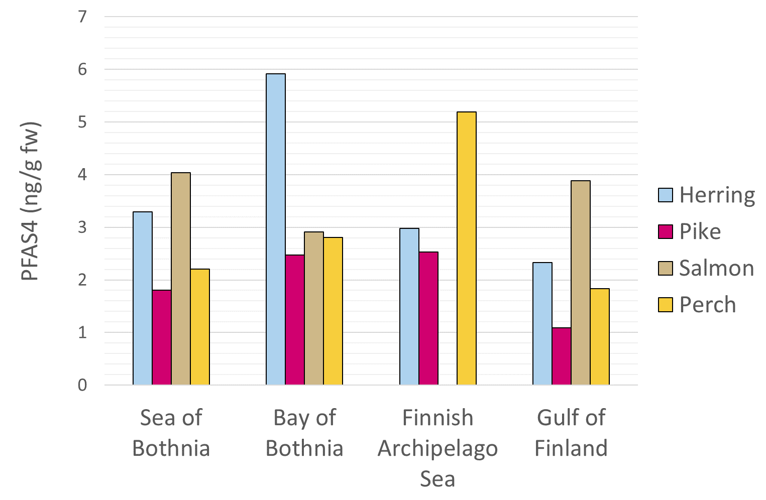
Average PFAS4 concentrations in fish in the Finnish areas of Baltic Sea, 2016
Results from: EU-fish III project
https://urn.fi/URN:ISBN:978-952-287-600-3

Slide 6
PFAS in fish from Baltic Sea and Finnish lakes: current status
Ongoing project EU-Fish IV:
PFAS and other environmental contaminants (dioxins required by EU derogation, Hg, …) – collaboration of 4 research organizations
  State of water environment and fish stocks
  Concentrations in most used fish species (from annual catch) in different parts of Baltic Sea and Finnish lakes/rivers
  Exposure of consumers via consumption of fish:
  2017 consumption data + several future scenarios, including NNR
  Safe use estimates by species, hazard (exposure ≤ TWI with 95% probability)
  PFAS assumption for burden of disease calculation:
  exposure exceeding TWI leads to +10% respiratory infections in children

Slide 7
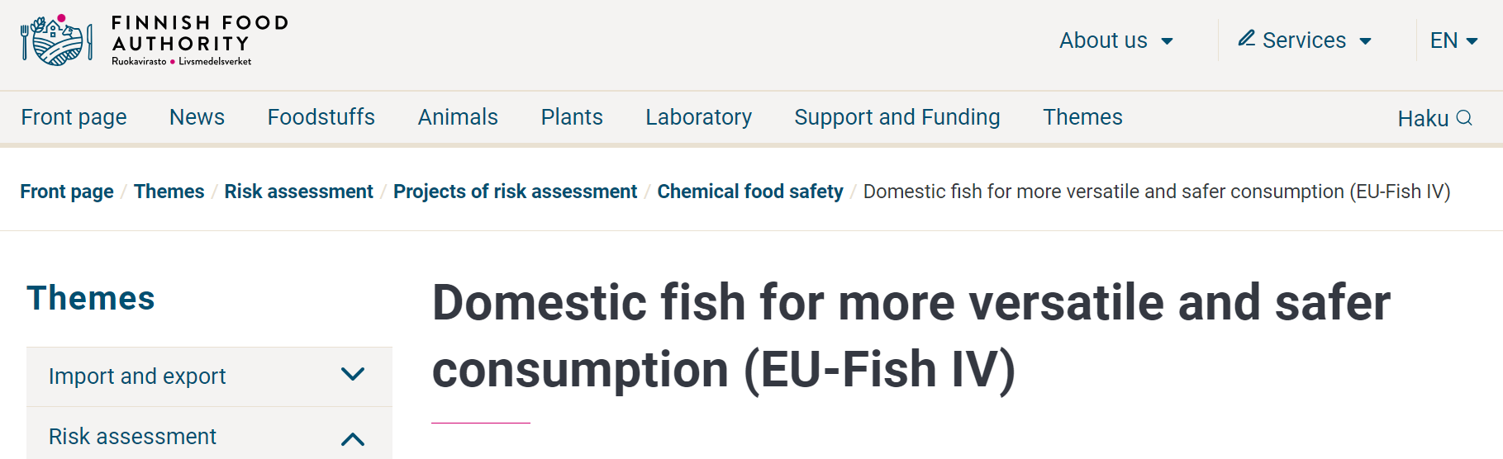
More information on the EU-Fish IV project
Report due 4/2024, scientific publications later – to be linked to website:
https://www.ruokavirasto.fi/EU-kalatIV
change language here (web page available in FI, SE and EN)

Slide 8
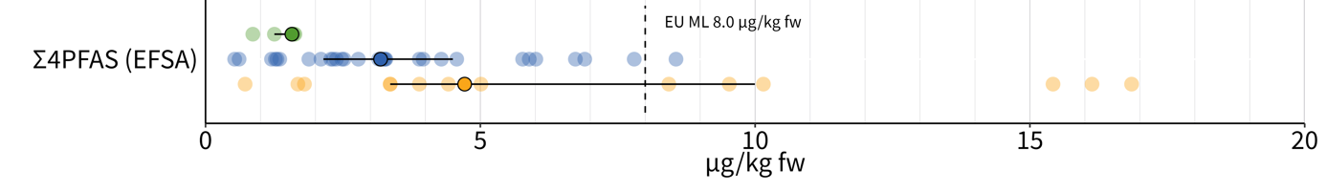
PFAS results of EU-fish IV
Preliminary results: rising trend in some species between 2009 and 2023
In Baltic herring some of the pooled samples exceeded EU ML on PFAS4, most often in fish from the Archipelago Sea and the Bothnian Sea
Sum of 4 PFAS in Baltic herring: 2009-10 (green), 2016-17 (light blue), 2022-23 (yellow)
Source: EU-FISH projects II, III and IV, figure cropped from Häkkinen et al., poster presented in FLUOROS 2023 conference

Slide 9
Thank you for your attention!
More information: johanna.suomi@ruokavirasto.fi
Risk Assessment Unit homepage: https://www.ruokavirasto.fi/en/risk-assessment

